Slide 1

Accessibility Features in Microsoft Office
Making our world more inclusive
SF Tech Week 2024
Scott Mauvais
scott@mauvais.com
www.mauvais.com/talks

Slide 2
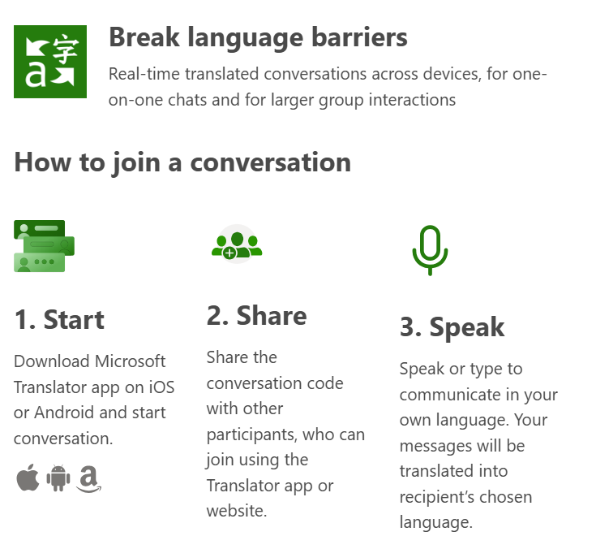
Microsoft Translator
Translate my presentation into you preferred language
Open
https://translate.it/XKYHC
On your PC laptop

Slide 3

In the past, you had to adapt to the world. In the future, the world will adapt to you.
In the past, you
had to adapt to
the world.
In the future, the world will adapt to you.

Slide 4
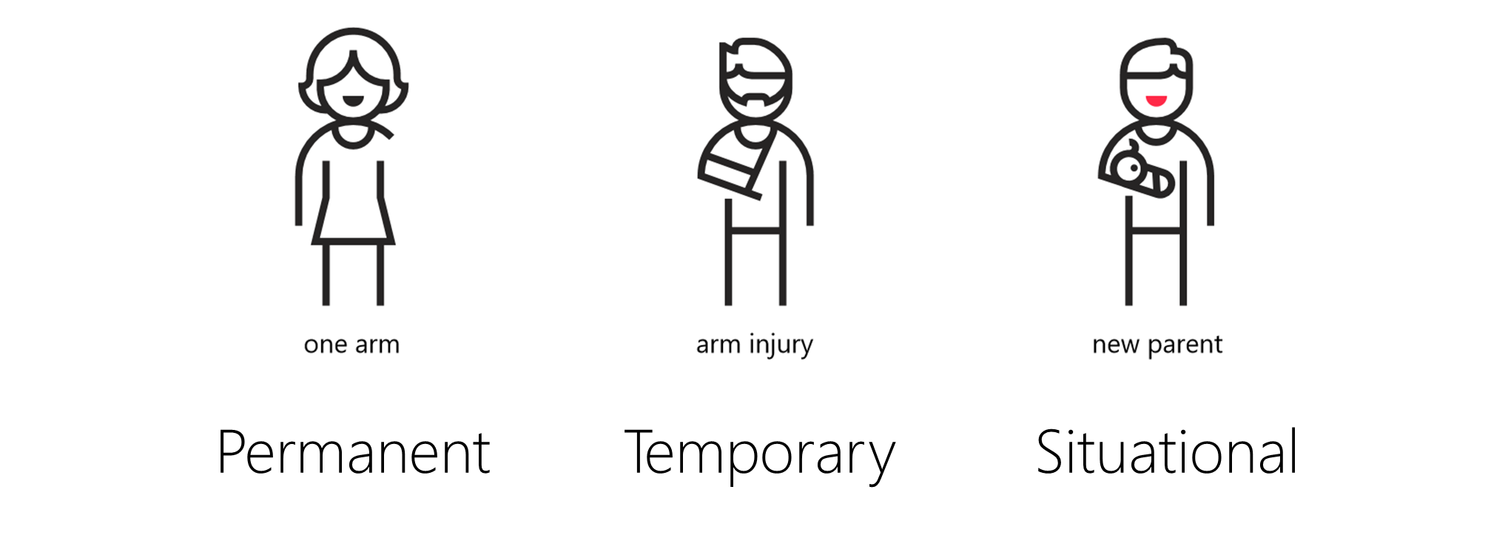
More people benefit
Microsoft Inclusive Design

Slide 5






Accessible technologies, enabled by AI, empower people with disabilities to unlock potential at work, school, and home​
Vision
Hearing
Neurodiversity
Learning
Mobility
Mental Health

Slide 6
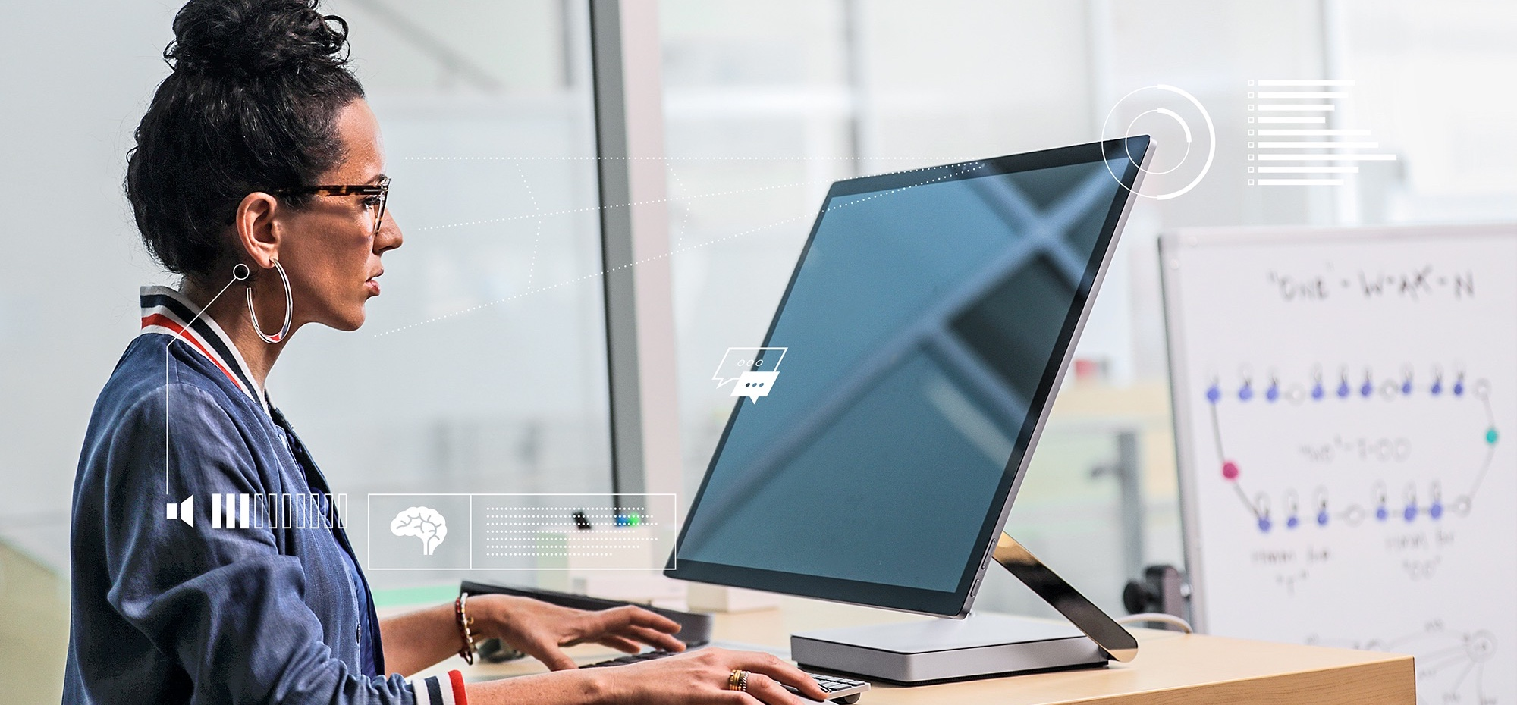
AI amplifies human capability
Image recognition
Speech recognition
Natural language interaction

Slide 7

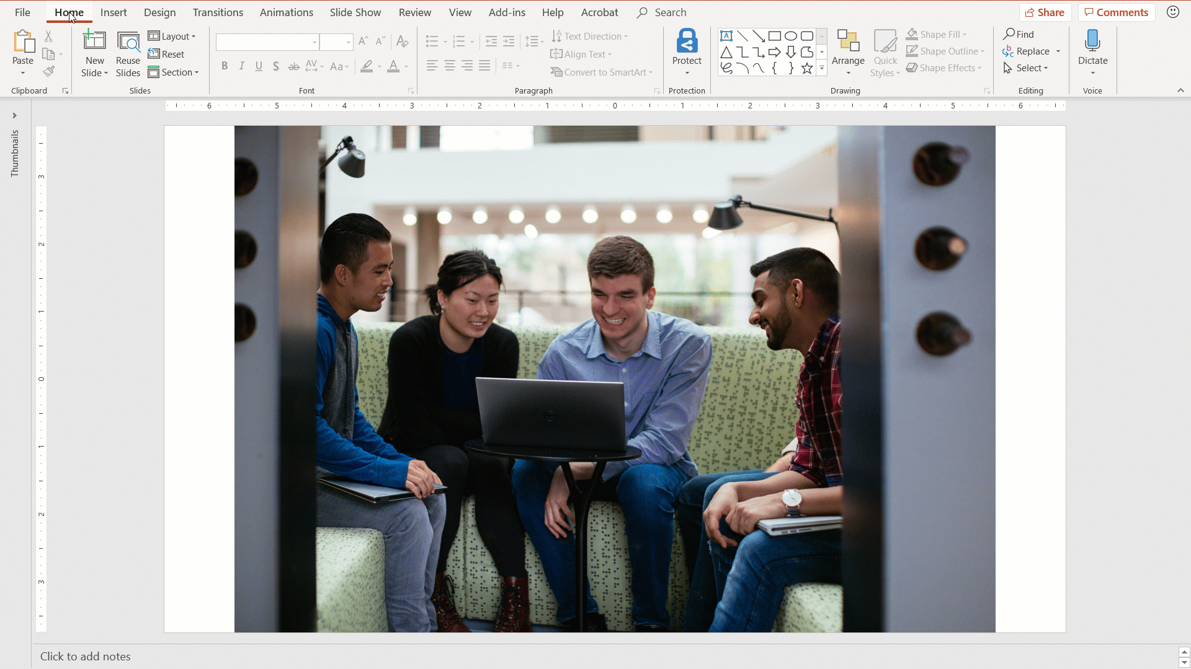
Accessibility Checker
Analyze your material to create more accessible content
Analyze your content
Simply select 'Check Accessibility' under the 'Review' tab to get started
Across all your applications
Now easily discoverable in Word, Excel, PowerPoint, OneNote, Outlook, and Visio
Learn More
aka.ms/AccessibilityChecker

Slide 8
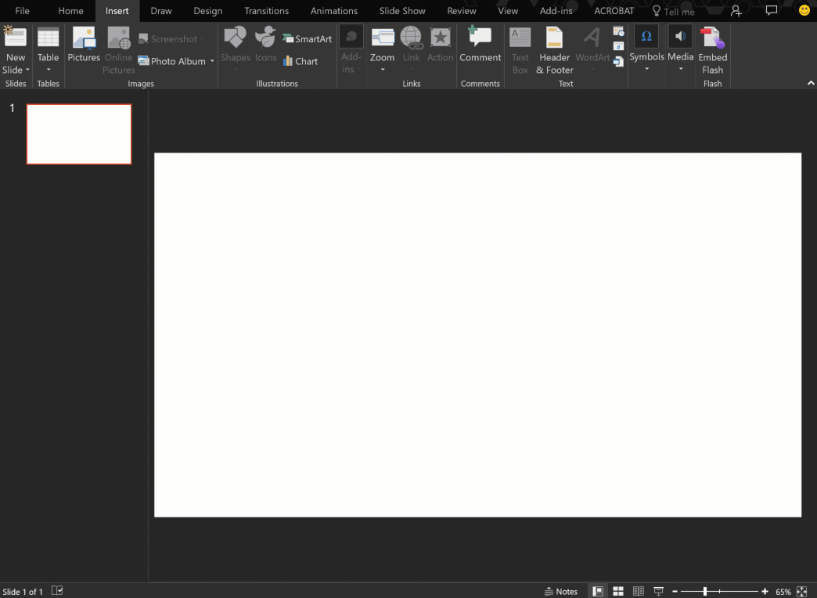
Automatic Alternative Text (Alt Text)
Get suggestions for image descriptions
AI based suggestions
Helps save time and ensures your media-rich PowerPoint presentations are accessible
Provides a confidence rating regarding the accuracy of the image description

Slide 9

PowerPoint Demo
https://bit.ly/sftw-ppt

Slide 10

Word Demo
https://bit.ly/sftw-Word
For more guidance see:
https://daisy.org/info-help/guidance-training/daisy-tools/creating-accessible-word-documents/

Slide 11
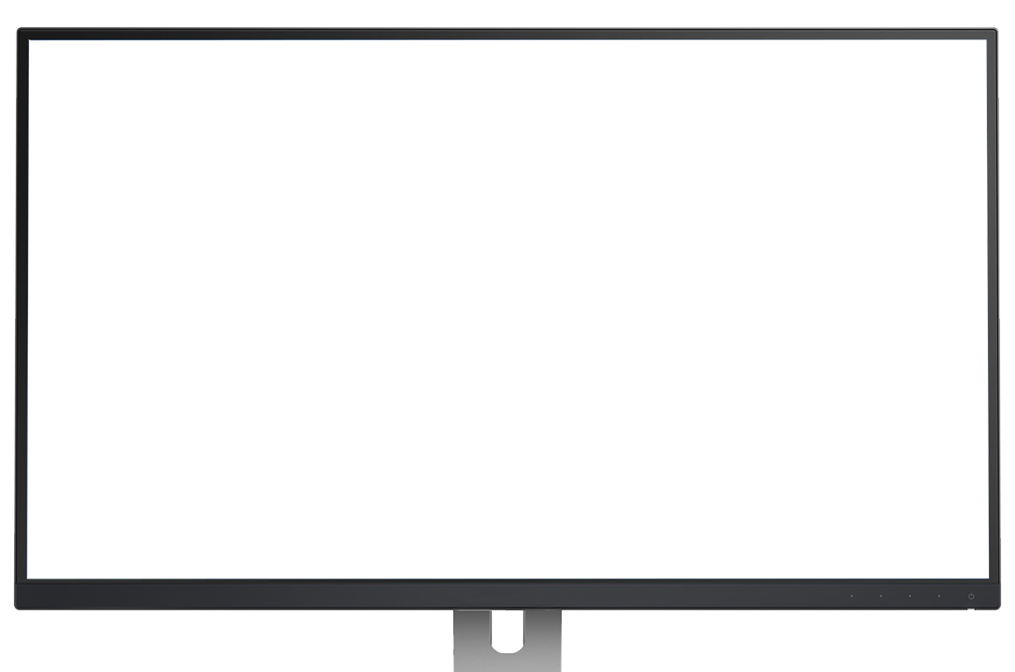
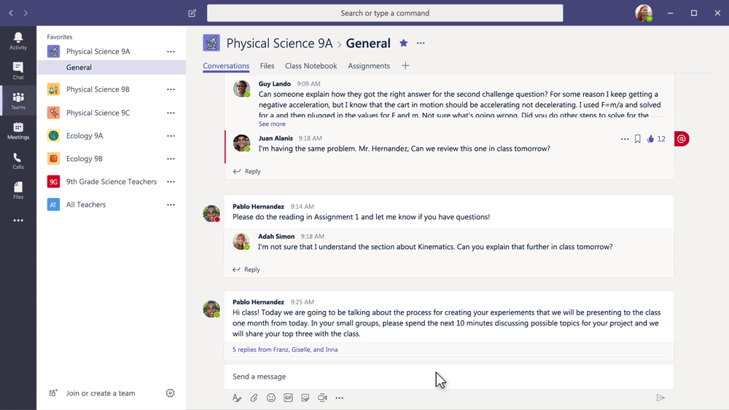
Learning Tools and Editor
Built into Office 365 to improve reading and writing
Improve reading skills
Learning Tools help people improve their reading skills, including gifted learners and students with learning differences by assisting decoding, fluency, and comprehension
Write with more confidence
Editor helps everyone write easy-to-read documents, with more confidence by reducing the energy spent on low-level processing like spelling and grammar

Slide 12
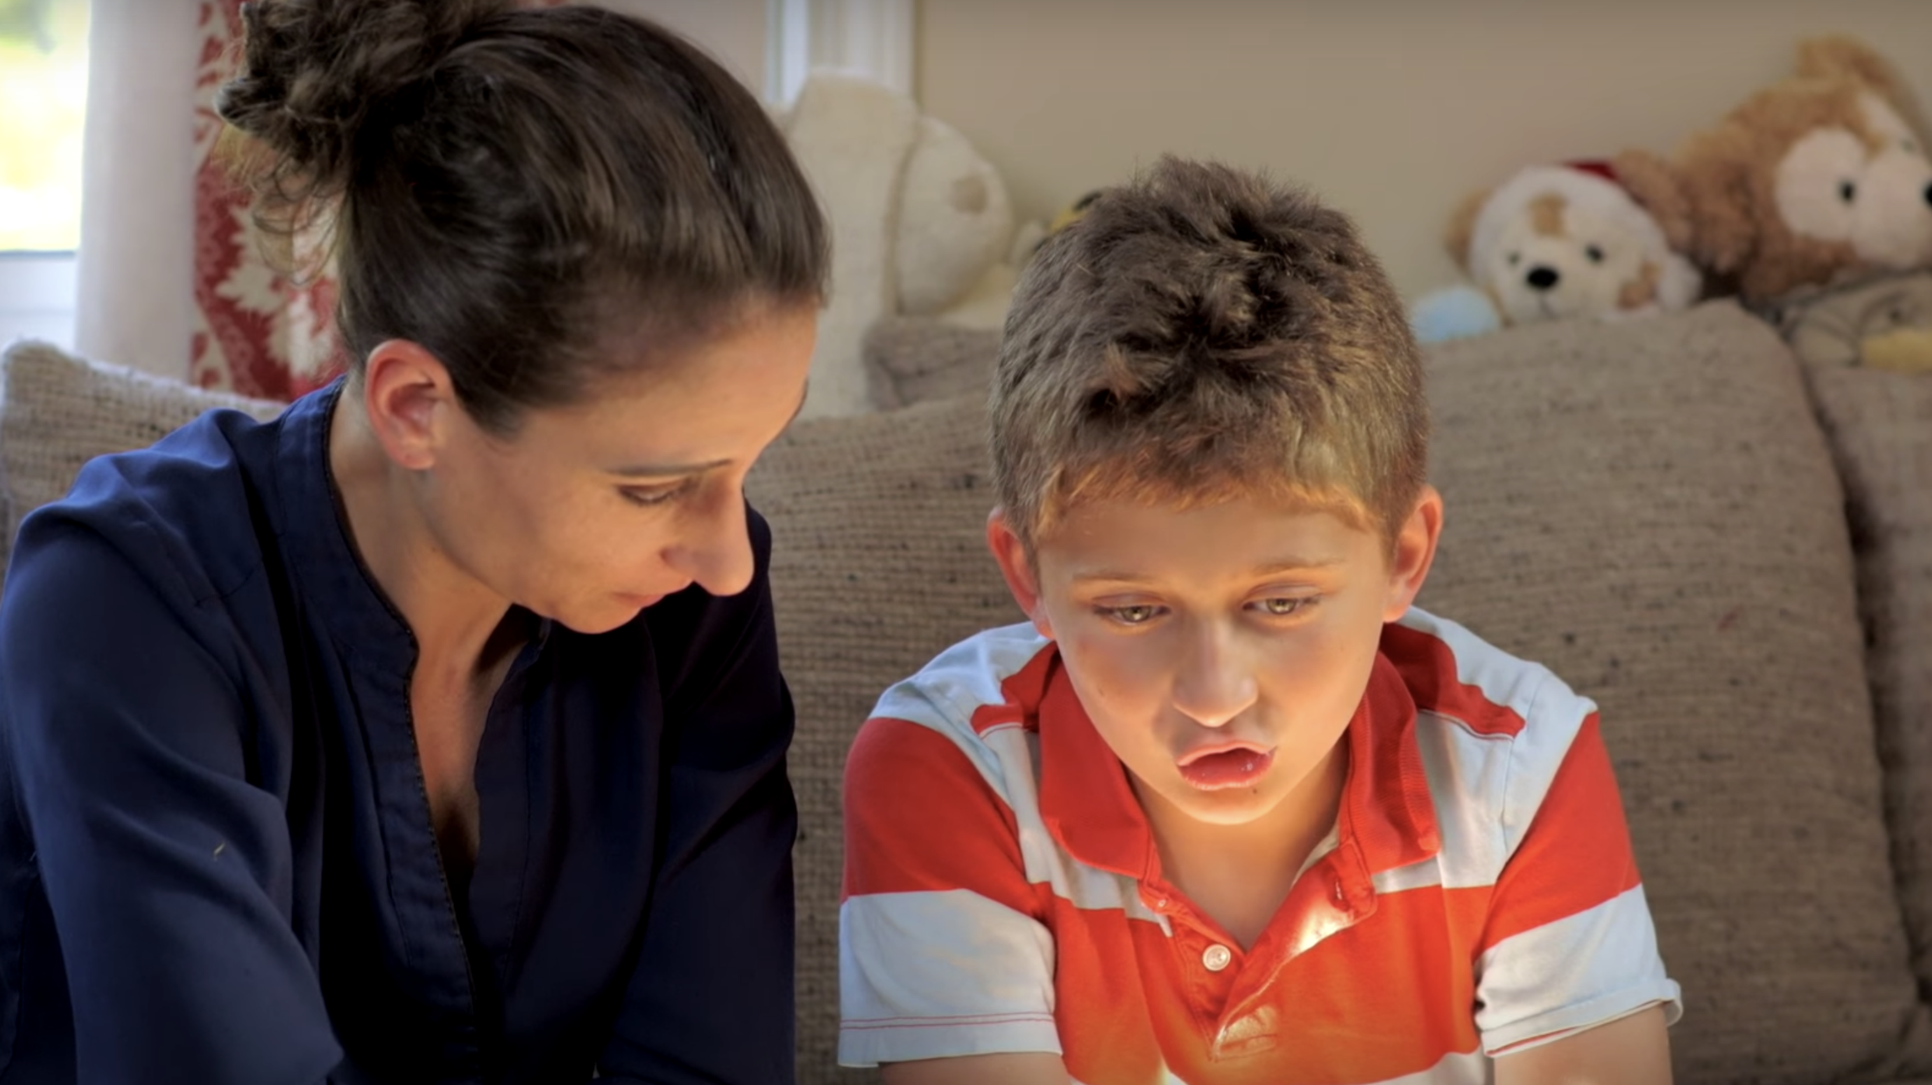
Learning Tools: Click to watch video
Learning Tools:
Click to watch video

Slide 13

OneNote Demo
https://bit.ly/sftw-onenote

Slide 14
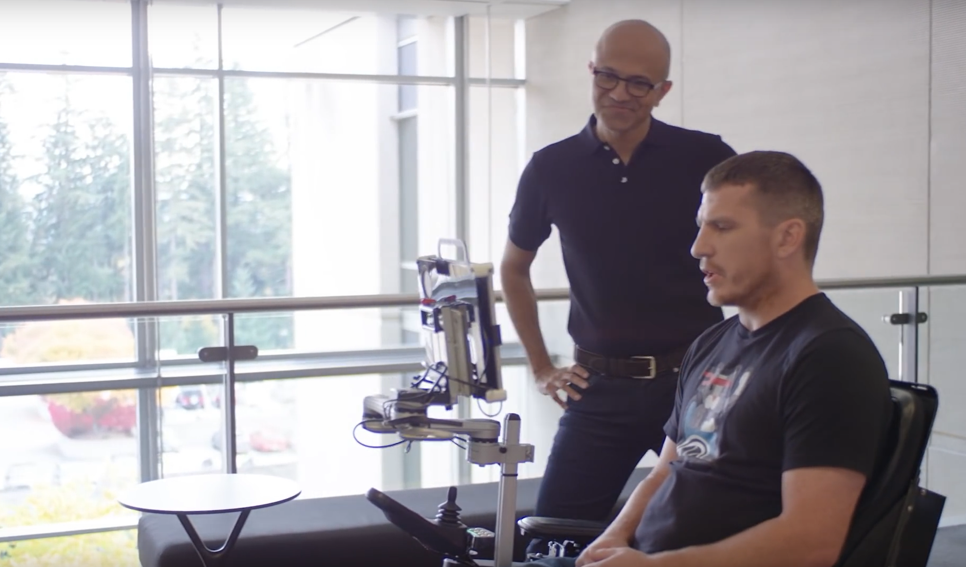
Eye Control: Click to watch video
Eye Control:
Click to watch video

Slide 15
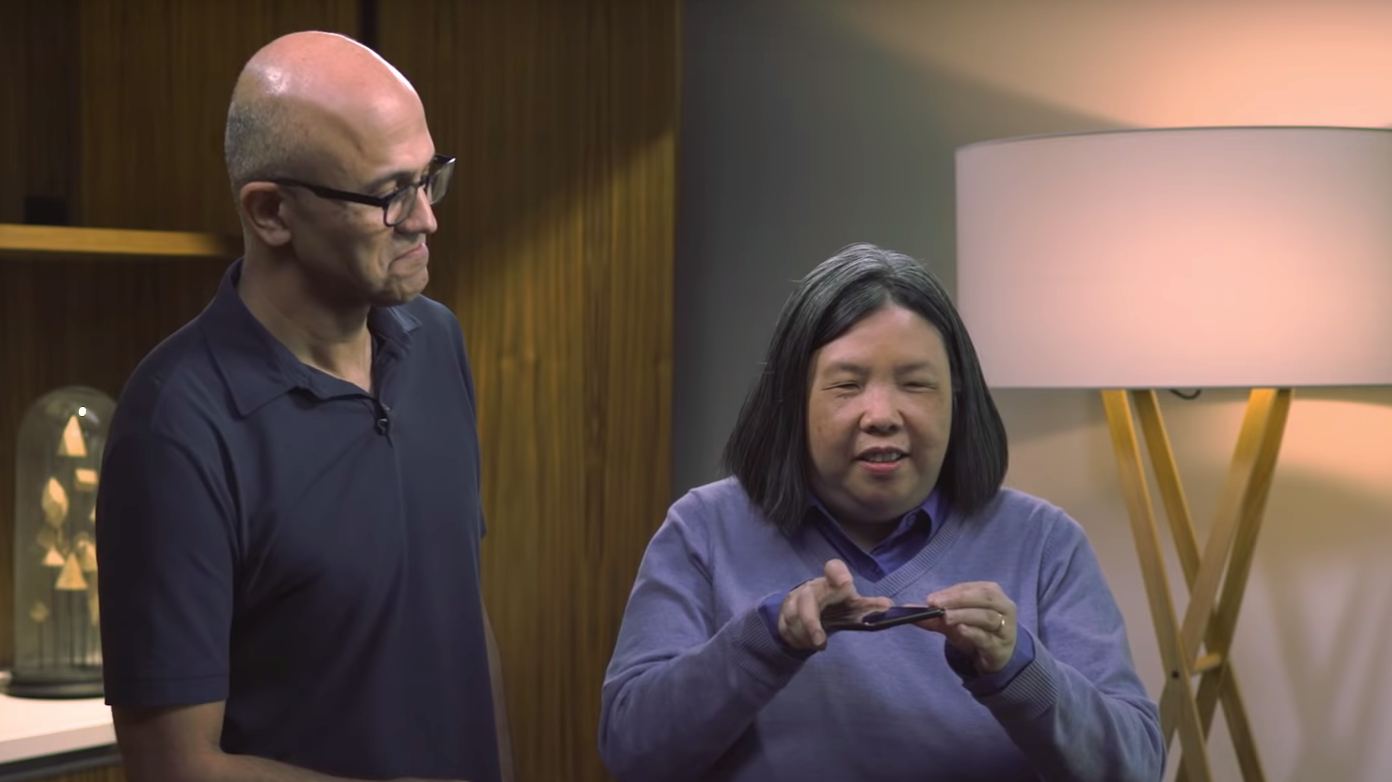
Seeing AI: Click to watch video
Seeing AI:
Click to watch video

