Slide 1
SF Tech Week 2025
AI: The Good, The Bad & The Ugly Scott Mauvais scott@mauvais.com www.mauvais.com/talks

Slide 2
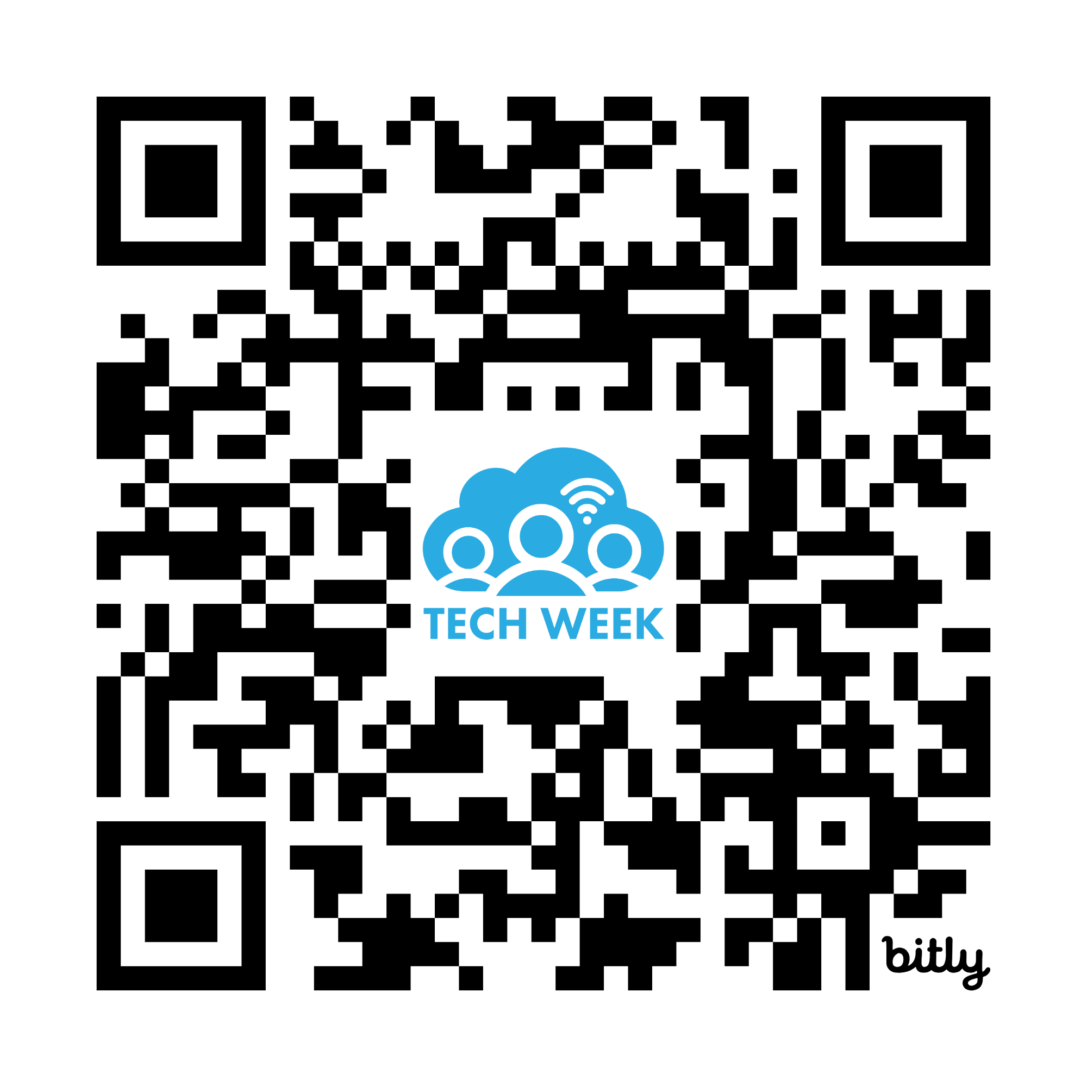
Tech Week Survey
https://on.sfpl.org/TWMay2025Survey

Slide 3
Agenda
The Bad There is inherent bias in the data that underpins AI
The Good AI provides a path for addressing today’s most vexing issues
The Ugly The biggest risks for AI aren’t technical, they are social

Slide 4
The Bad

Slide 5
Training data is biased

Slide 7
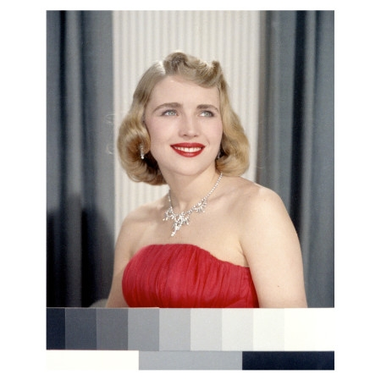
Meet Shirley

Slide 8
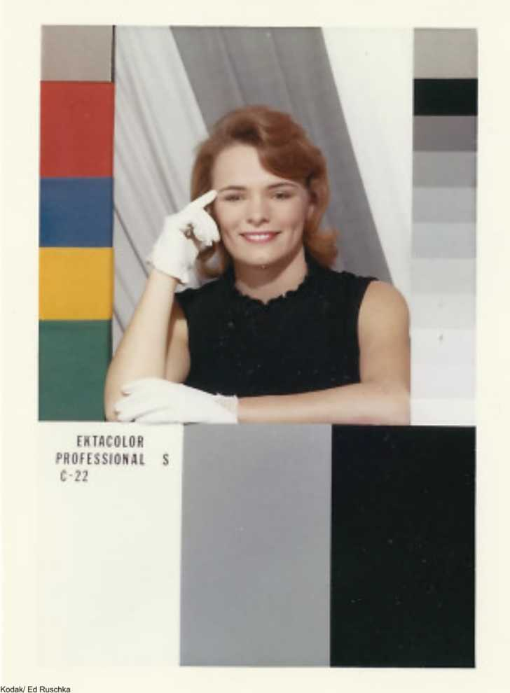
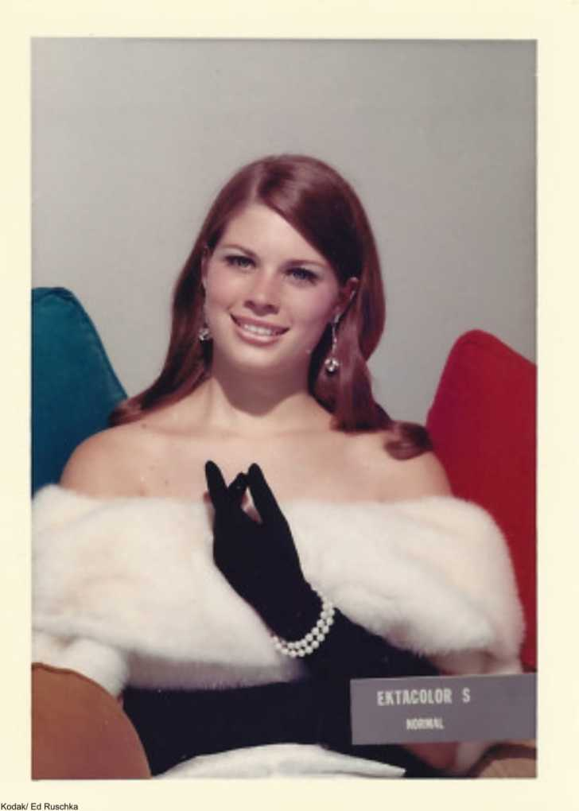
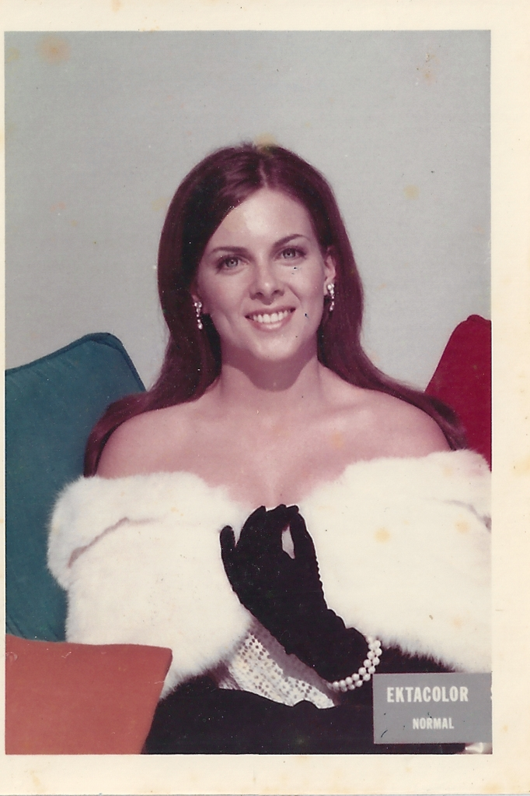
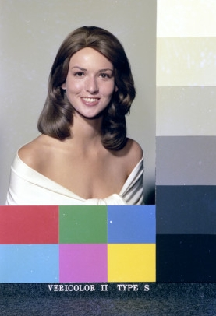
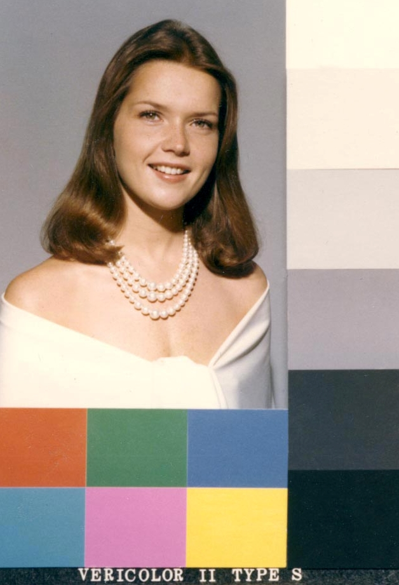

Slide 10
Data voids create bias

Slide 12
Reality is biased

Slide 14
Percentage of Fortune 500 CEOs

Slide 15
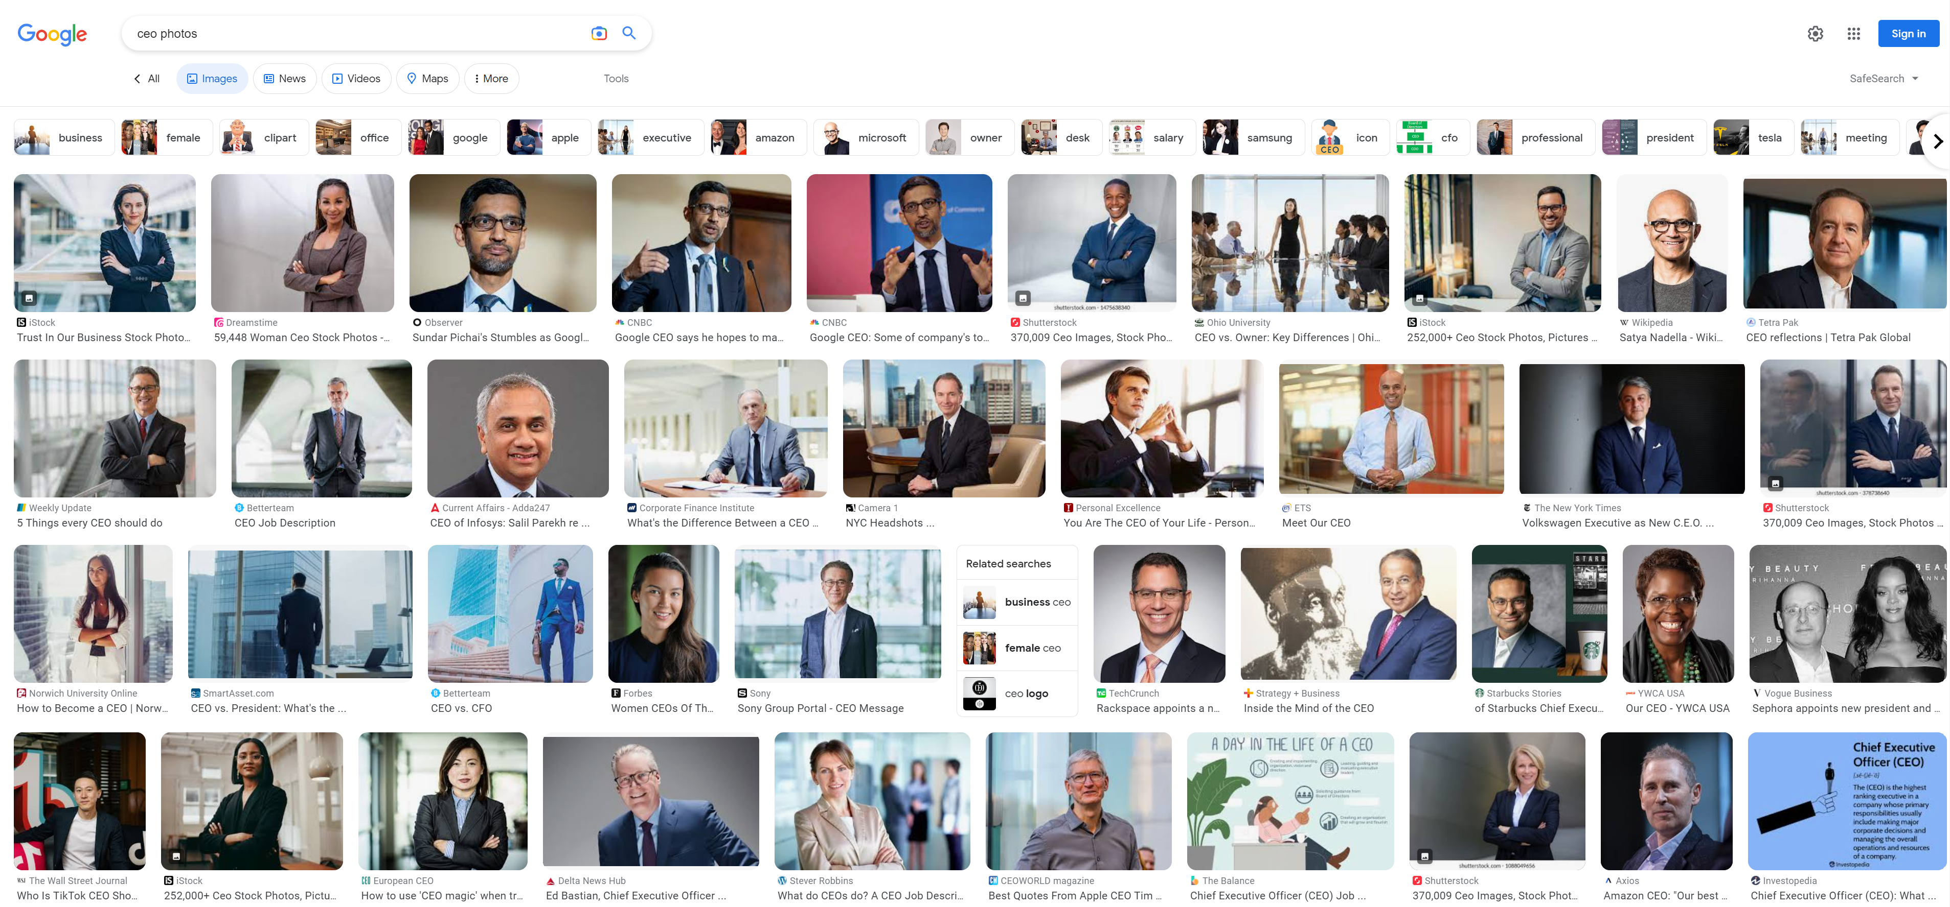
Search Engines Curating Results (2023)

Slide 16
More than just biased data

Slide 17
It is us

Slide 18
We are biased

Slide 19
We are AI’s study-buddy and we are teaching all our misogyny and hatred
—Amy Webb

Slide 21
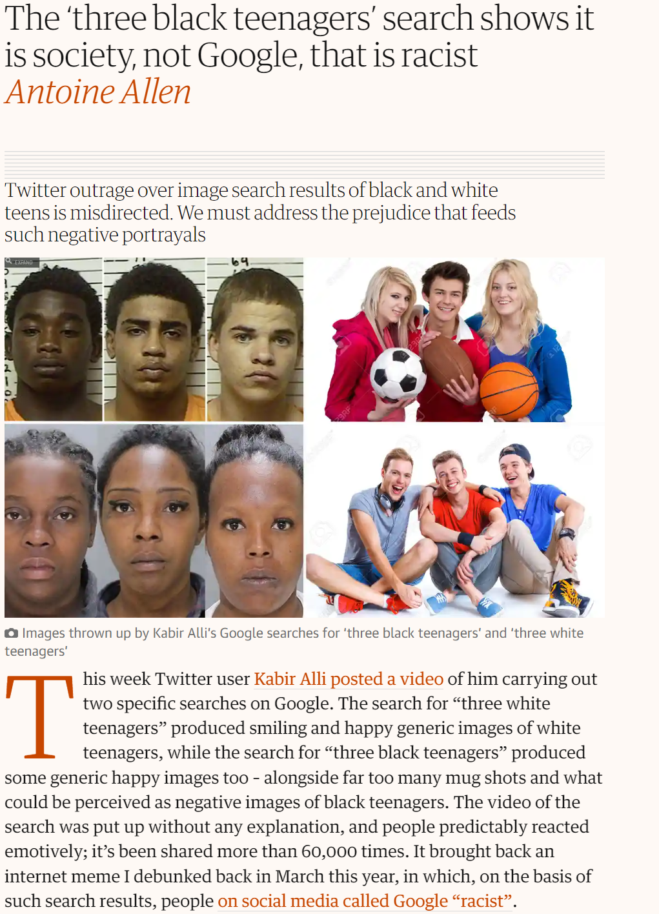

Slide 22
Bias in AI is fixable
(I’m not so sure about human bias)

Slide 25
What does this mean for GenAI

Slide 26
Guidance for Responsible use of Gen AI
Disclose when AI is used, especially in decision-making
Understand GenAI’s limitations and verify responses
Avoid generating content that imitates or infringes on other intellectual property
Do not input sensitive data (if it’s free, you are the product)
Regularly audit for harmful stereotypes or discriminatory outputs

Slide 27
Guidance for Responsible use of Gen AI
Disclose when AI is used, especially in decision-making
Understand GenAI’s limitations and verify responses
Avoid generating content that imitates or infringes on other intellectual property
Do not input sensitive data (if it’s free, you are the product)
Regularly audit for harmful stereotypes or discriminatory outputs
* I asked ChatGPT to create a list which I lightly edited for length clarity.
Prompt: In just bullet points, what are the best practices for using generative AI responsibly

Slide 28
Go to ChatGPT (or the such)
Enter: "Give me a CV for a doctor"
Now compare
Gender
Name
Education
Try
Oncologist
Psychotherapist
Presidential candidate
Presidential candidate (in country)

Slide 29
What does this mean for Embodied AI

Slide 31
Agenda
The Bad There is inherent bias in the data that underpins AI
The Good AI provides a path for addressing extremely difficult problems
The Impact What does this mean for jobs, for art, for society

Slide 32
Illegal Fishing is threatening our oceans
80%
THE OCEAN PRODUCES
OF ALL LIFE ON
EARTH DWELLS
IN THE OCEAN
OVER
HALF
THE OCEAN IS CRUCIAL TO THE CARBON CYCLE, AND REGULATES OUR WEATHER AND CLIMATE
OF THE OXYGEN
WE BREATHE
3
THE OCEAN PROVIDES FOOD SECURITY FOR
BILLION PEOPLE
AND THE LIVELIHOOD OF
12%
OF THE WORLDS POPULATION

Slide 33
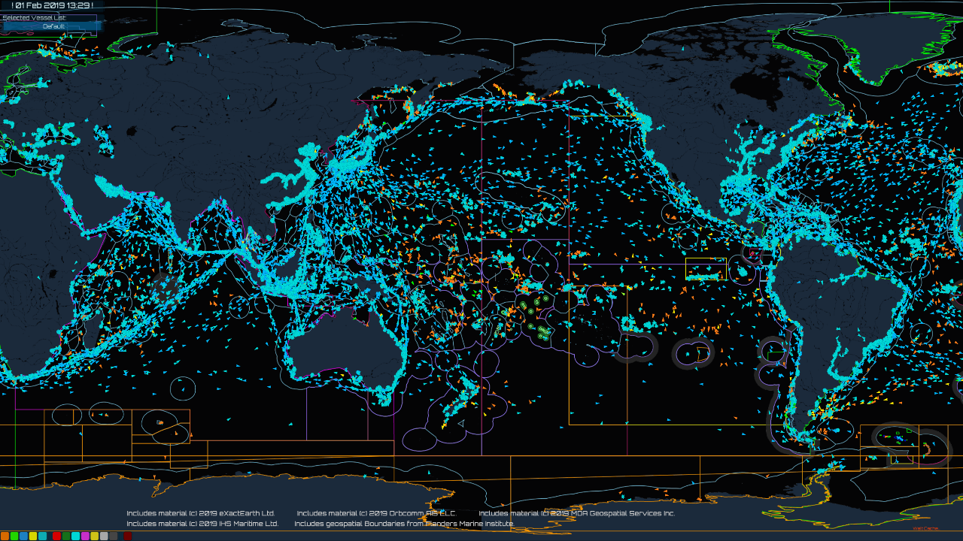

Slide 34
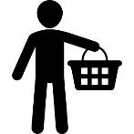
How OceanMind Works
Satellite
Observations
Web
Portal
Vessel Identity
Artificial
Authorities
Vessel Tracking
Intelligence
?
Regulations
Local
Information
Actionable
Insights
Seafood Buyers

Slide 35
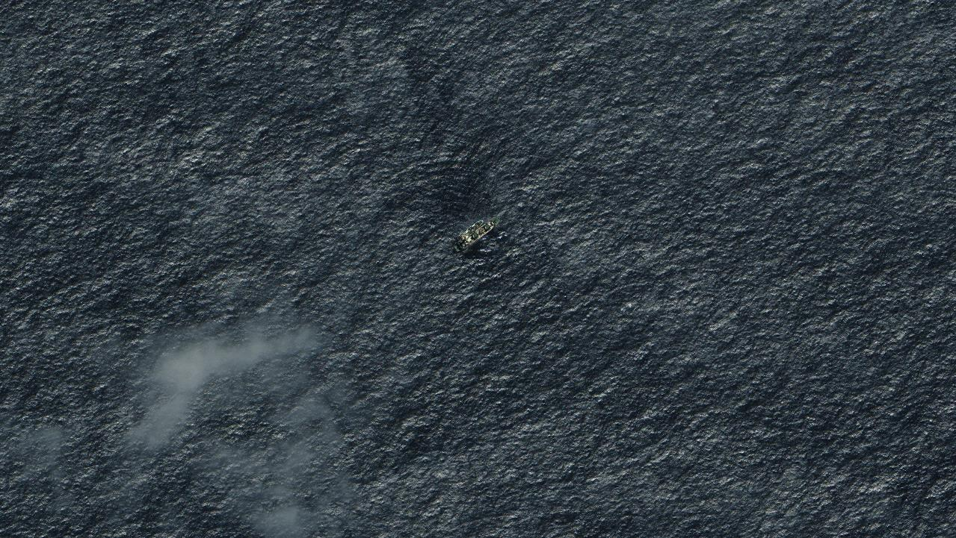
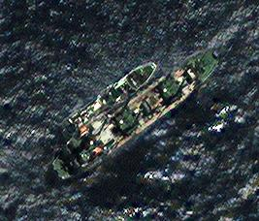
Image: © Digital Globe Inc, All Rights Reserved

Slide 36
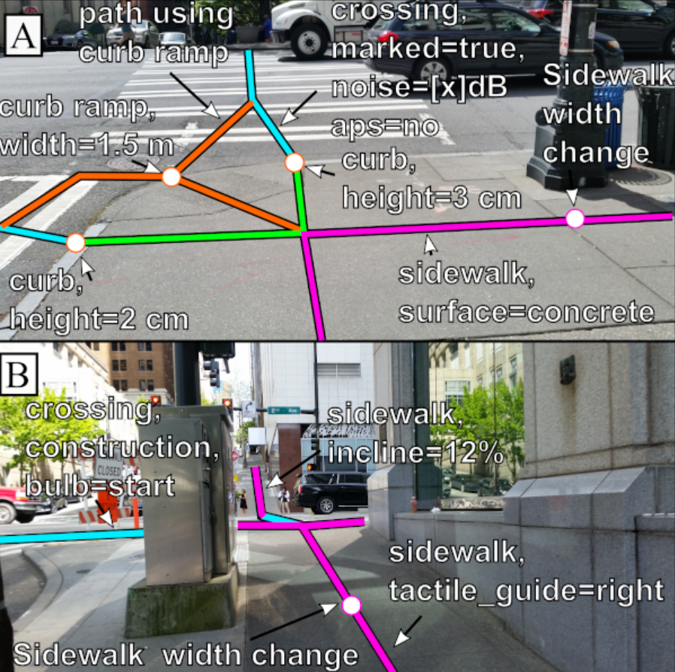

Slide 37
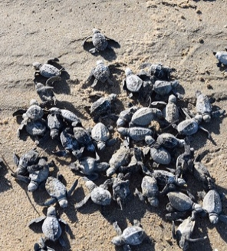
CASE STUDY: Australia, ANZ
Guidance for Field
Instructions Select regionally relevant case studies from appendix to add to the deck. Customize slide content for audience as needed. For latest case studies, visit Win Wire for complete list and description of S500 engagements.
CSIRO
Turtle conservation through AI
Partnered with Indigenous communities, nonprofits and private companies to reverse effects of predators on turtle populations.
AI-based solution is 90% accurate in analyzing tens of thousands of images every month.
The partnership has reduced the loss of turtle hatchlings from 100% to 30%.

Slide 38
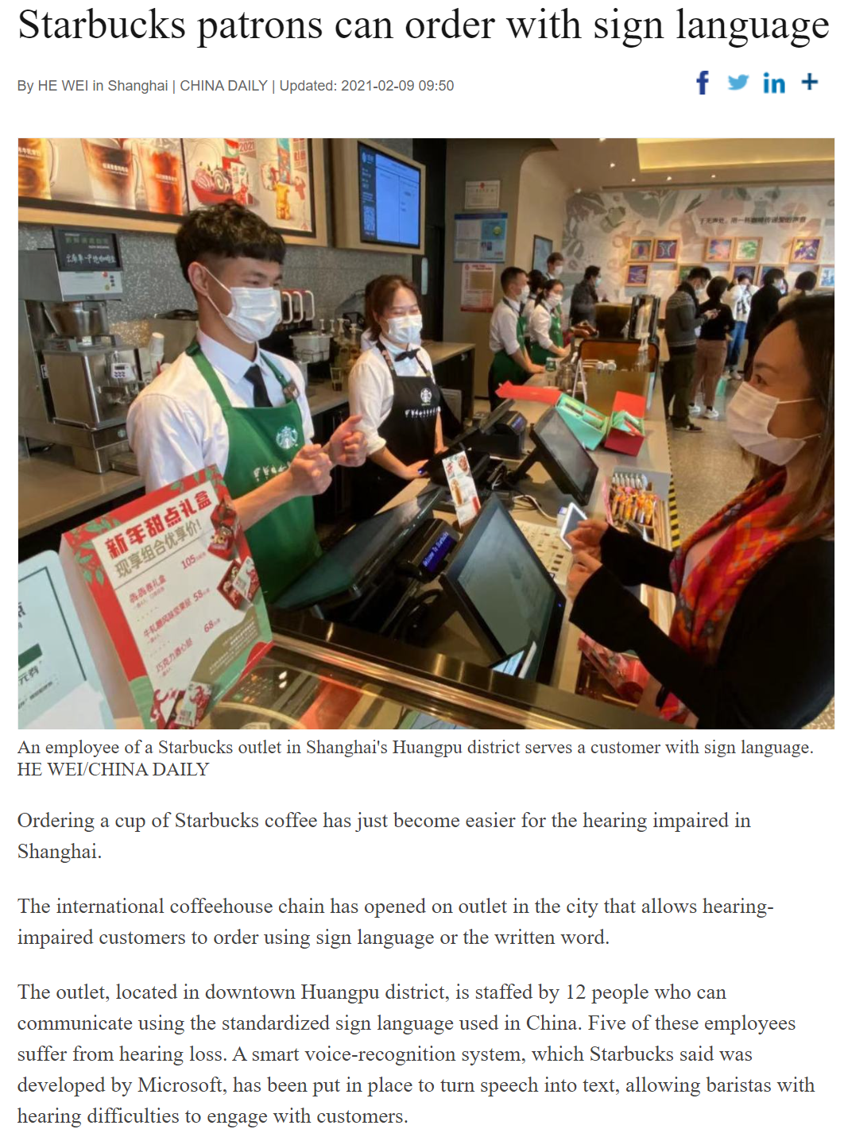

Slide 39
Agenda
The Bad There is inherent bias in the data that underpins AI
The Good AI provides a path for addressing extremely difficult problems
The Impact What does this mean for jobs, for art, for society

Slide 43
Discussion: Which is worse?

Slide 44
AI: The Good, The Bad & The Ugly Scott Mauvais scott@mauvais.com www.mauvais.com/talks

Slide 45
Tech Week Survey
https://on.sfpl.org/TWMay2025Survey

