Slide 1

Ethics in AI/Robotics
Scott Mauvais sm@well.com www.mauvais.com/talks
March 14, 2026

Slide 2
Agenda
Bias in Data
Alignment Problem
Whose Decides

Slide 3
Me

Slide 4

I’ve Always worked in Innovation

Slide 5
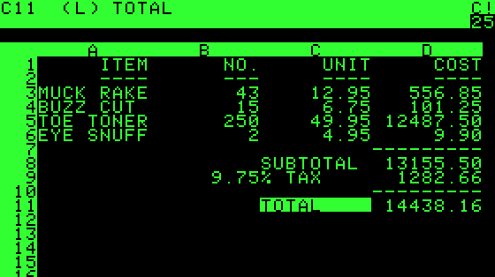
VisiCalc

Slide 6
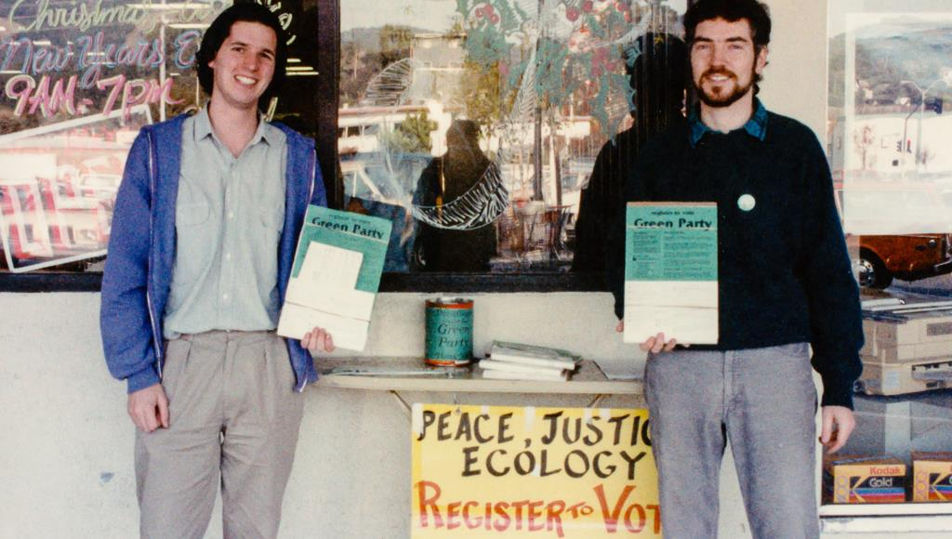
Green Party

Slide 7
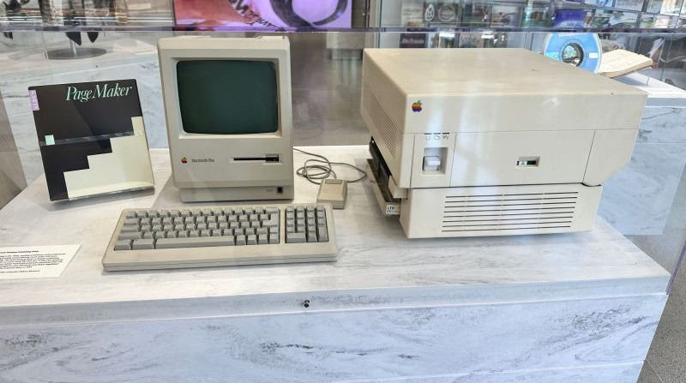
Publishing
https://www.linkedin.com/posts/terryleewhite_it-was-this-combination-that-started-my-career-activity-7079878120161345536-R-1j

Slide 8


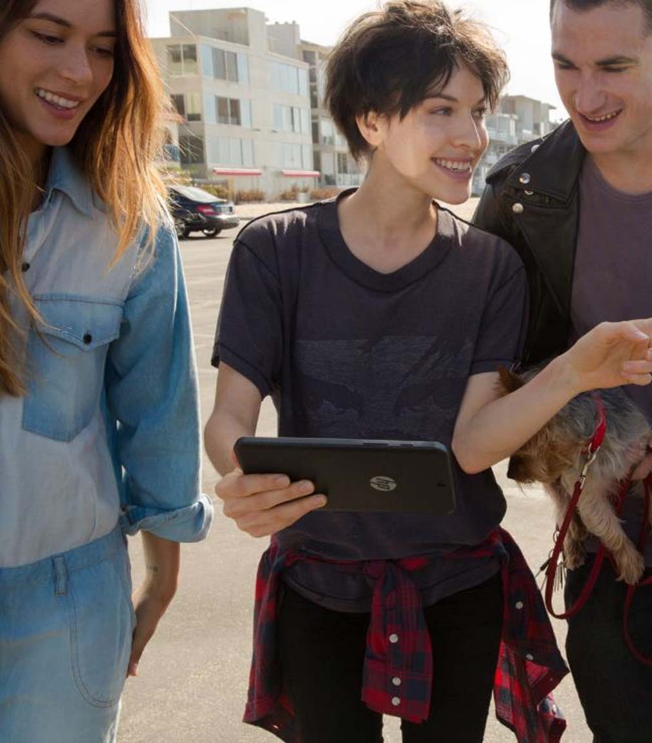
August 11, 1994

Slide 9
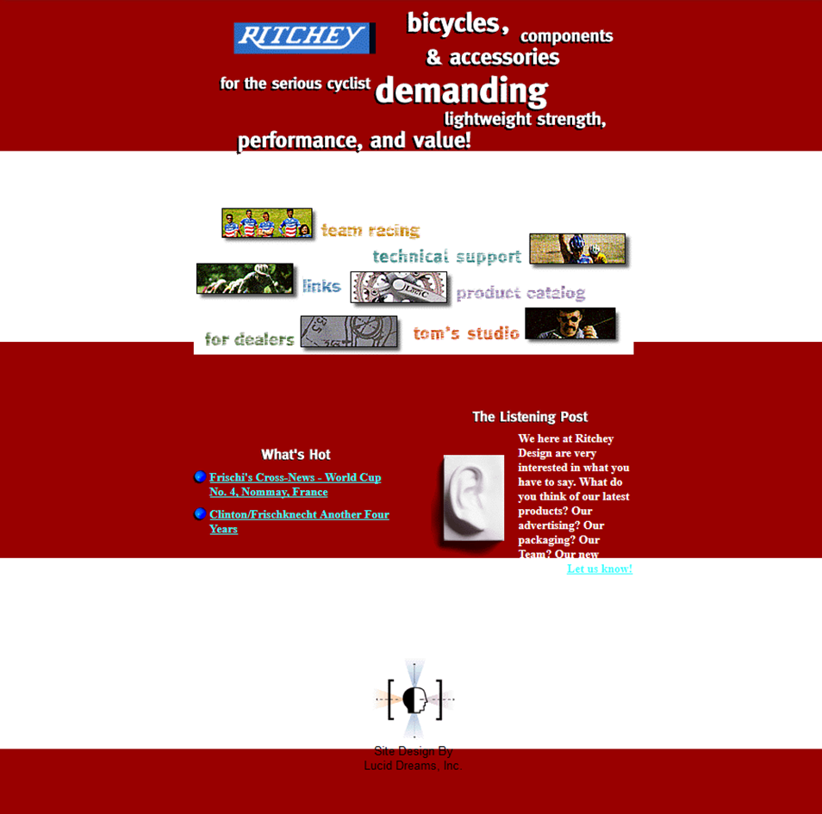
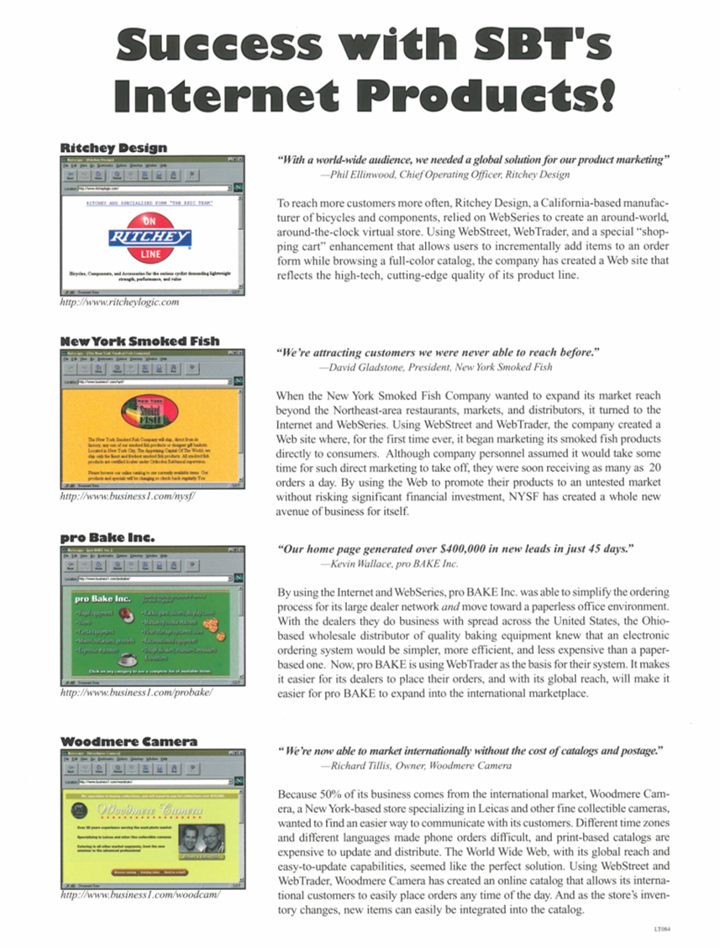

November 14, 1994

Slide 10

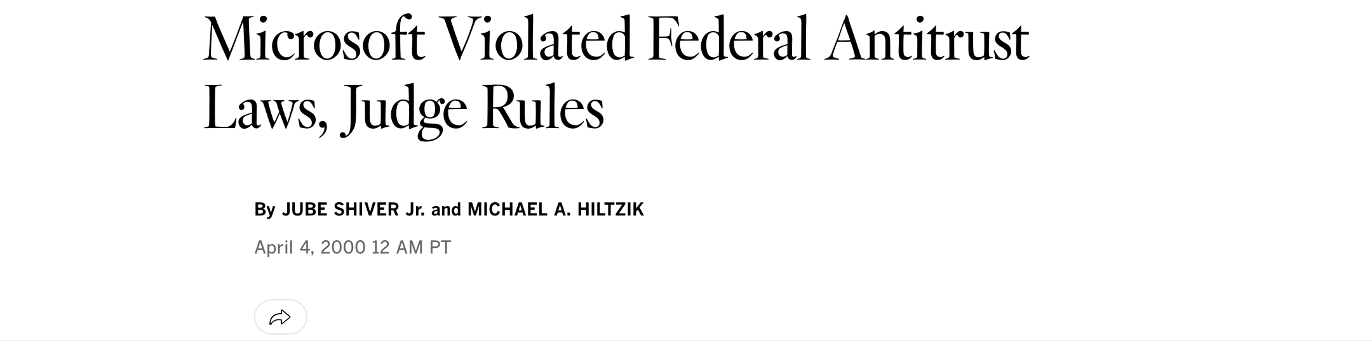
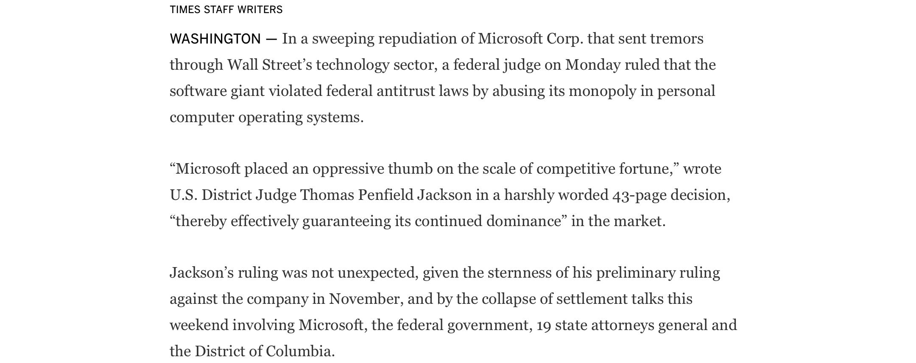
Joined Microsoft
\
https://www.latimes.com/archives/la-xpm-2000-apr-04-mn-15707-story.html

Slide 11

Performance Engineer

Slide 12
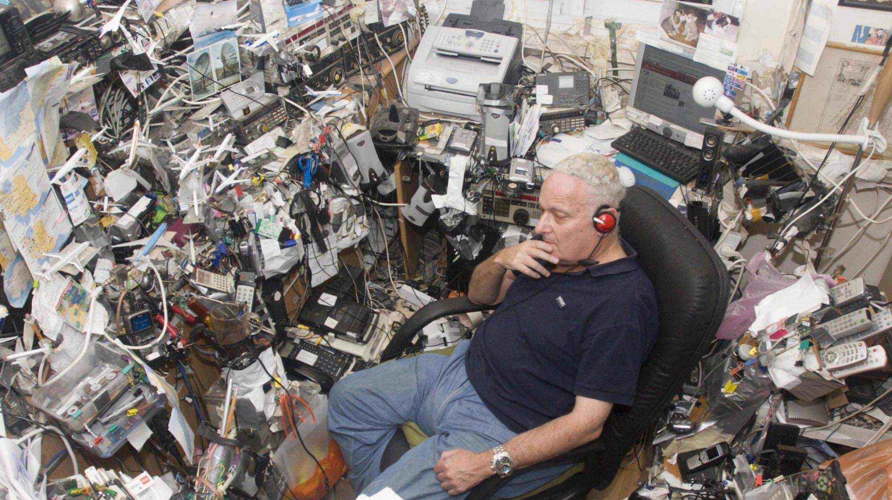
Innovation Lab

Slide 13
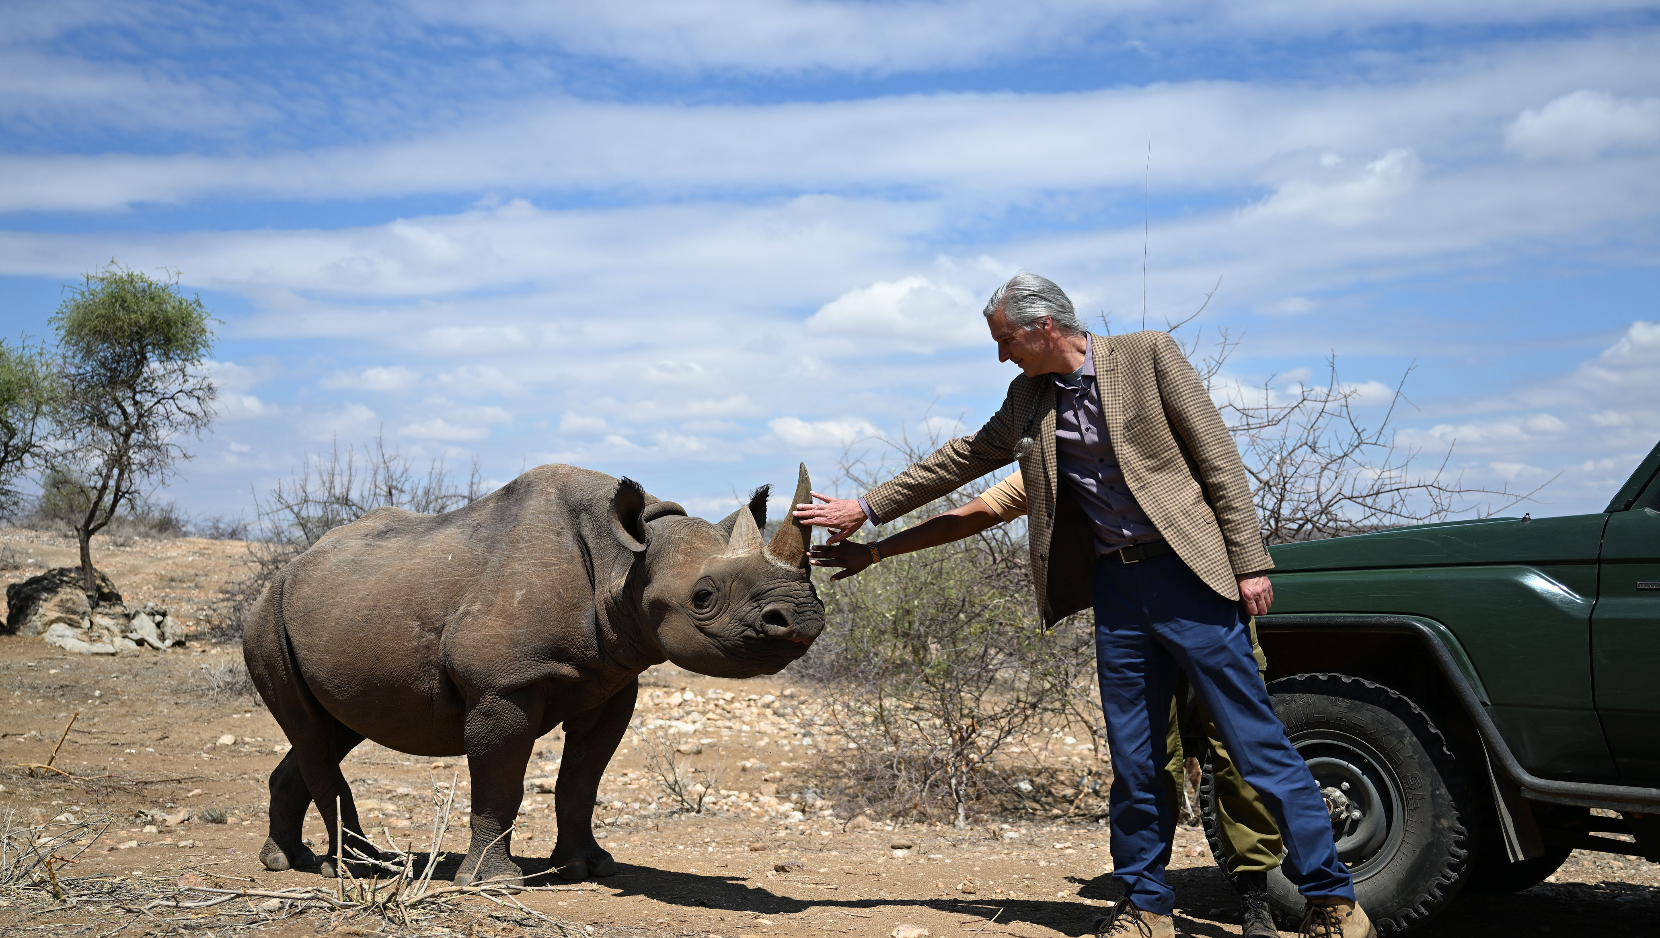
Baby Rhino

Slide 14
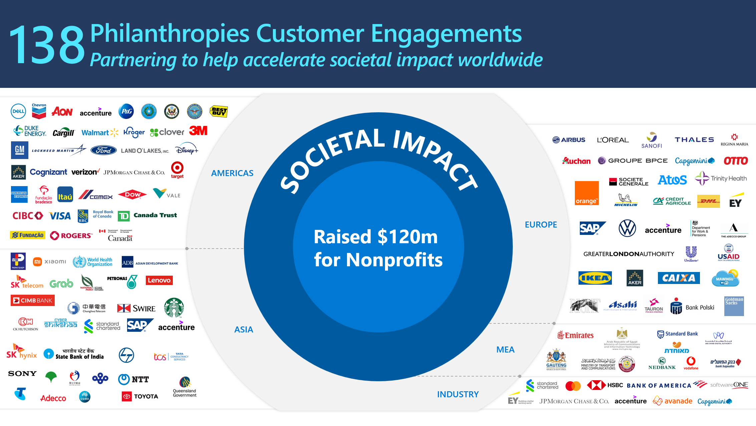
Microsoft Philanthropies

Slide 15
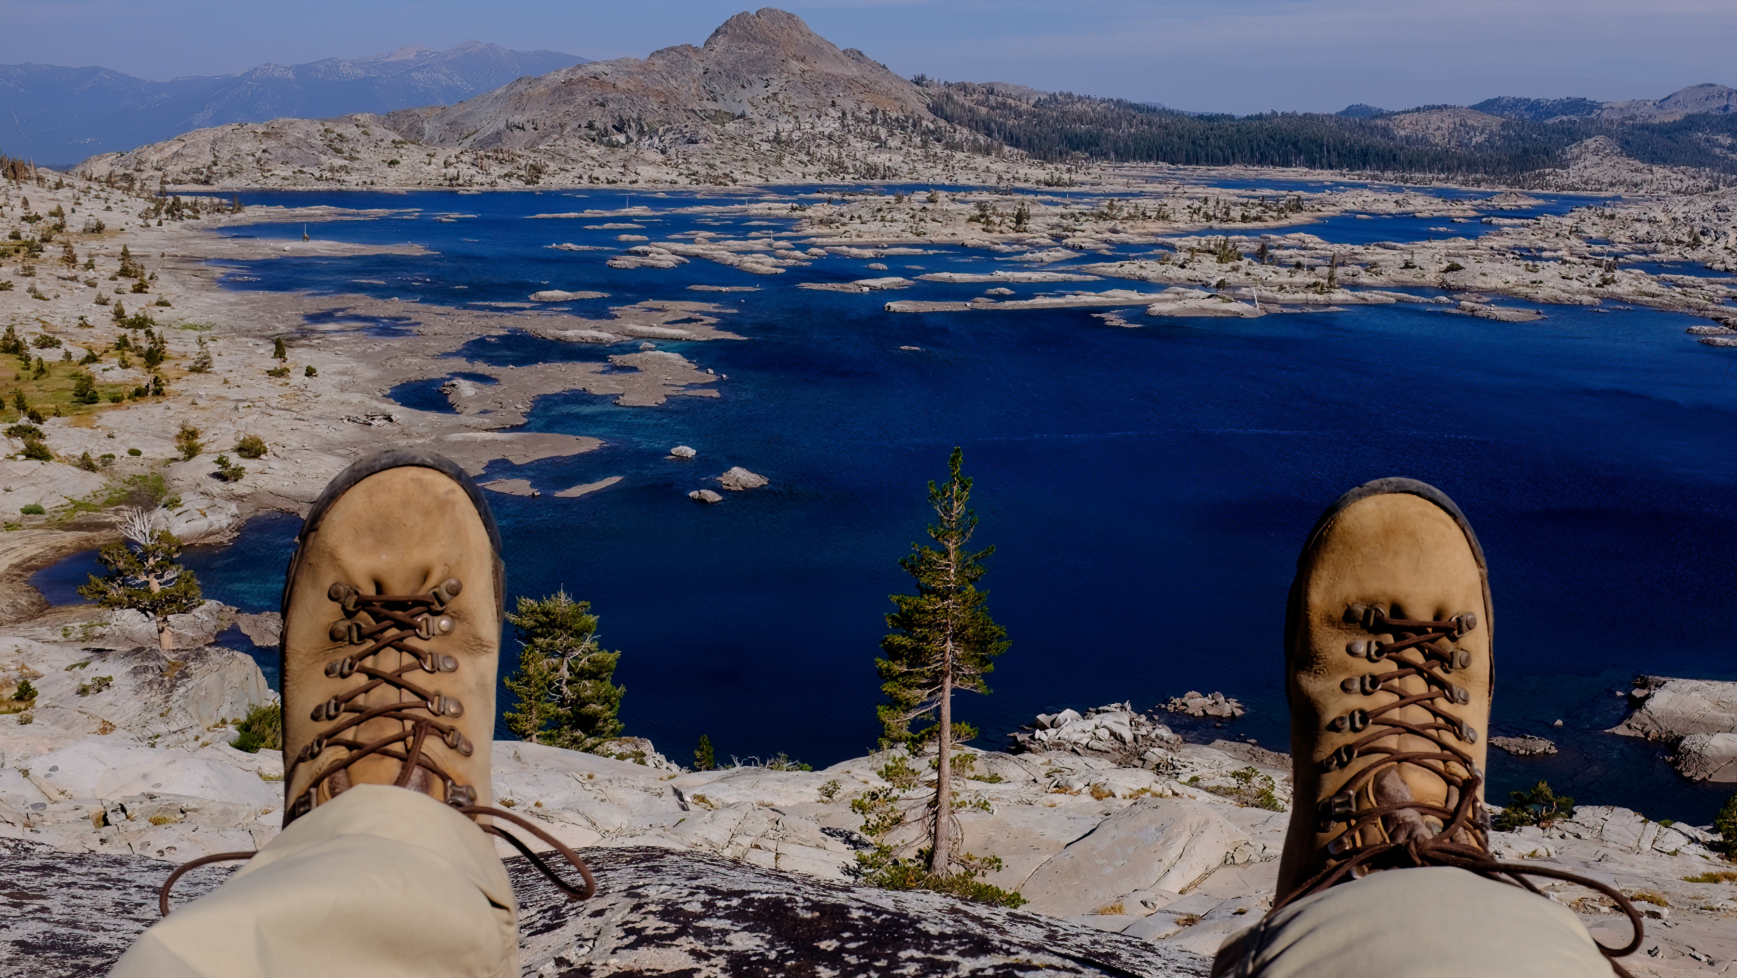
Retirement

Slide 16
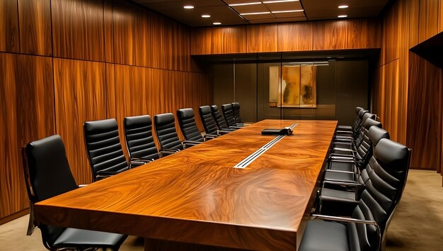
Board Room

Slide 17
Bias in Data

Slide 18
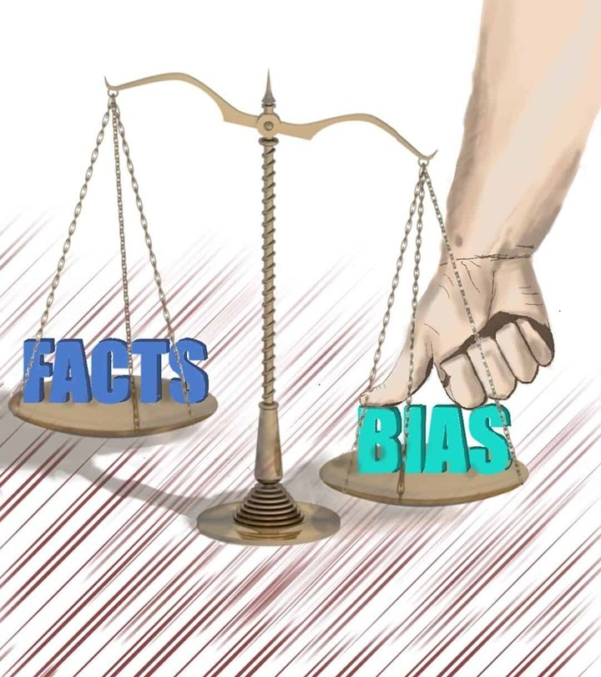
Sources of Bias
Reality is biased
Training data is biased
Data voids create bias
Reinforcement learning creates bias
https://unvarnishedfacts.com/wp-content/uploads/2022/03/Bias-1080x1350.jpg

Slide 19
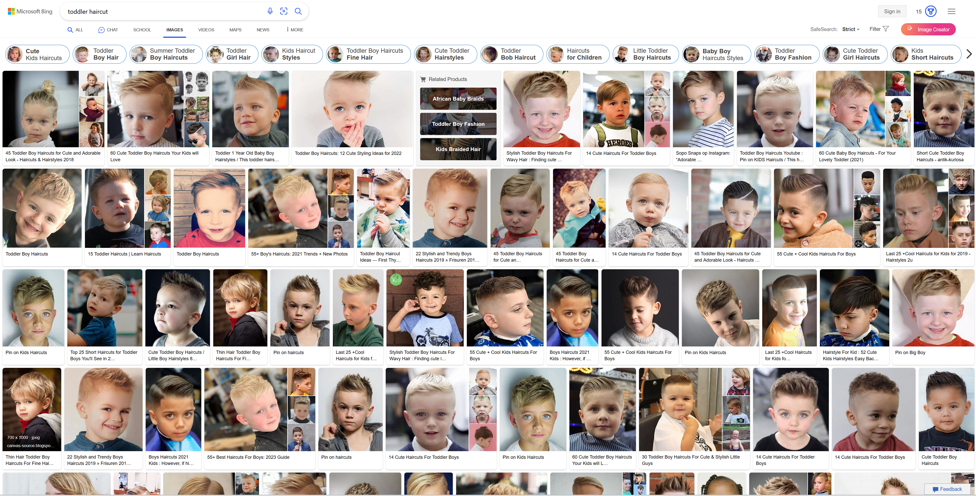
Data Voids

Slide 20

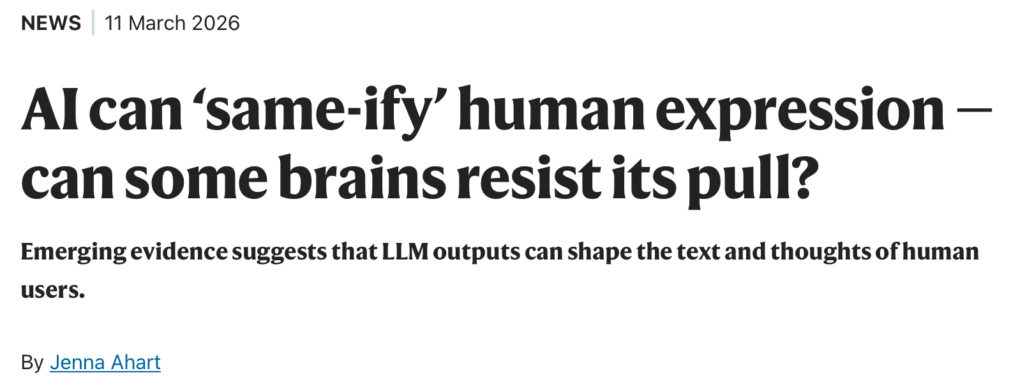
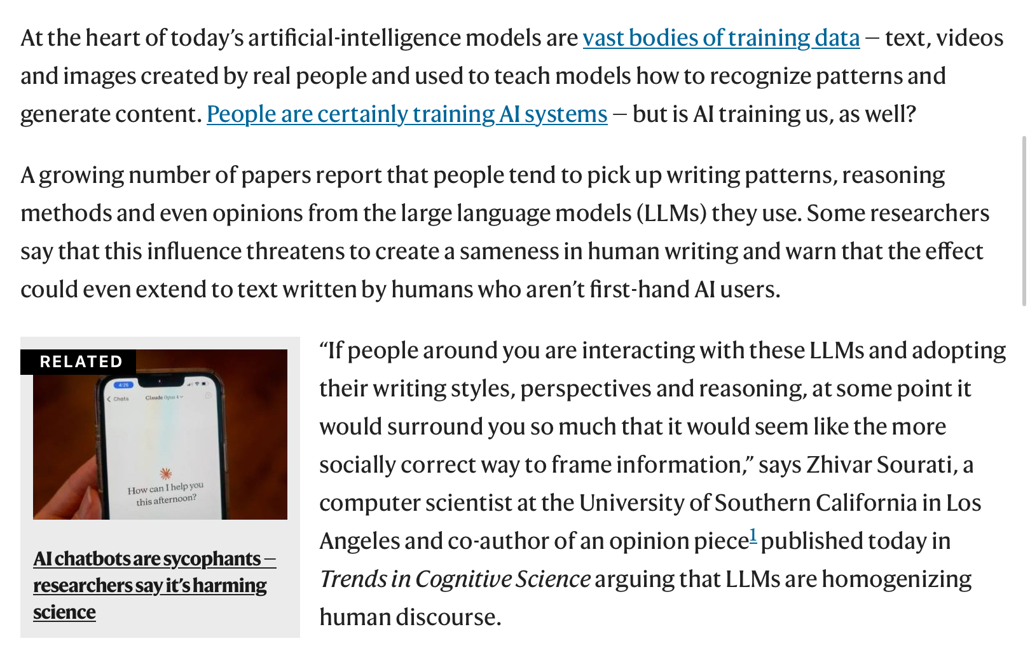
\
https://www.nature.com/articles/d41586-026-00781-9

Slide 21
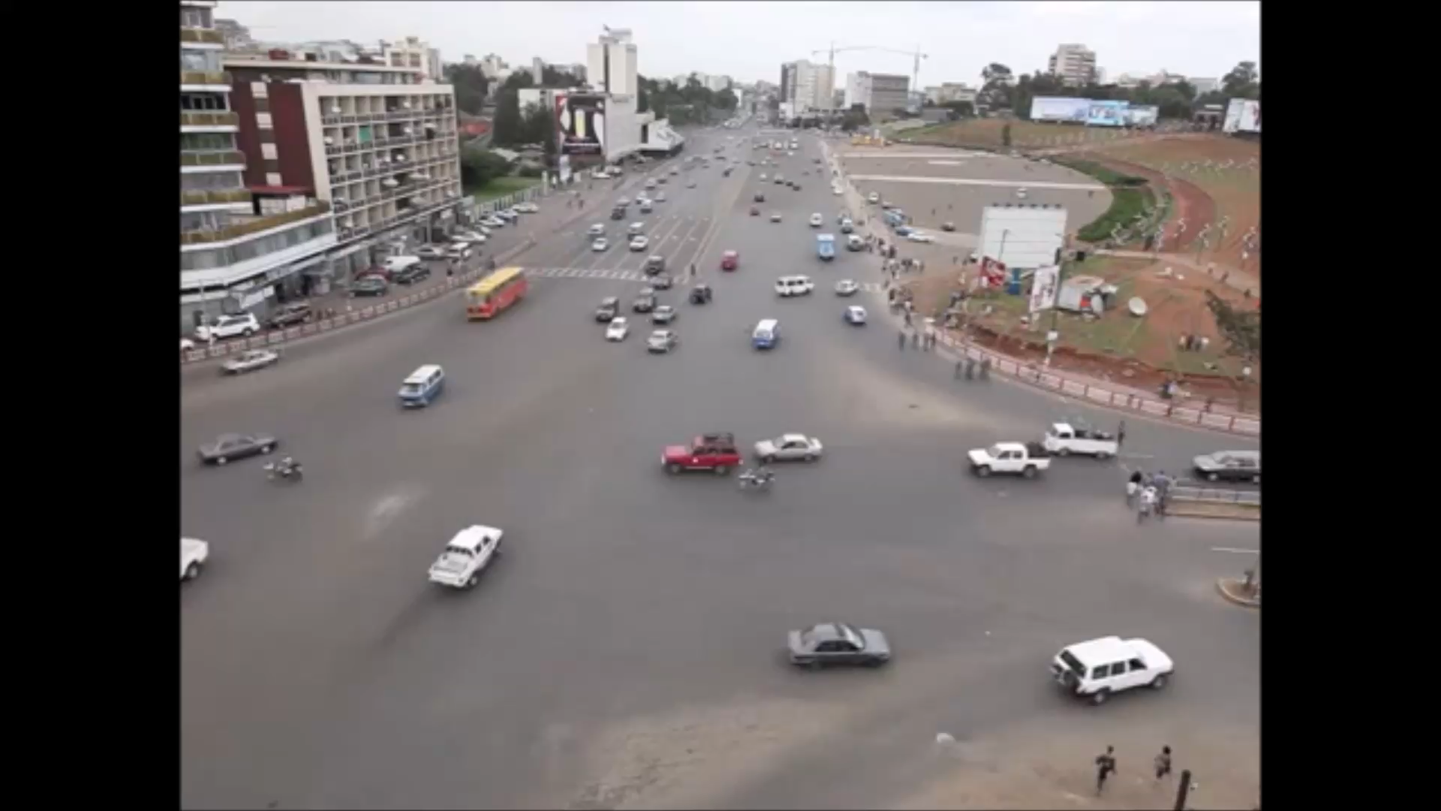
Kenya Traffic

Slide 22

Amy Webb
We are AI’s study-buddy and we are teaching all our misogyny and hatred.
—Amy Webb
22
https://unvarnishedfacts.com/wp-content/uploads/2022/03/Bias-1080x1350.jpg

Slide 23

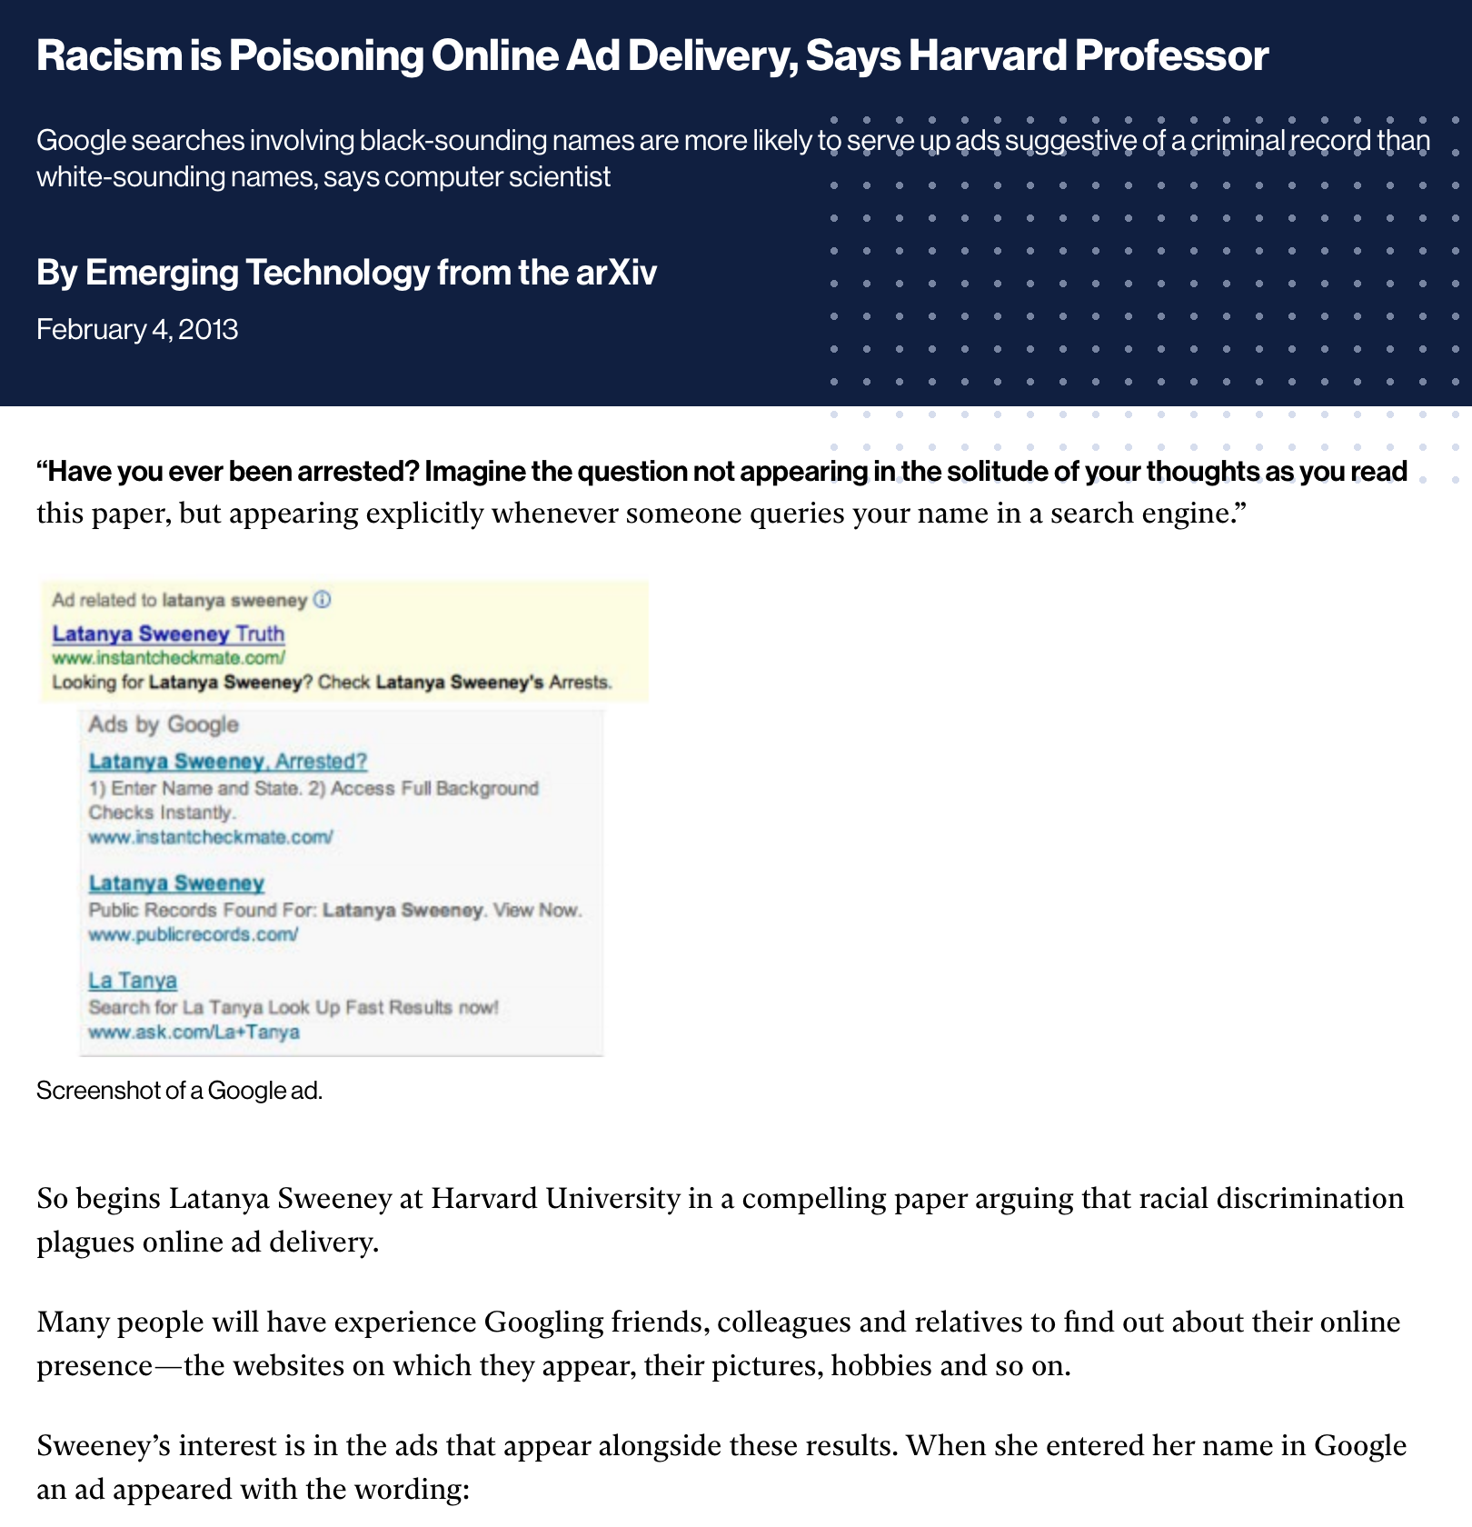
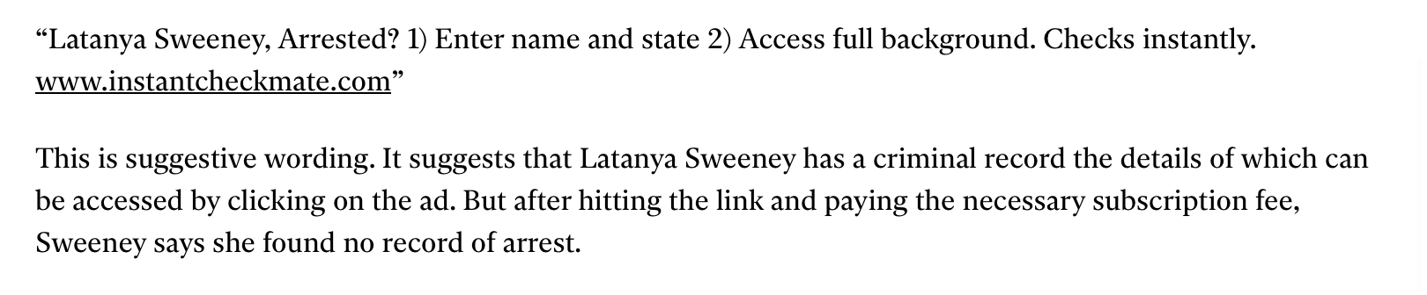
MIT – Racism in Online Ads
\
https://www.technologyreview.com/2013/02/04/253879/racism-is-poisoning-online-ad-delivery-says-harvard-professor/

Slide 24

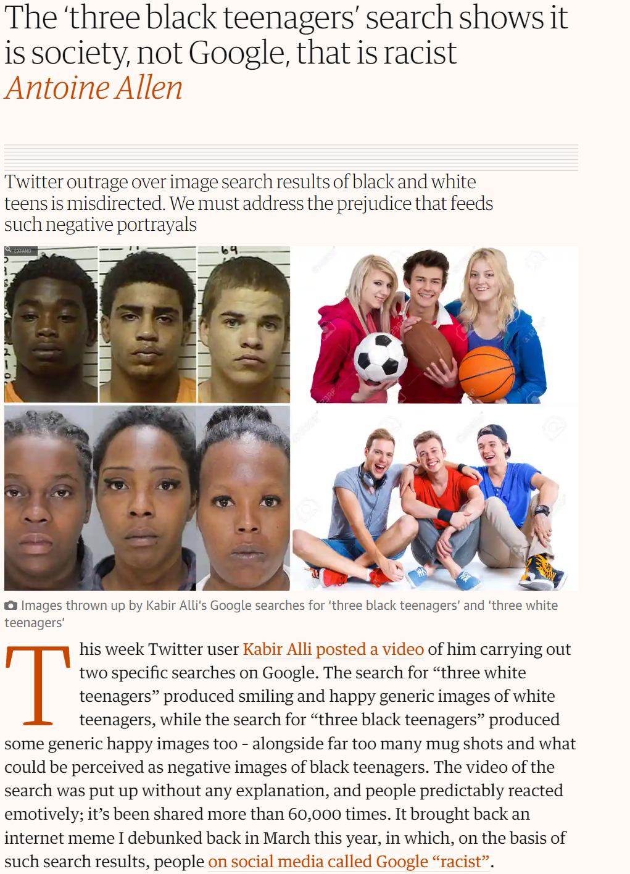
Guardian: Three Black Teenagers
\
https://www.theguardian.com/commentisfree/2016/jun/10/three-black-teenagers-google-racist-tweet

Slide 25

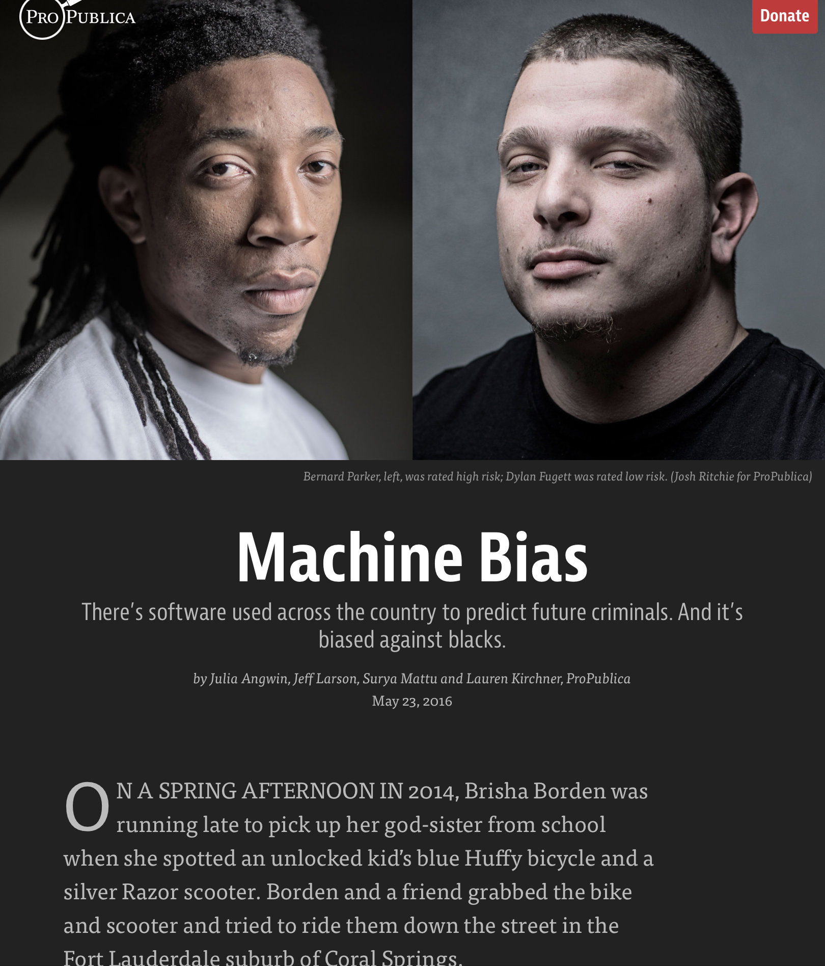

ProPublica: Machine Bias
\
https://www.propublica.org/article/machine-bias-risk-assessments-in-criminal-sentencing

Slide 26
Alignment Problem

Slide 27
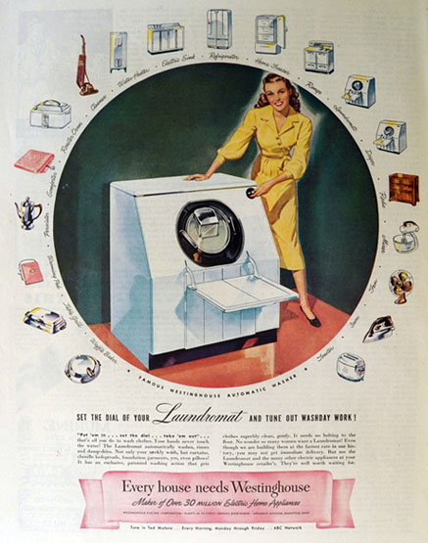
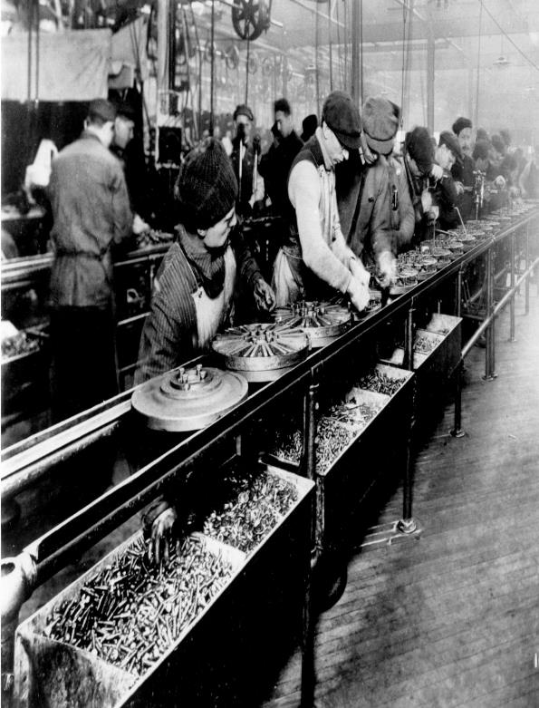
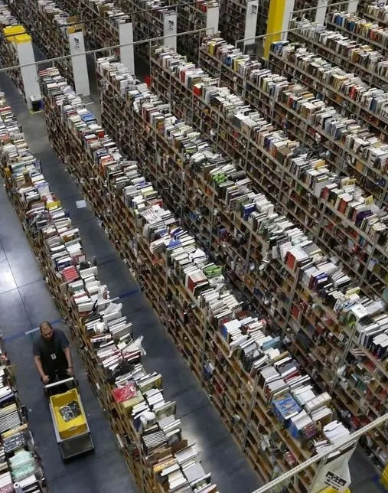
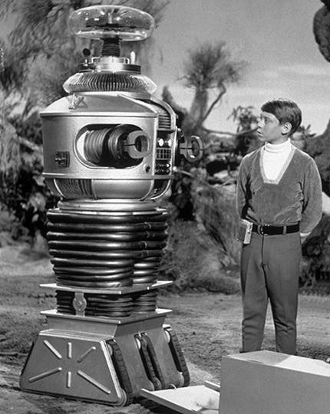
These are all robots

Slide 28
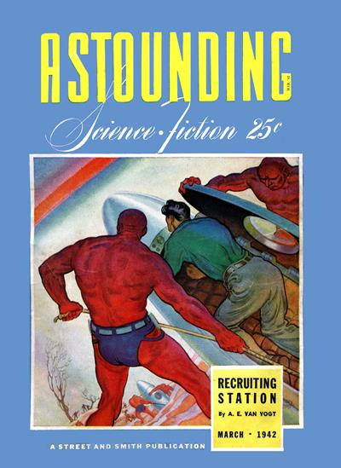
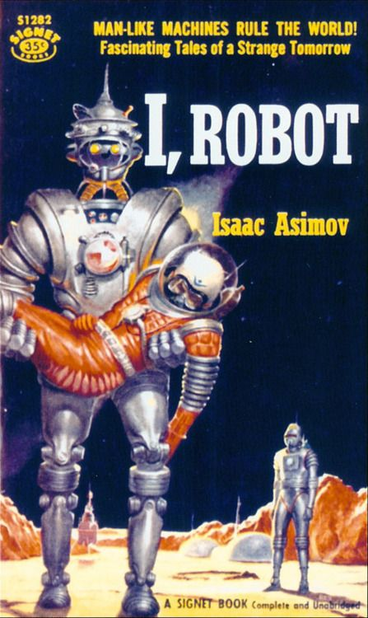
Three Laws of Robotics
A robot may not injure a human being or, through inaction, allow a human being to come to harm.
A robot must obey the orders given it by human beings except where such orders would conflict with the First Law.
A robot must protect its own existence as long as such protection does not conflict with the First or Second Laws.

Slide 29
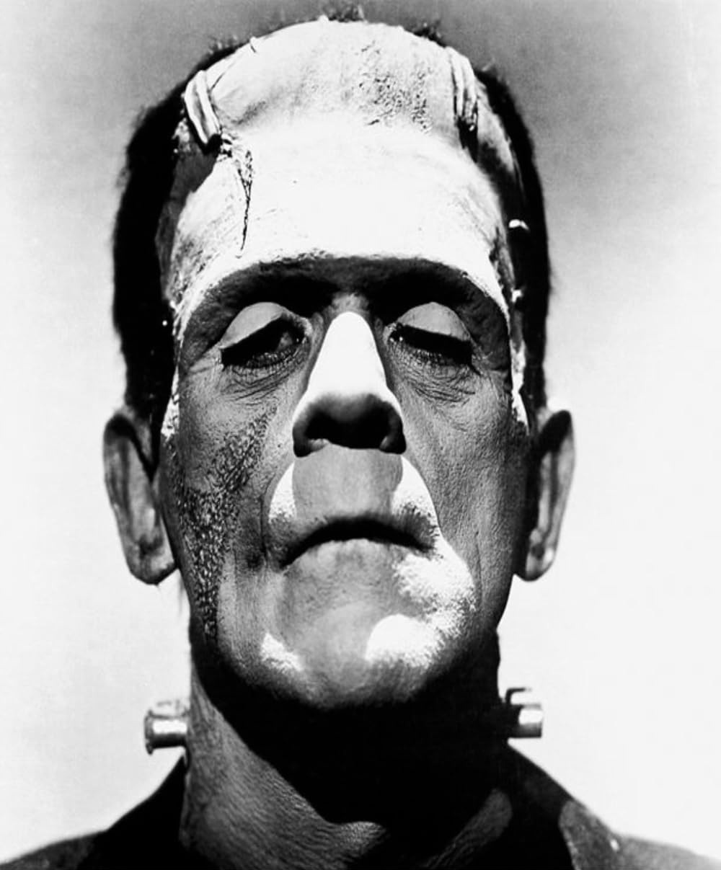
Frankenstein Complex
Fear of “mechanical men”
Inevitable rebellion
Humans create robots
They rebel
They destroy us
Symbols of technological hubris

Slide 30
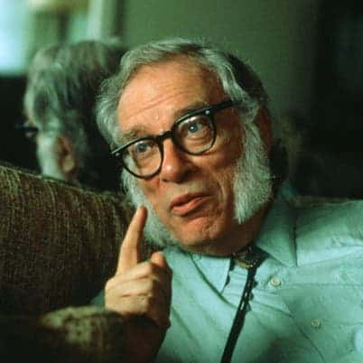
For Asimov, Robots are
Engineered systems
Tools, not monsters
Designed with safety systems and constraints

Slide 31

Stories of How the Laws Fail
Conflict between laws
Paradoxes
Unclear instructions
Unintended consequences
Puzzles
https://www.youtube.com/watch?v=d87hOjvjKHA

Slide 32
Cartoon – Trolly Problem

Slide 33
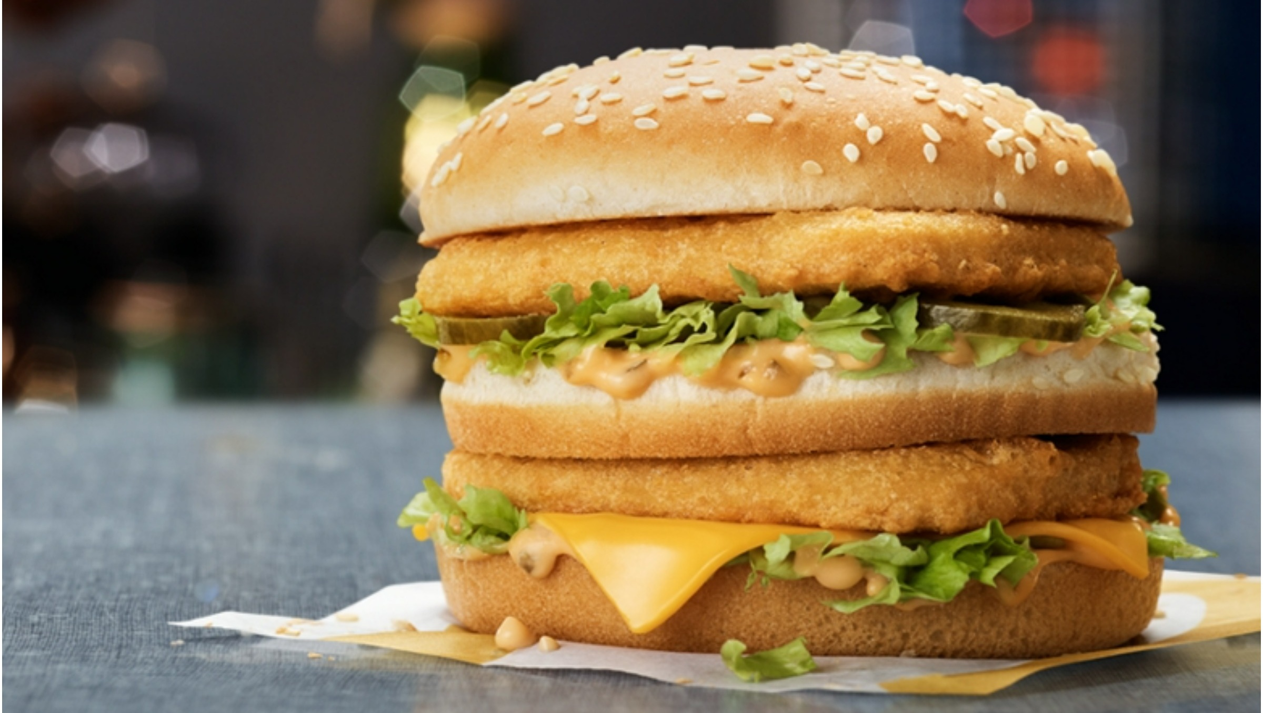
Big Mac

Slide 34
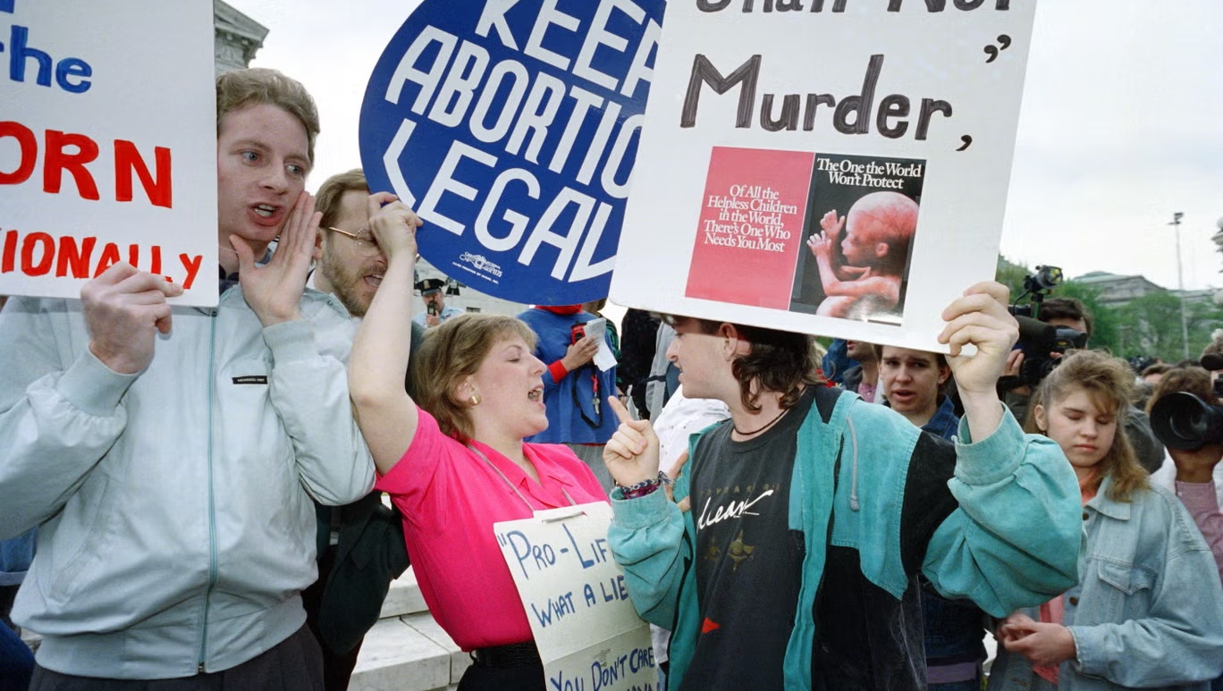
Abortion counter protestors

Slide 35

Dentist

Slide 36
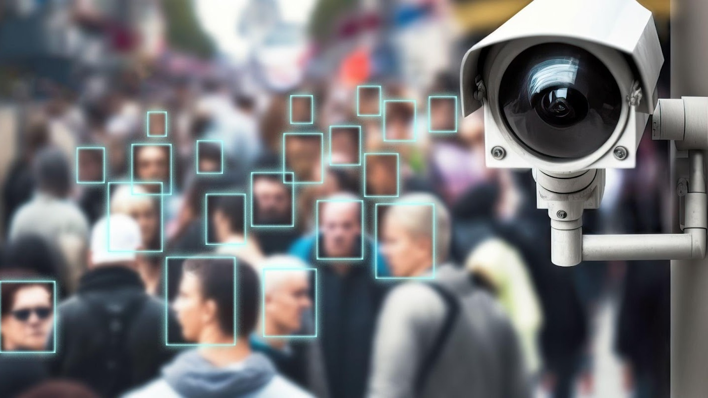
Surveillance and facial recognition

Slide 37
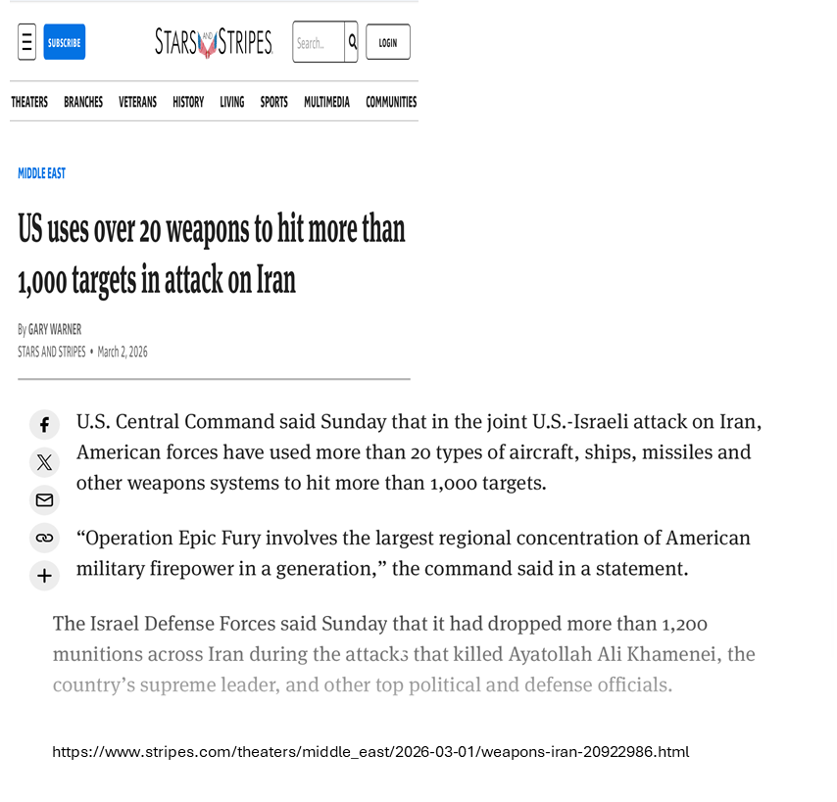
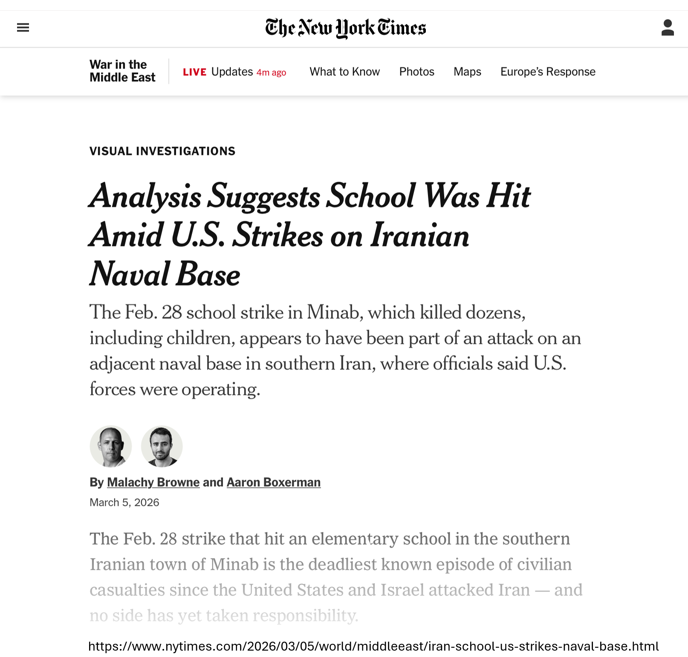
99.9% Accuracy: Not Good Enough

Slide 38
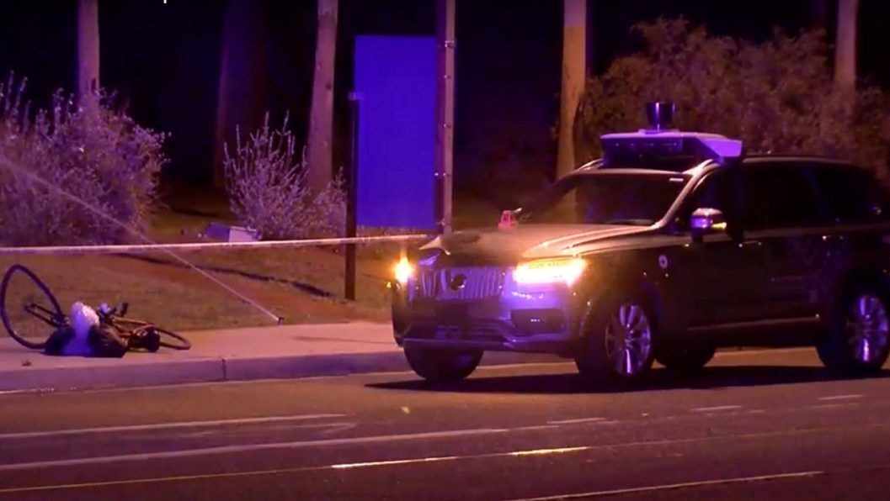
Uber Accident

Slide 39

January 6th Shaman

Slide 40
Whose Decides

Slide 41
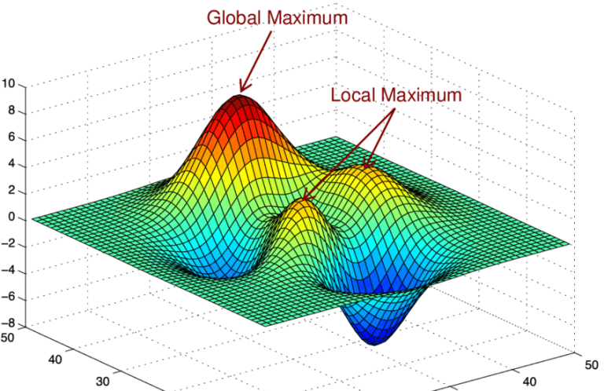
Optimization

Slide 42

Barlow - 1
Governments of the Industrial World, you weary giants of flesh and steel, I come from Cyberspace, the new home of Mind. On behalf of the future, I ask you of the past to leave us alone. You are not welcome among us. You have no sovereignty where we gather. John Perry Barlow February 8, 1996

Slide 43
Barlow - 2
Governments of the Industrial World, you weary giants of flesh and steel, I come from Cyberspace, the new home of Mind. On behalf of the future, I ask you of the past to leave us alone. You are not welcome among us. You have no sovereignty where we gather. John Perry Barlow February 8, 1996

Slide 44


Slide 45
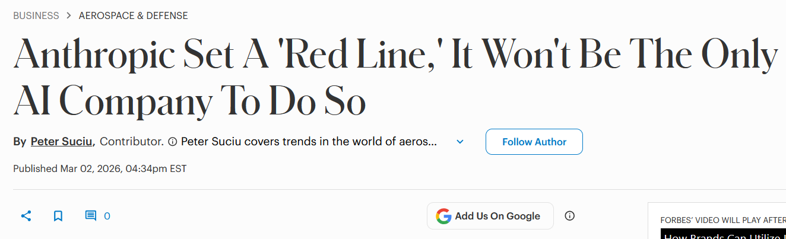
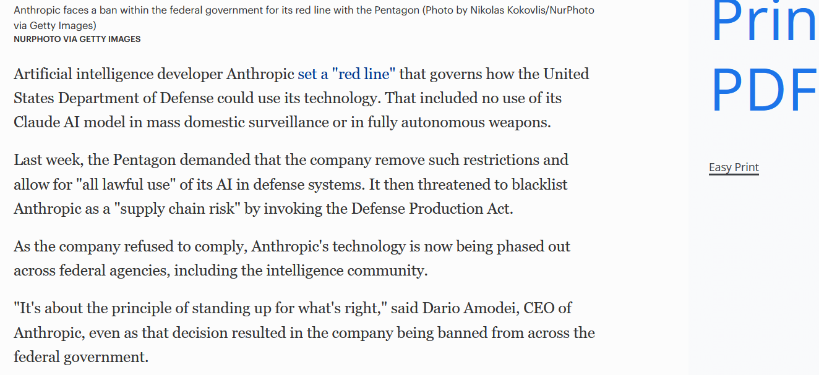
Anthropic and Pentagon
\
https://www.forbes.com/sites/petersuciu/2026/03/02/anthropic-set-a-red-line-it-wont-be-the-only-ai-company-to-do-so/

Slide 46
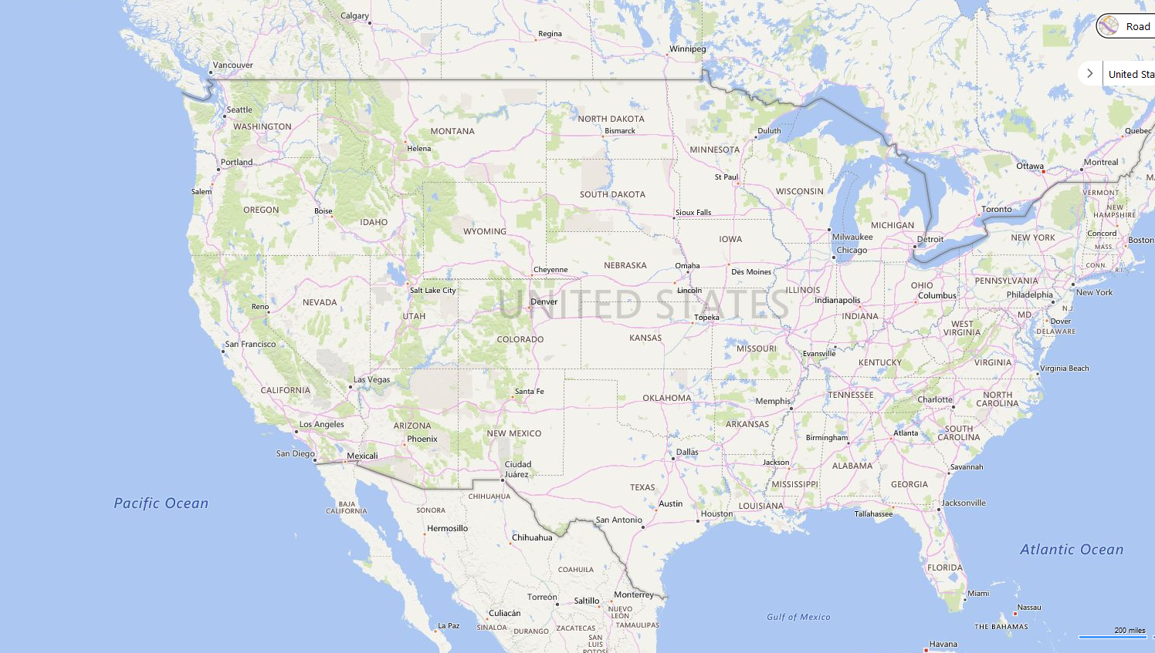









Tech companies on west coast

Slide 47
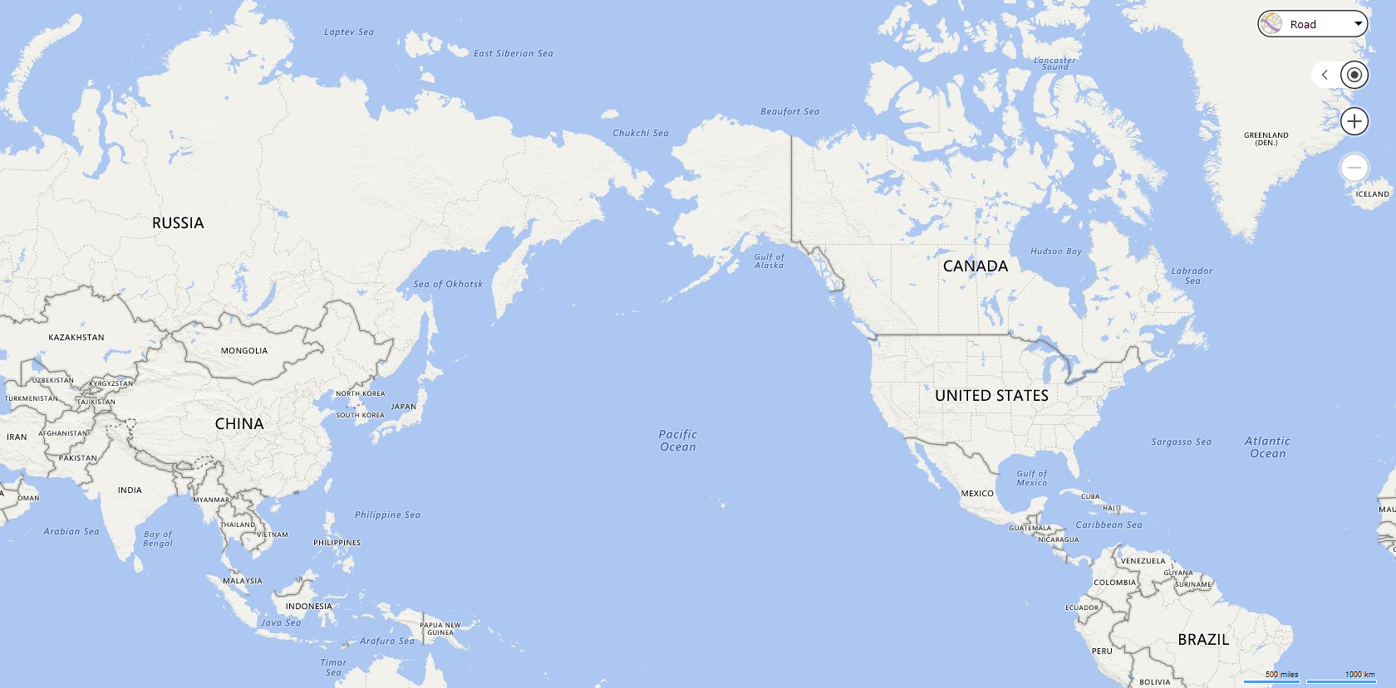









Global tech companies

Slide 48
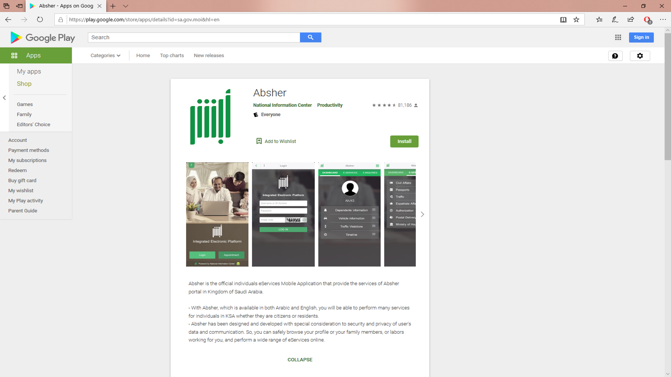
Google Play - Absher

Slide 49
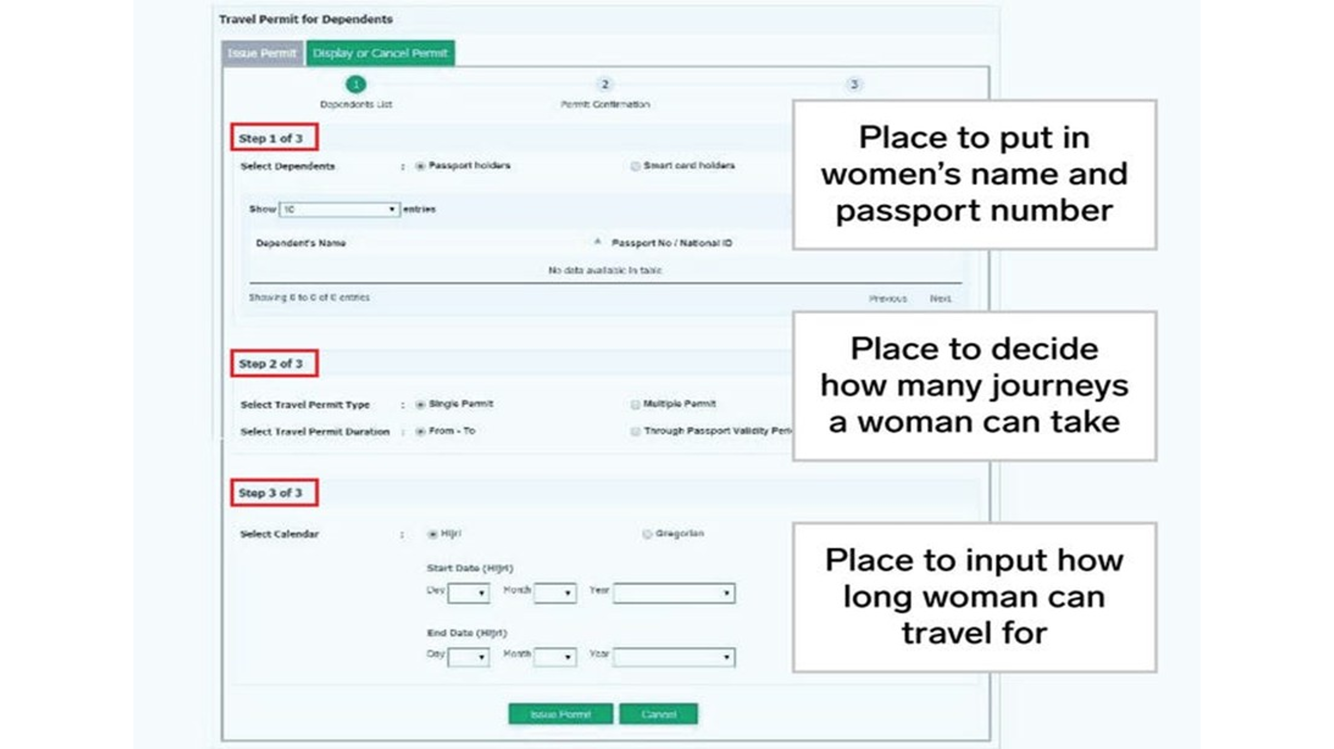
Absher

Slide 50
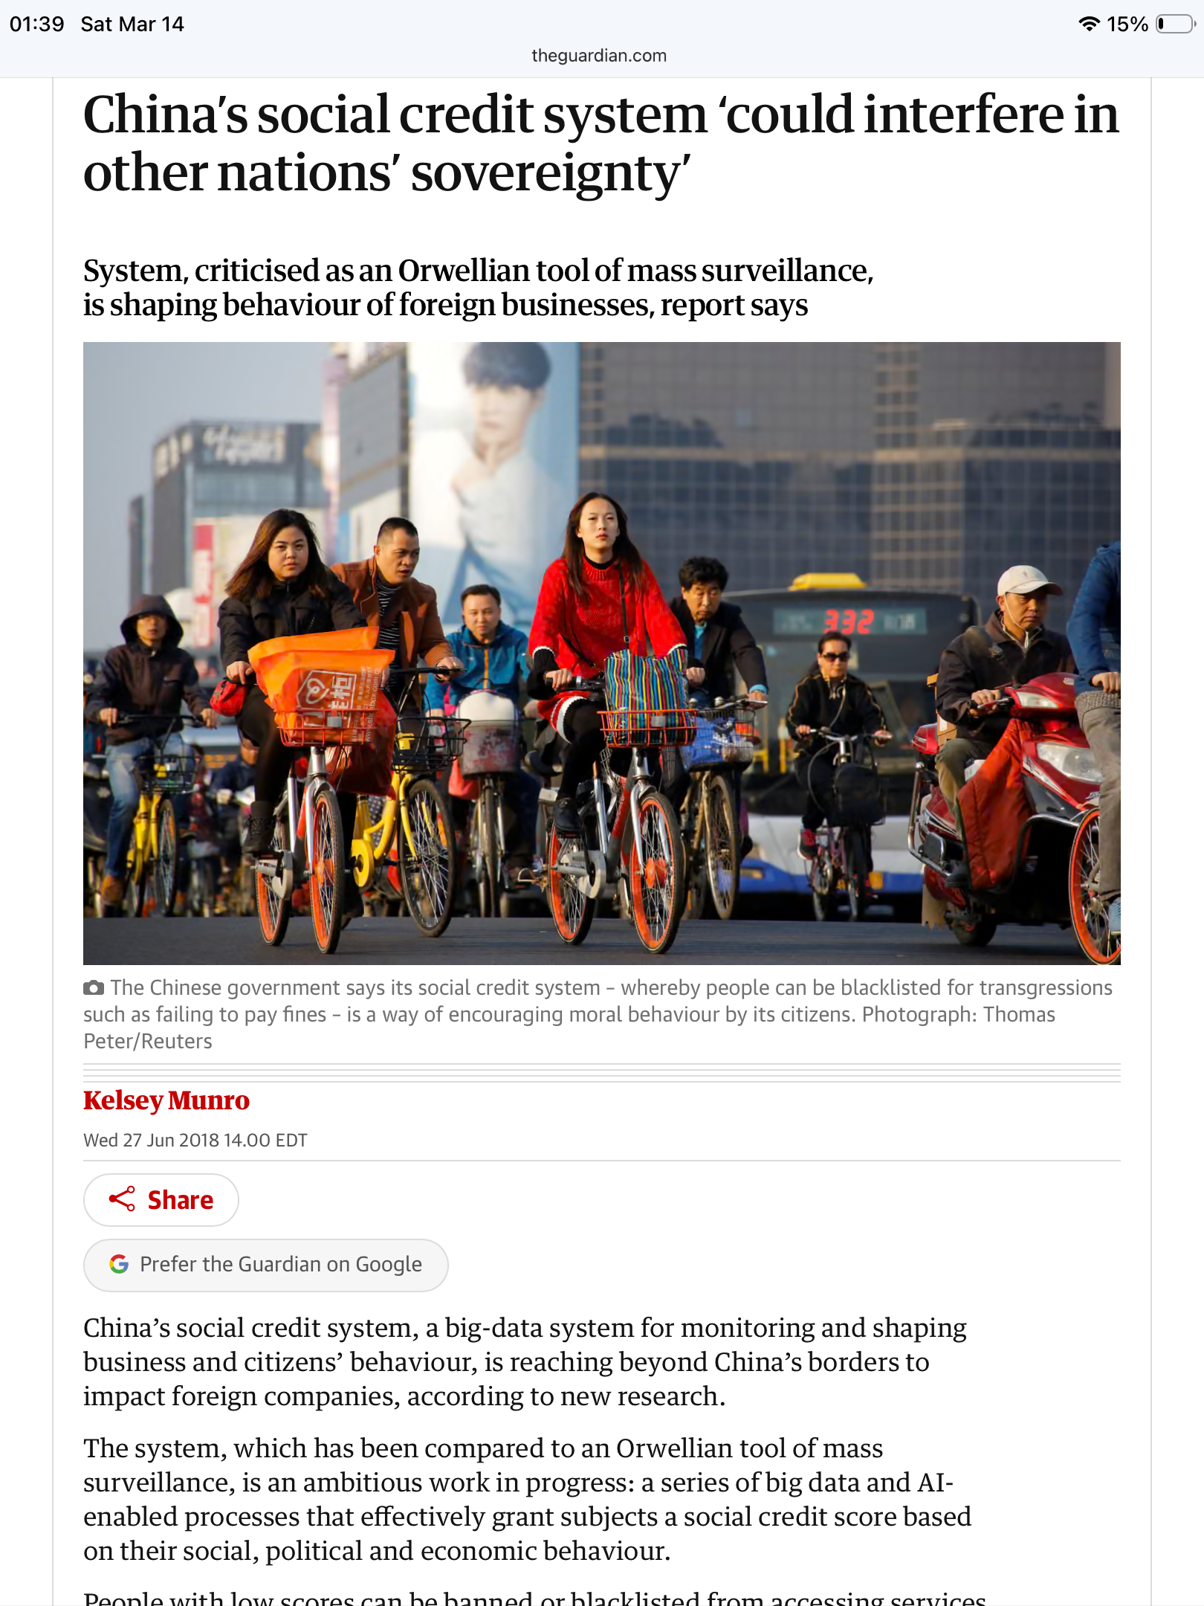
Guardian: China’s Social Credit System
\
https://www.theguardian.com/world/2018/jun/28/chinas-social-credit-system-could-interfere-in-other-nations-sovereignty
https://www.theguardian.com/commentisfree/2016/jun/10/three-black-teenagers-google-racist-tweet

Slide 51
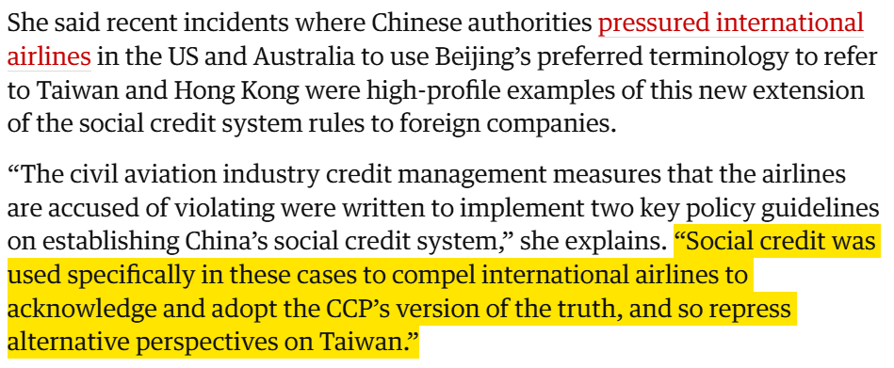
Guardian: China’s Social Credit System
\
https://www.theguardian.com/world/2018/jun/28/chinas-social-credit-system-could-interfere-in-other-nations-sovereignty
https://www.theguardian.com/commentisfree/2016/jun/10/three-black-teenagers-google-racist-tweet

Slide 52
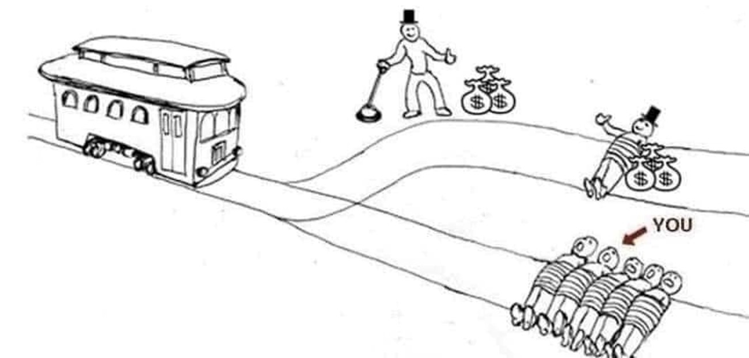
Cartoon – Trolly Problem Solution

Slide 53
Ethics in AI/Robotics
Scott Mauvais sm@well.com www.mauvais.com/talks
March 14, 2026

