Slide 1
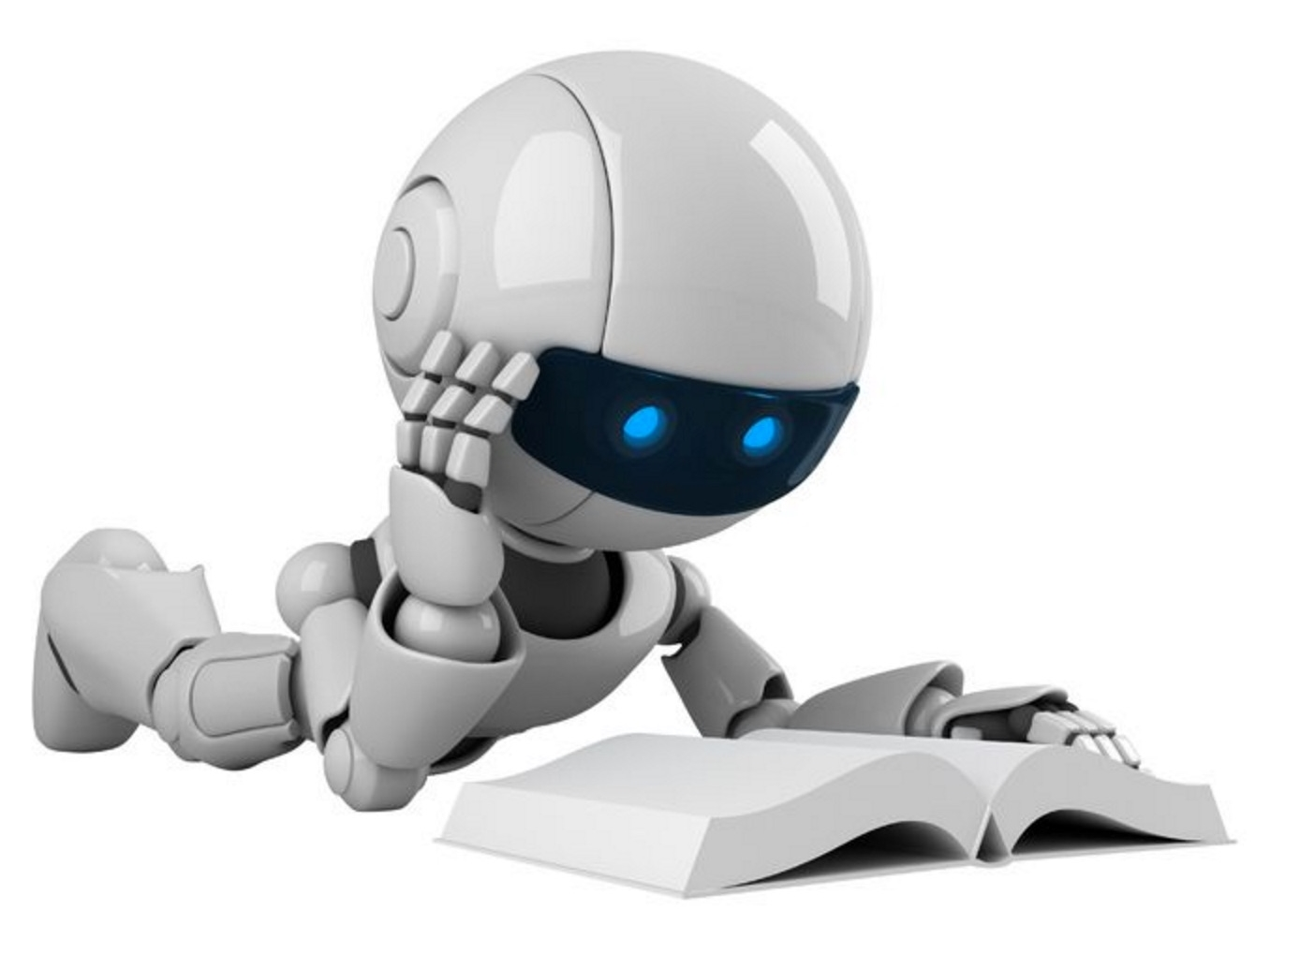
San Francisco 2023
AI Robotics Youth Program
g
AI:
The Good,
The Bad, & The Impact on
Society
Scott Mauvais
scott@mauvais.com
www.mauvais.com/talks
June 27, 2023

Slide 2

Agenda
The Bad
There is inherent bias in the data that underpins AI
The Good
AI provides a path for addressing extremely difficult problems
The Impact
What does this mean for jobs, for art,
for society

Slide 3



Agenda
The Bad
There is inherent bias in the data that underpins AI
The Good
AI provides a path for addressing extremely difficult problems
The Impact
What does this mean for jobs, for art,
for society

Slide 4
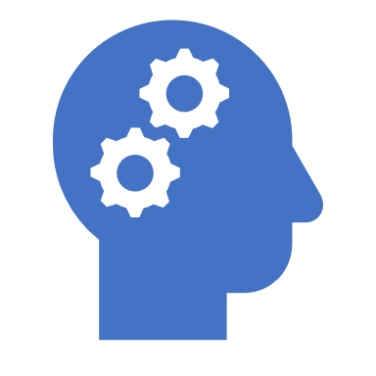
Training data is biased

Slide 5
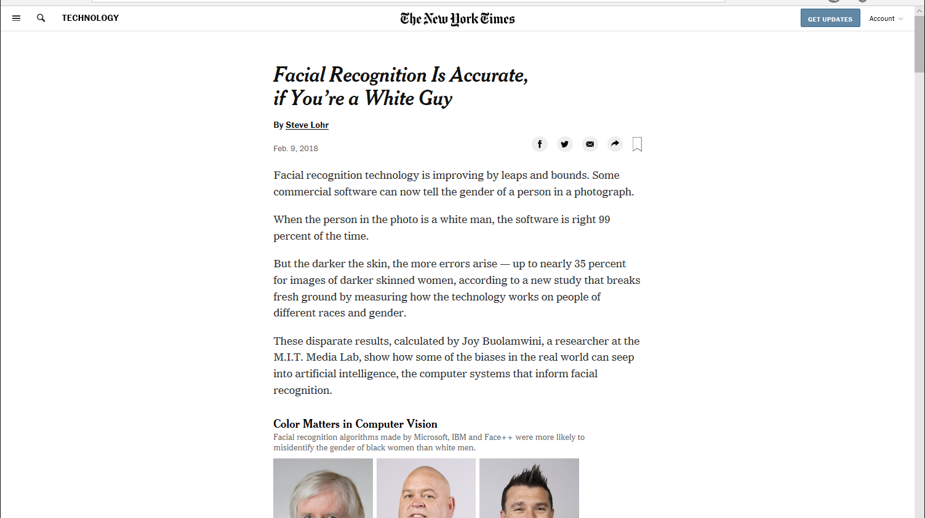

Slide 6

Meet Shirley

Slide 7
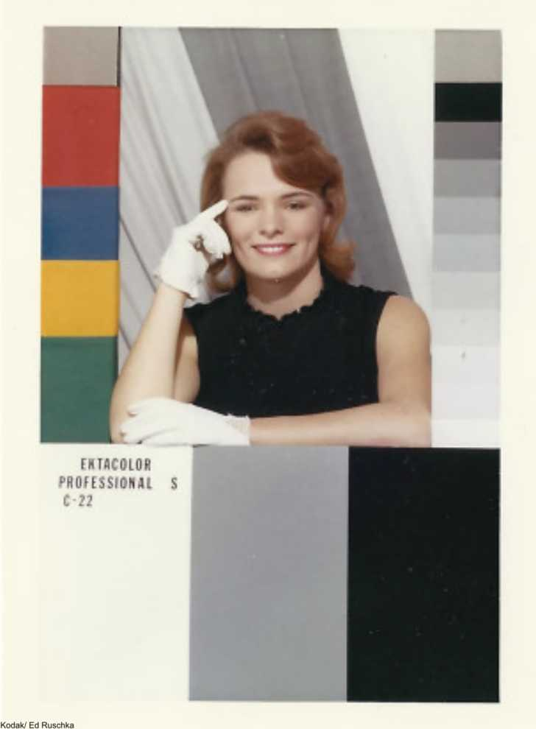


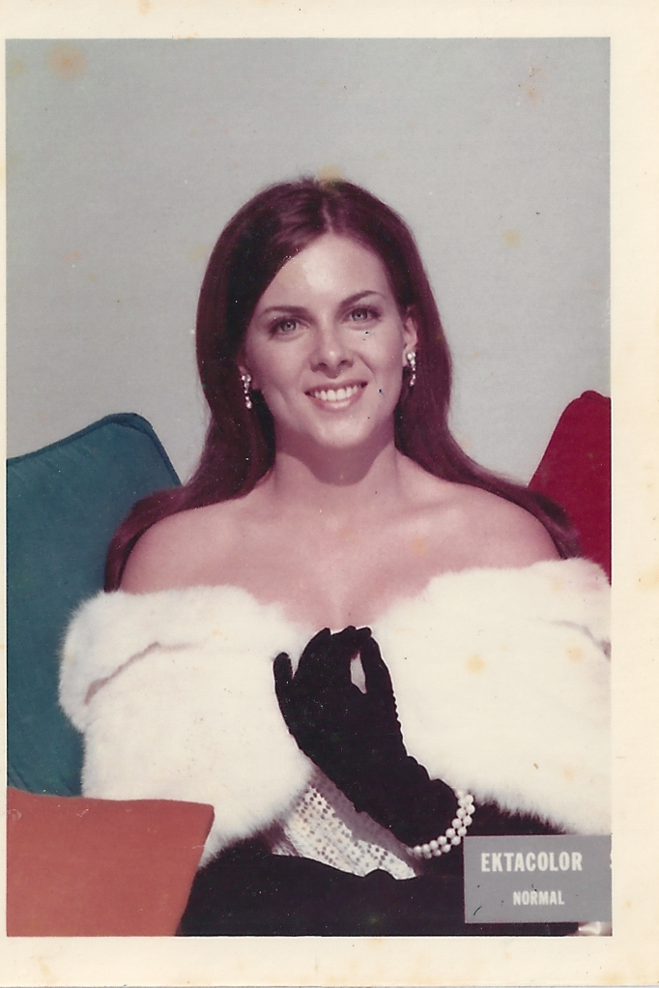



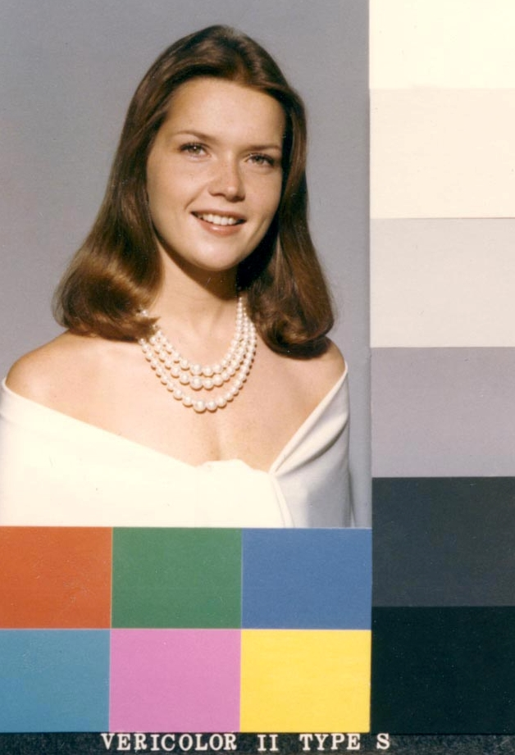

Slide 8
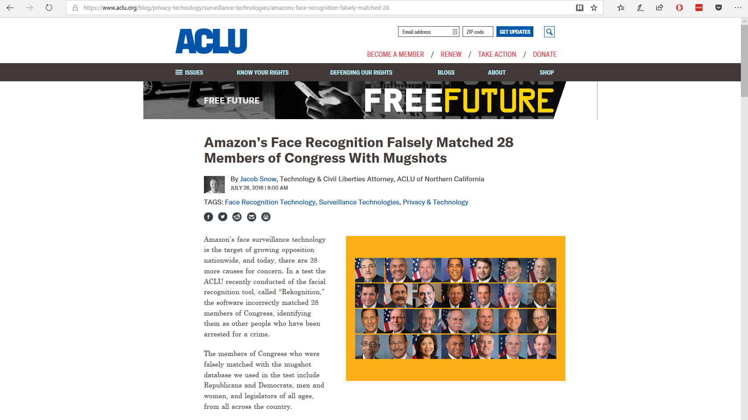

Slide 9
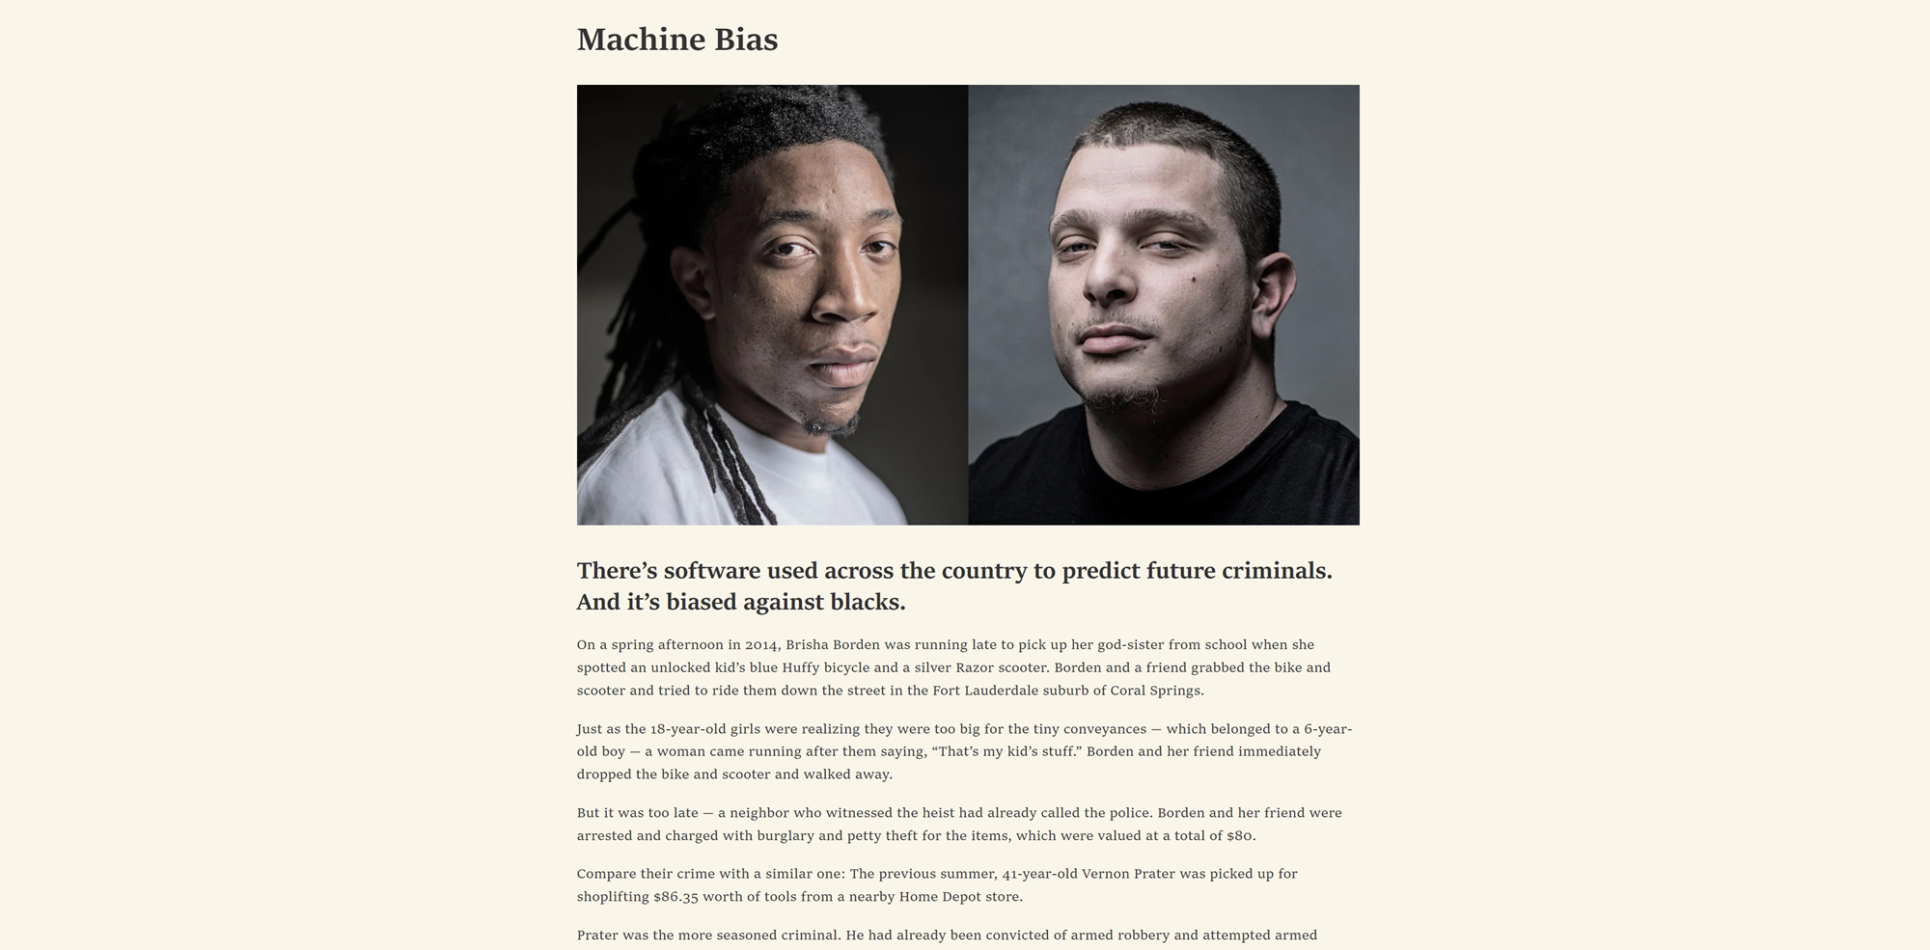


Slide 10
Data voids create bias

Slide 12
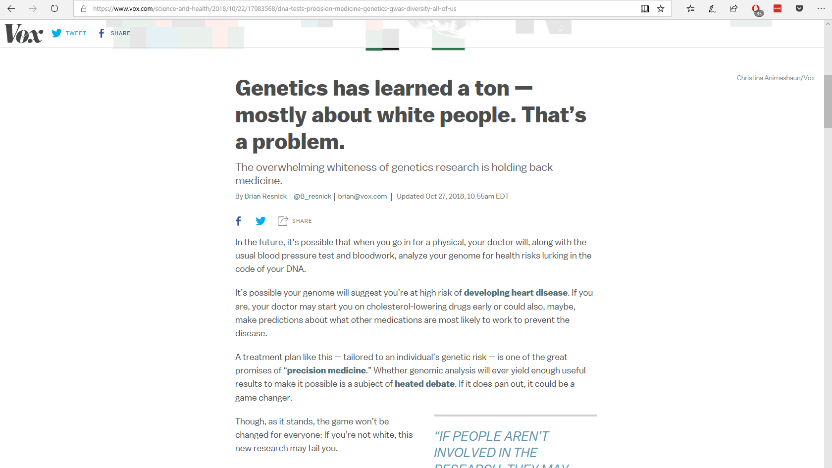

Slide 13
Reality is biased

Slide 14
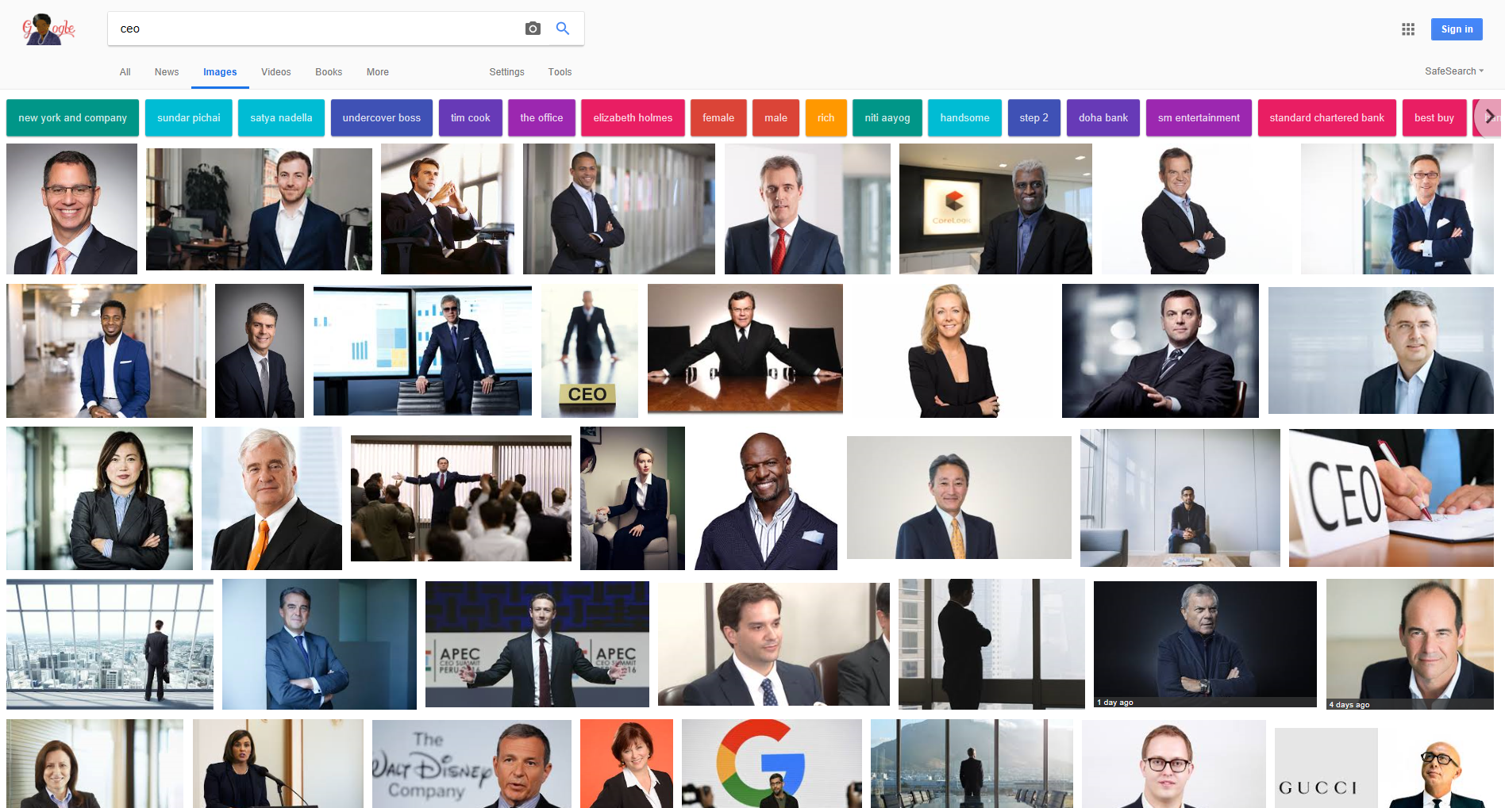

Slide 15
Percentage of Fortune 500 CEOs

Slide 16
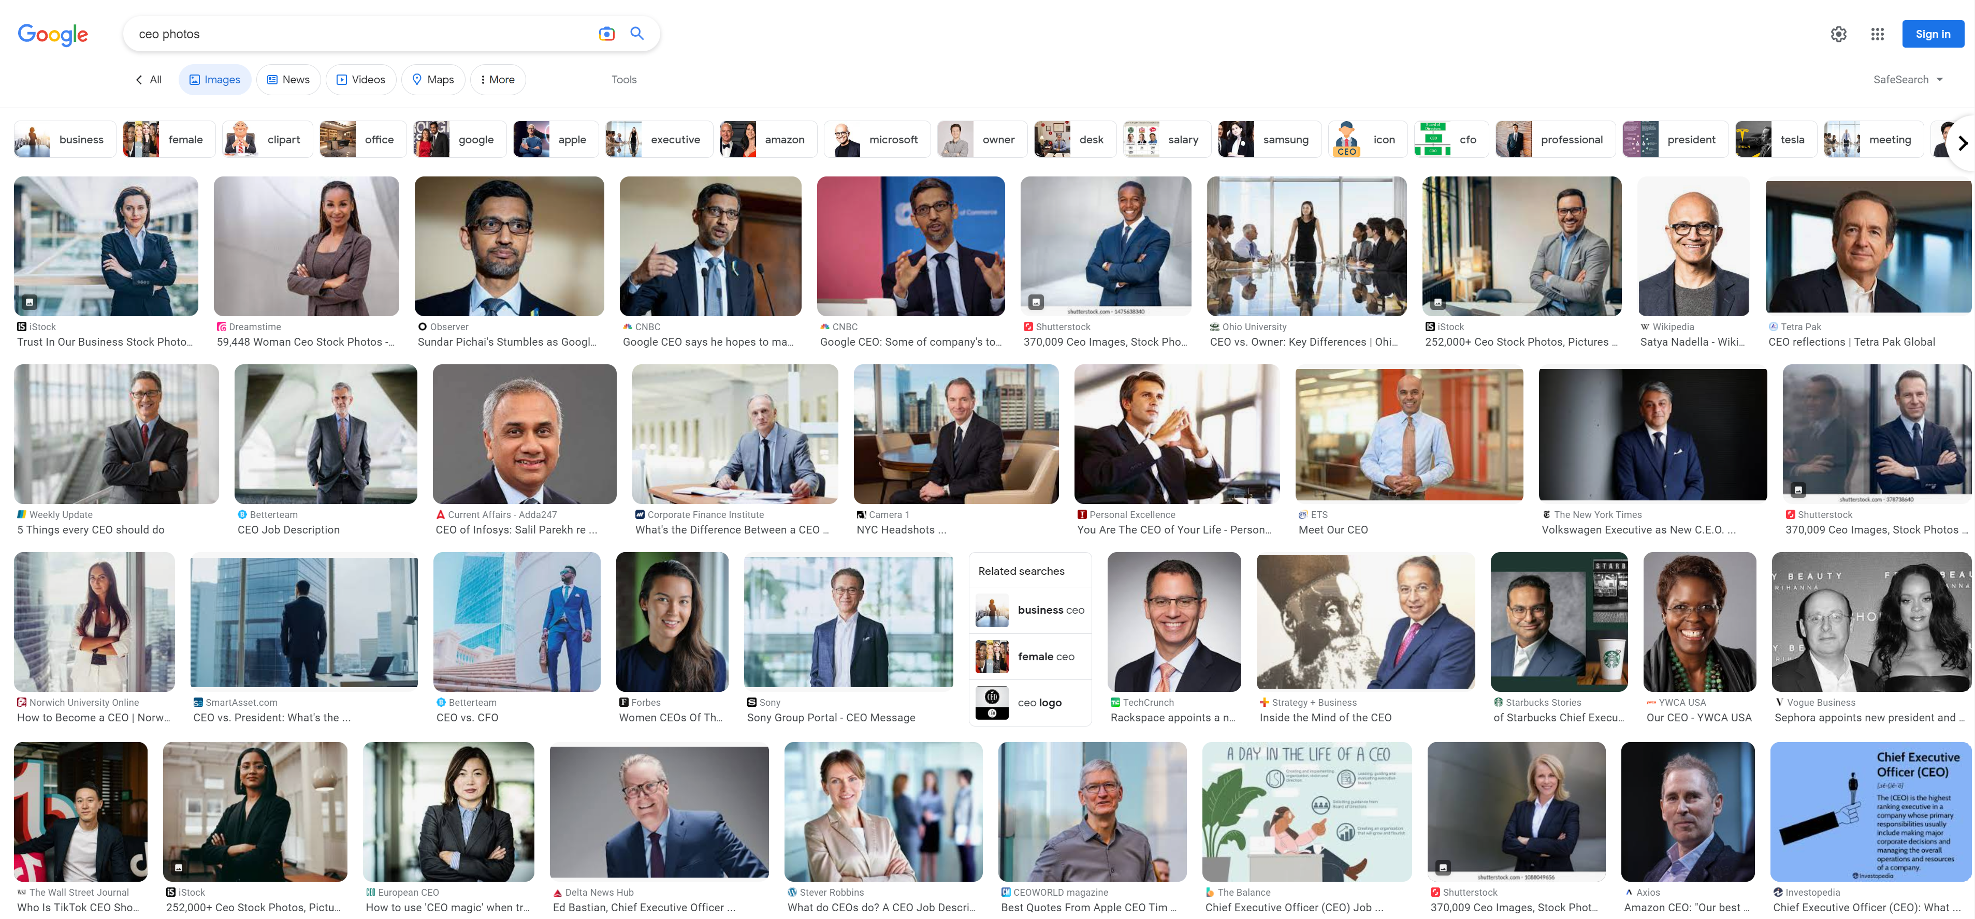
Search Engines Curating Results (2023)

Slide 17
Search Engines Curating Results (2023)

Slide 18
More than just biased data

Slide 19
The is problem us
We are biased

Slide 20

We are AI’s study-buddy and we are teaching all our misogyny and hatred
—Amy Webb

Slide 21

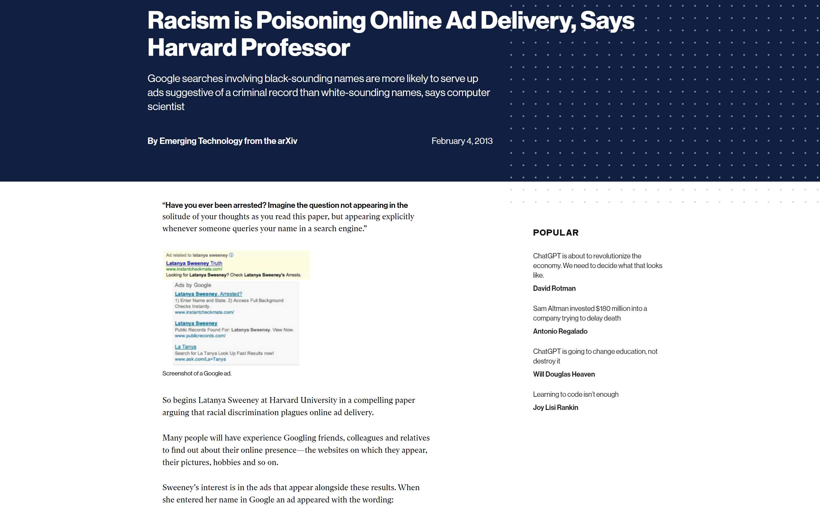

Slide 22

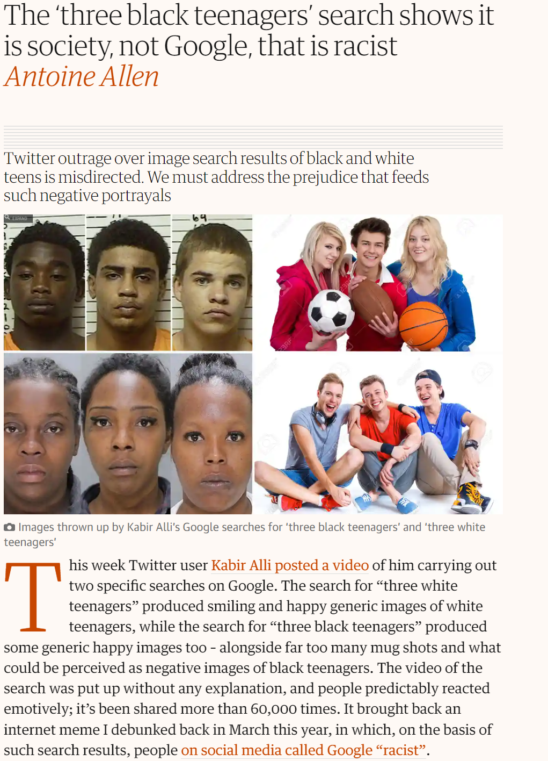

Slide 23
Bias in AI is fixable
(I’m not so sure about human bias)

Slide 24
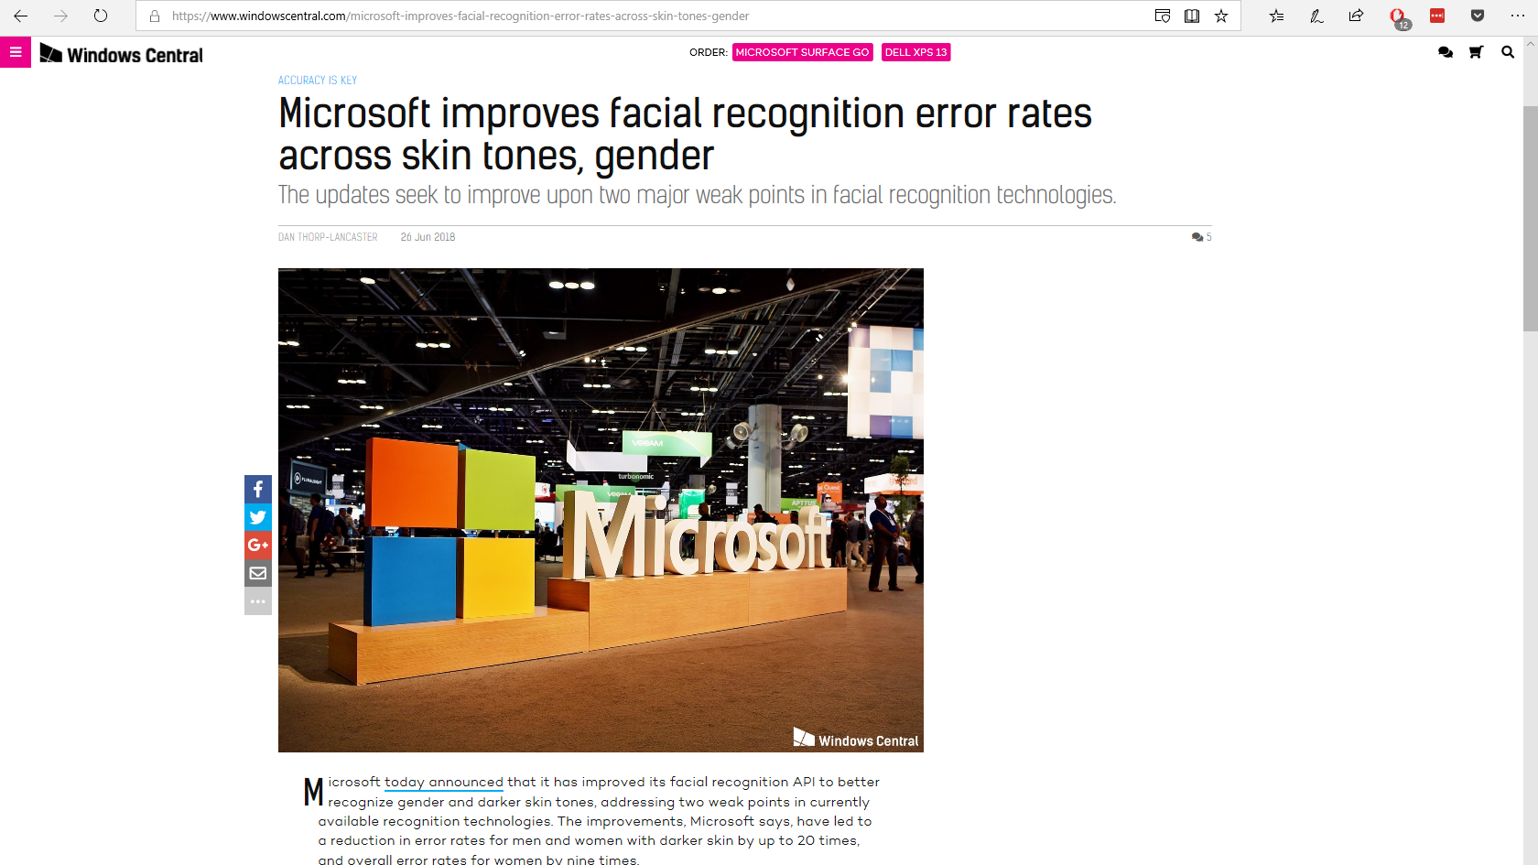

Slide 25
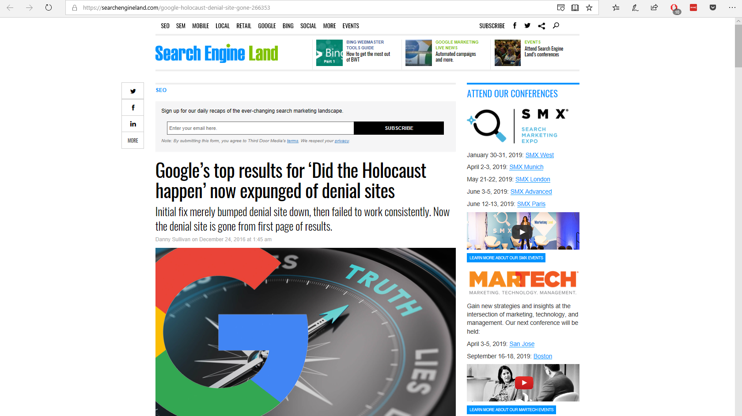

Slide 26

Quiz 1

Slide 27
Agenda
The Bad
There is inherent bias in the data that underpins AI
The Good
AI provides a path for addressing extremely difficult problems
The Impact
What does this mean for jobs, for art,
for society

Slide 28







Illegal Fishing is threatening our oceans
80%
THE OCEAN PRODUCES
OF ALL LIFE ON
EARTH DWELLS
IN THE OCEAN
OVER
HALF
THE OCEAN IS CRUCIAL TO THE CARBON CYCLE, AND REGULATES OUR WEATHER AND CLIMATE
OF THE OXYGEN
WE BREATHE
3
THE OCEAN PROVIDES FOOD SECURITY FOR
BILLION PEOPLE
AND THE LIVELIHOOD OF
12%
OF THE WORLDS POPULATION

Slide 29
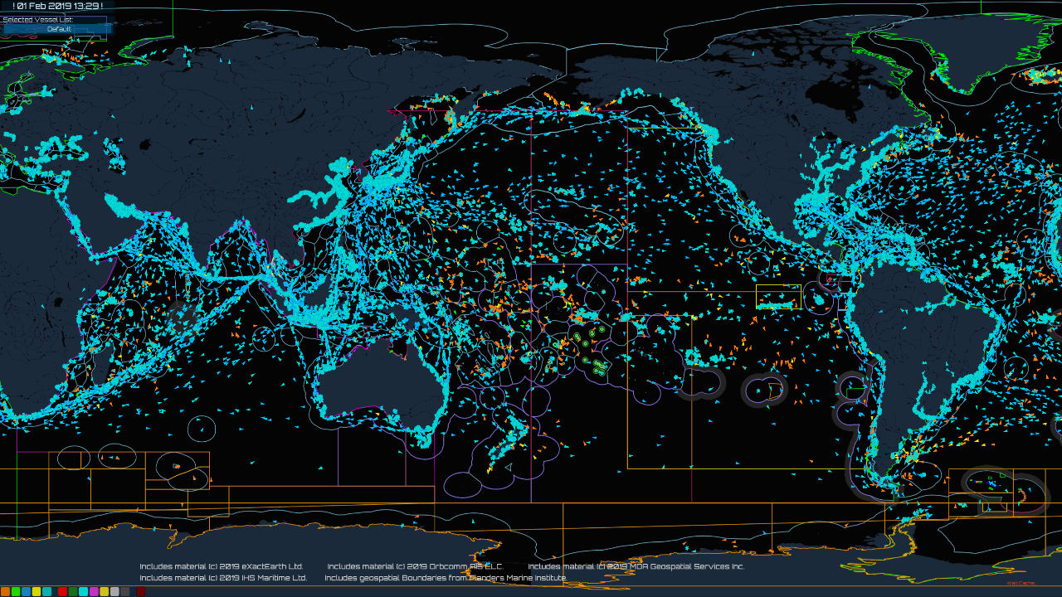

Slide 30










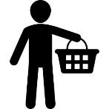


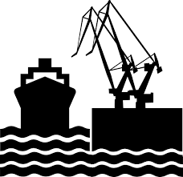

How OceanMind Works
Satellite
Observations
Web
Portal
Vessel Identity
Artificial
Authorities
Vessel Tracking
Intelligence
?
Regulations
Local
Information
Actionable
Insights
Seafood Buyers

Slide 31
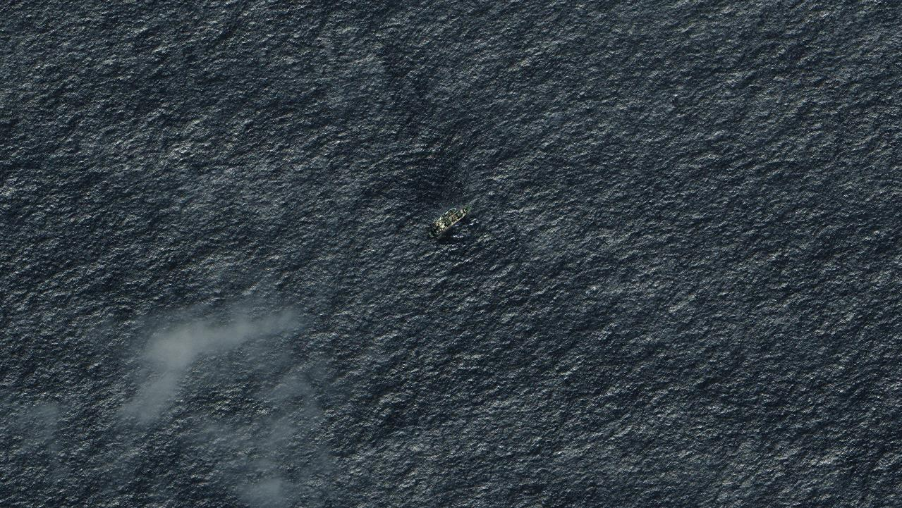
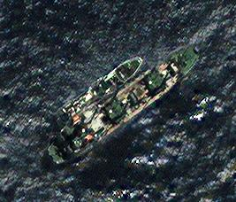
Image: © Digital Globe Inc, All Rights Reserved

Slide 32
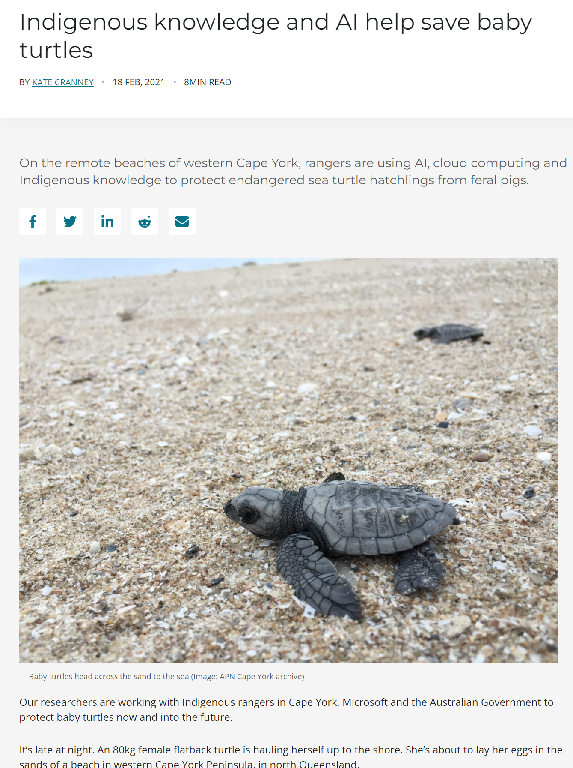
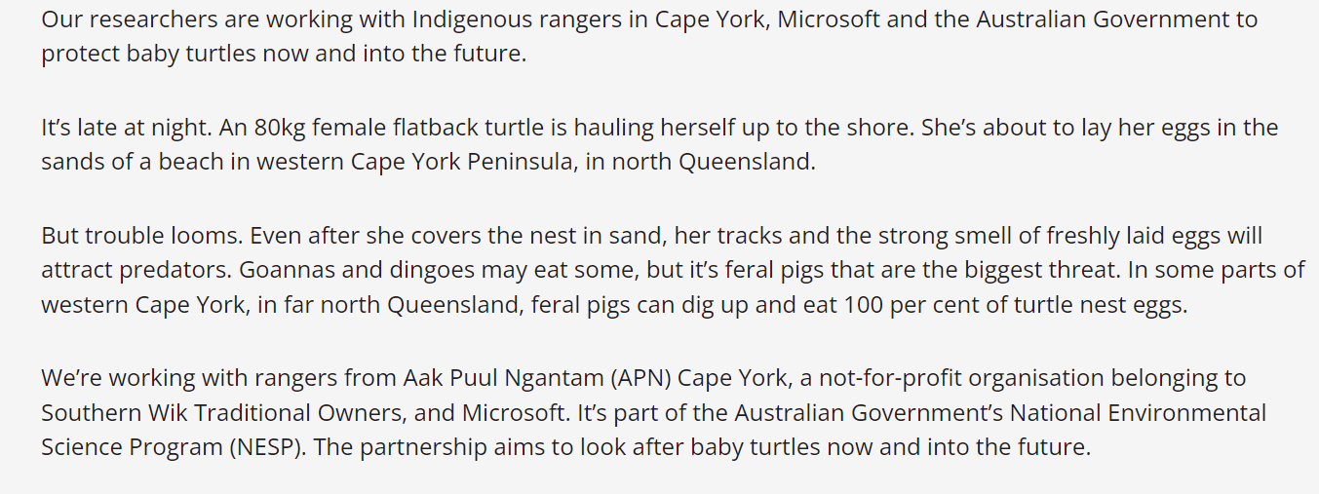
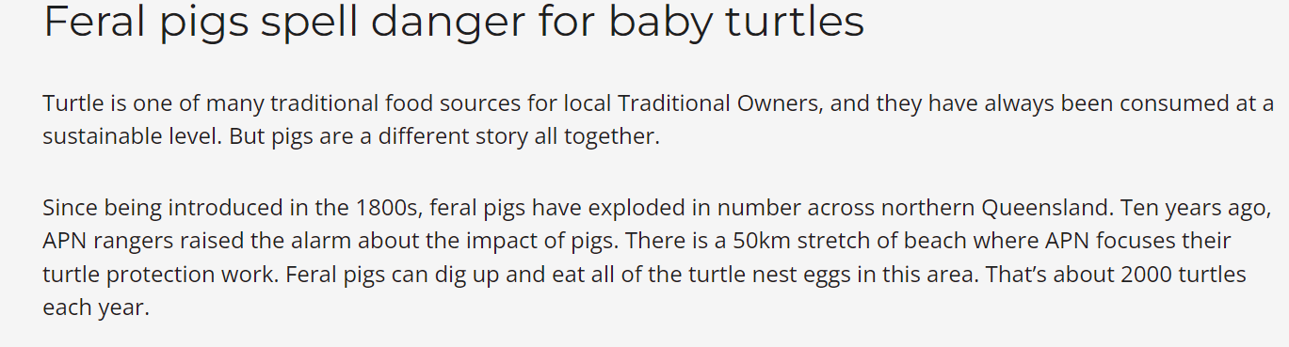

Slide 33
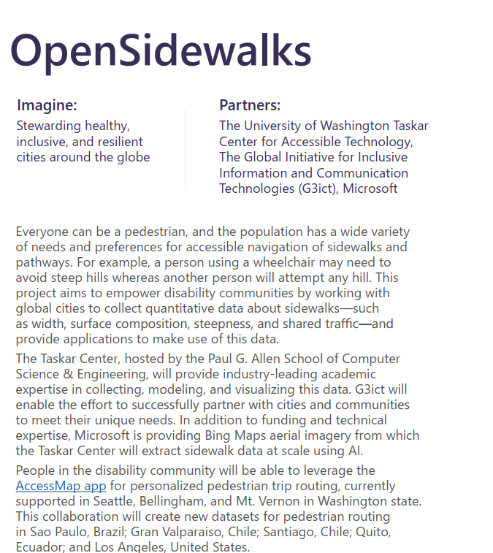
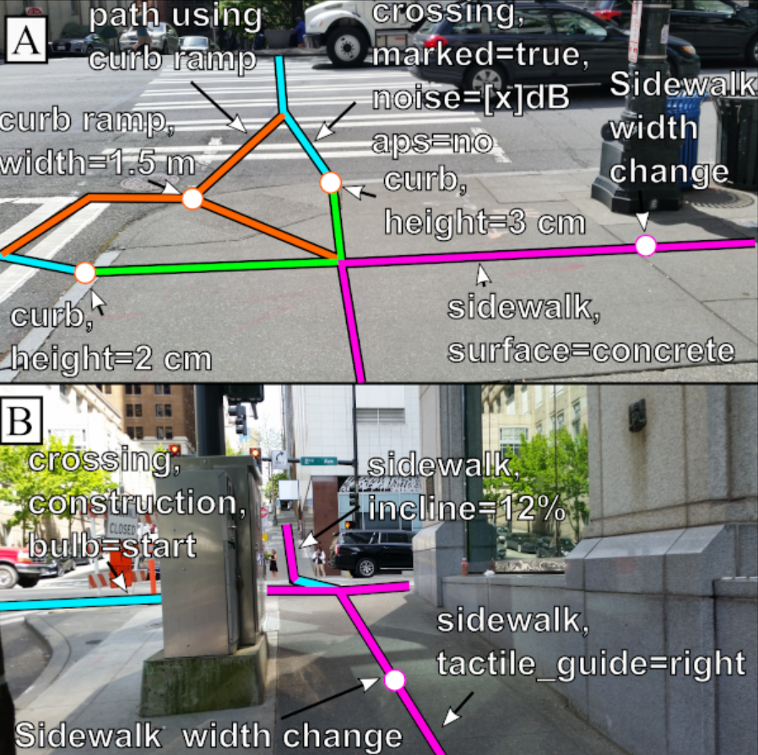

Slide 34
Quiz 2

Slide 35
Agenda
The Bad
There is inherent bias in the data that underpins AI
The Good
AI provides a path for addressing extremely difficult problems
The Impact
What does this mean for jobs, for art,
for society

Slide 36
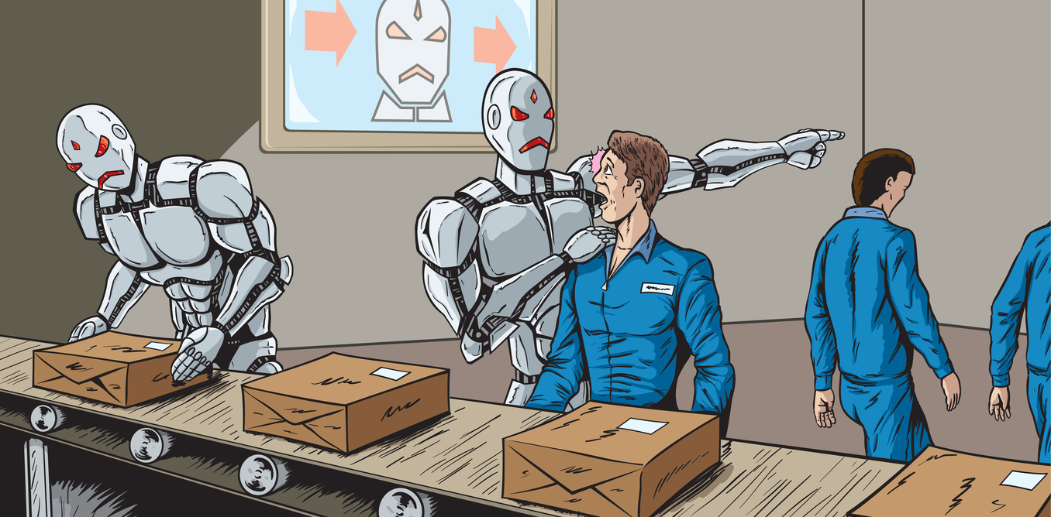

Slide 37
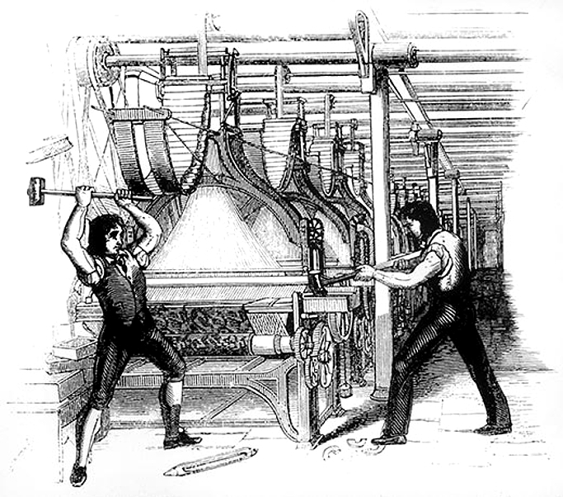

Slide 38
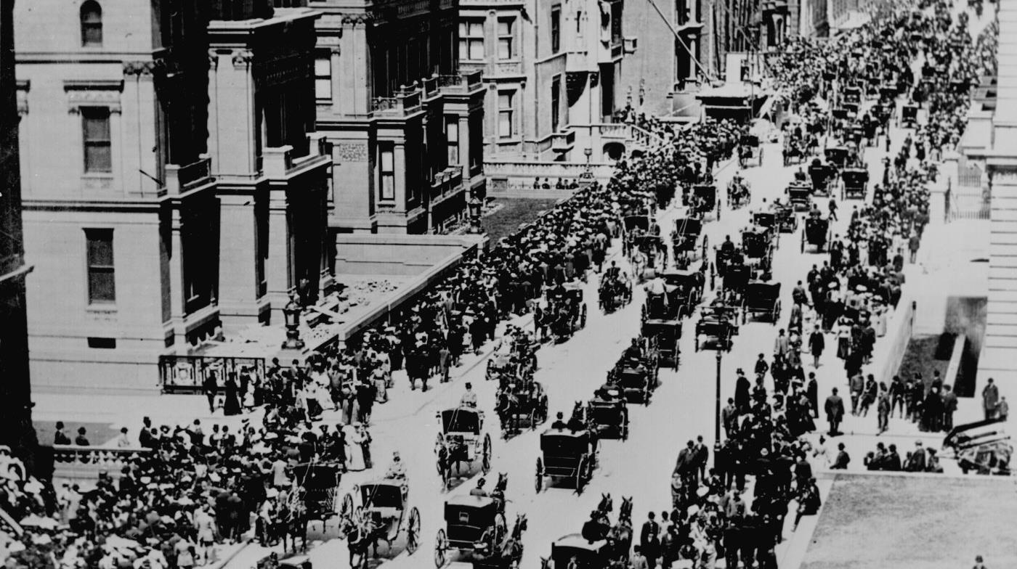

Slide 39
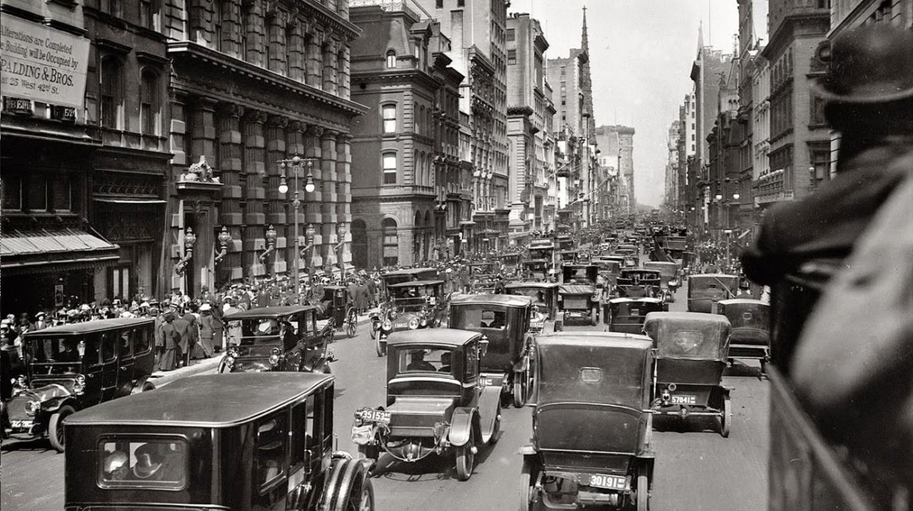

Slide 40
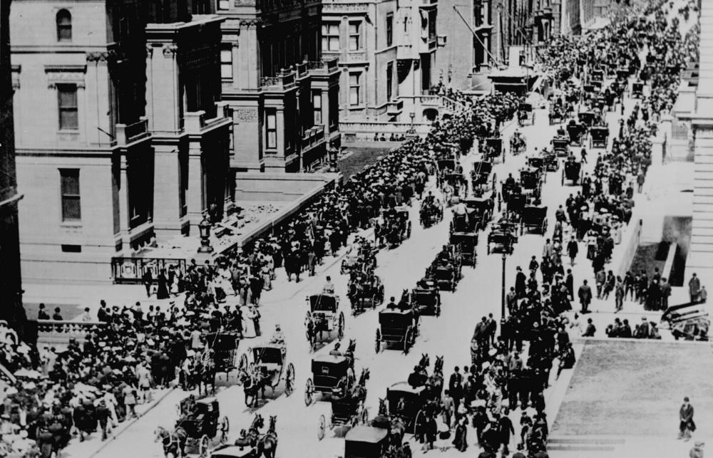
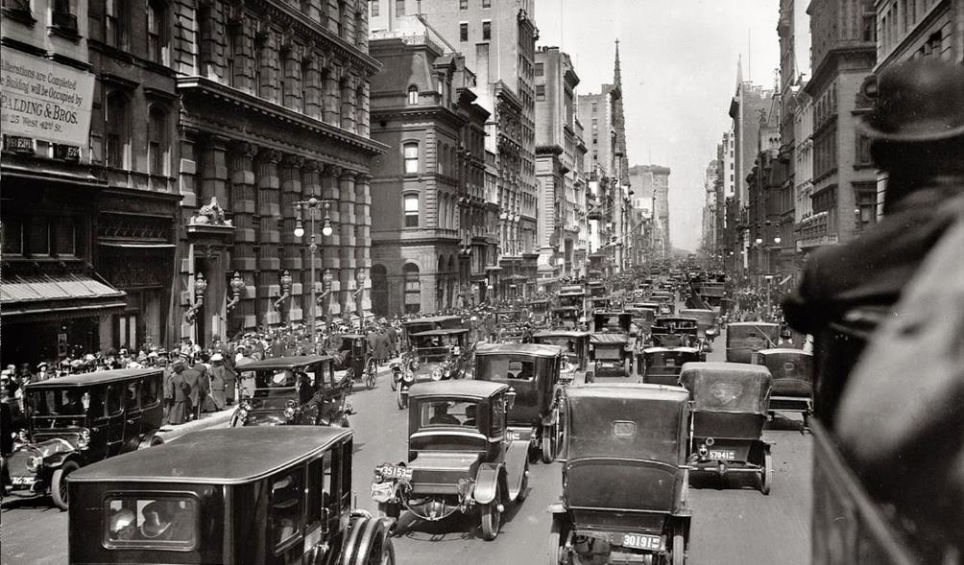

Slide 41
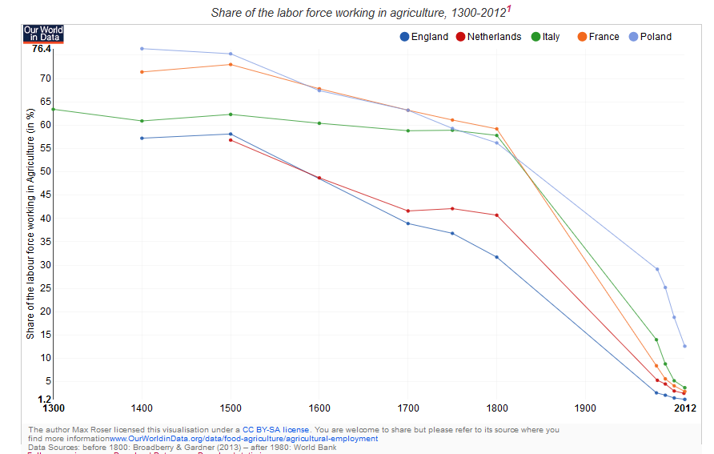

Slide 42
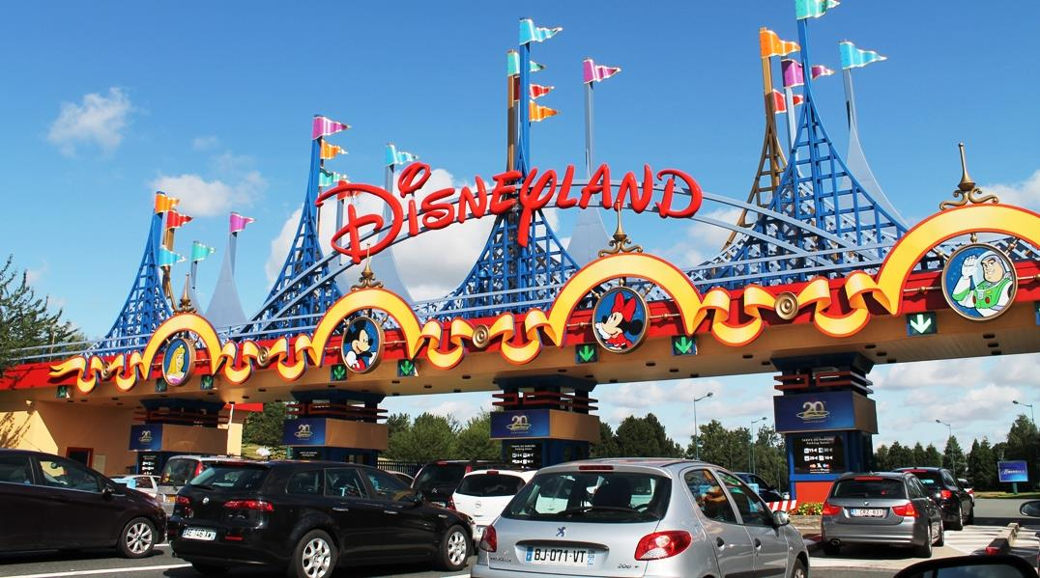

Slide 43
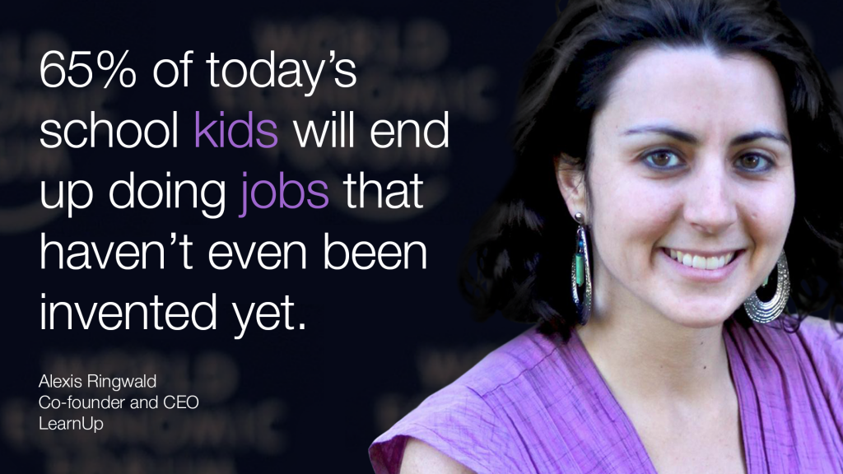

Slide 44
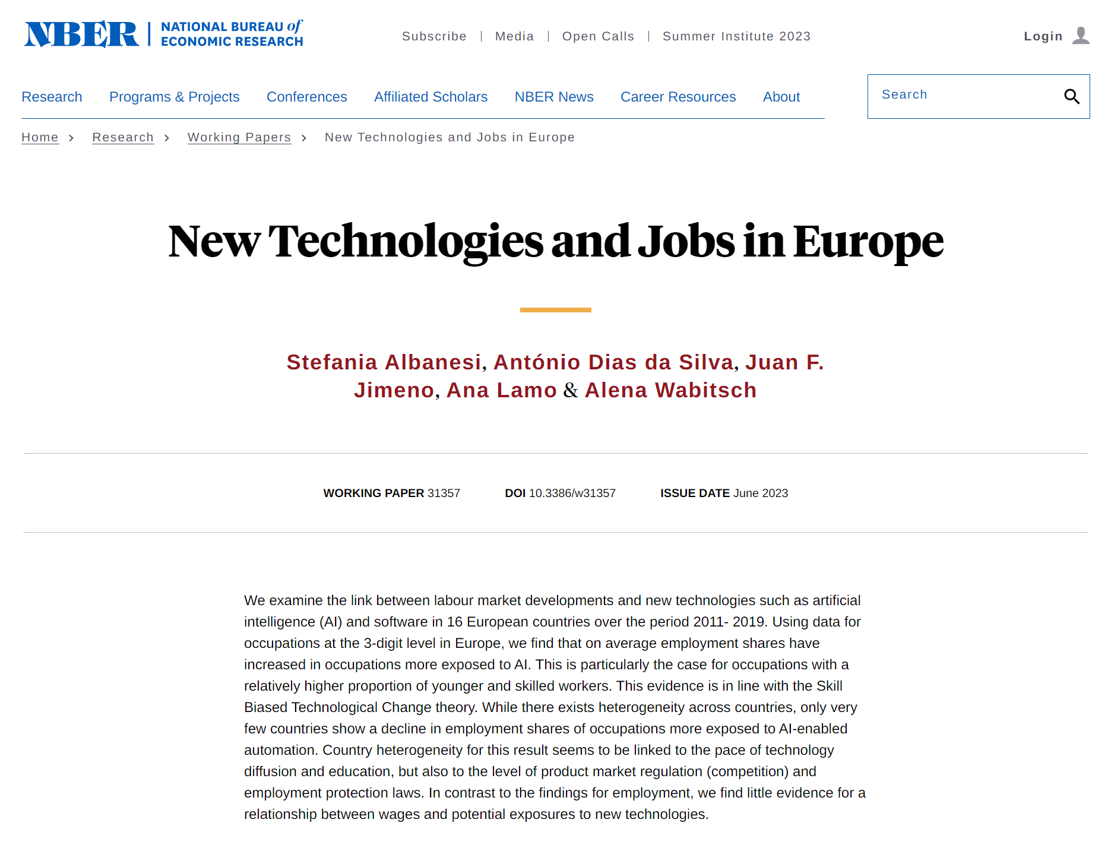

Slide 45
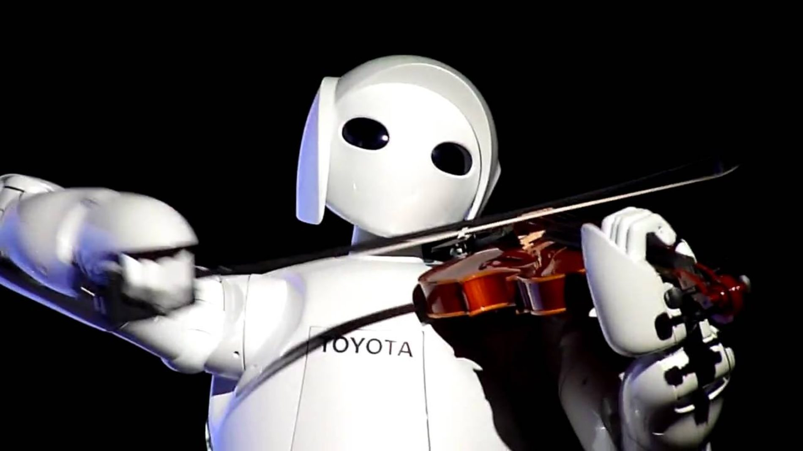

Slide 46
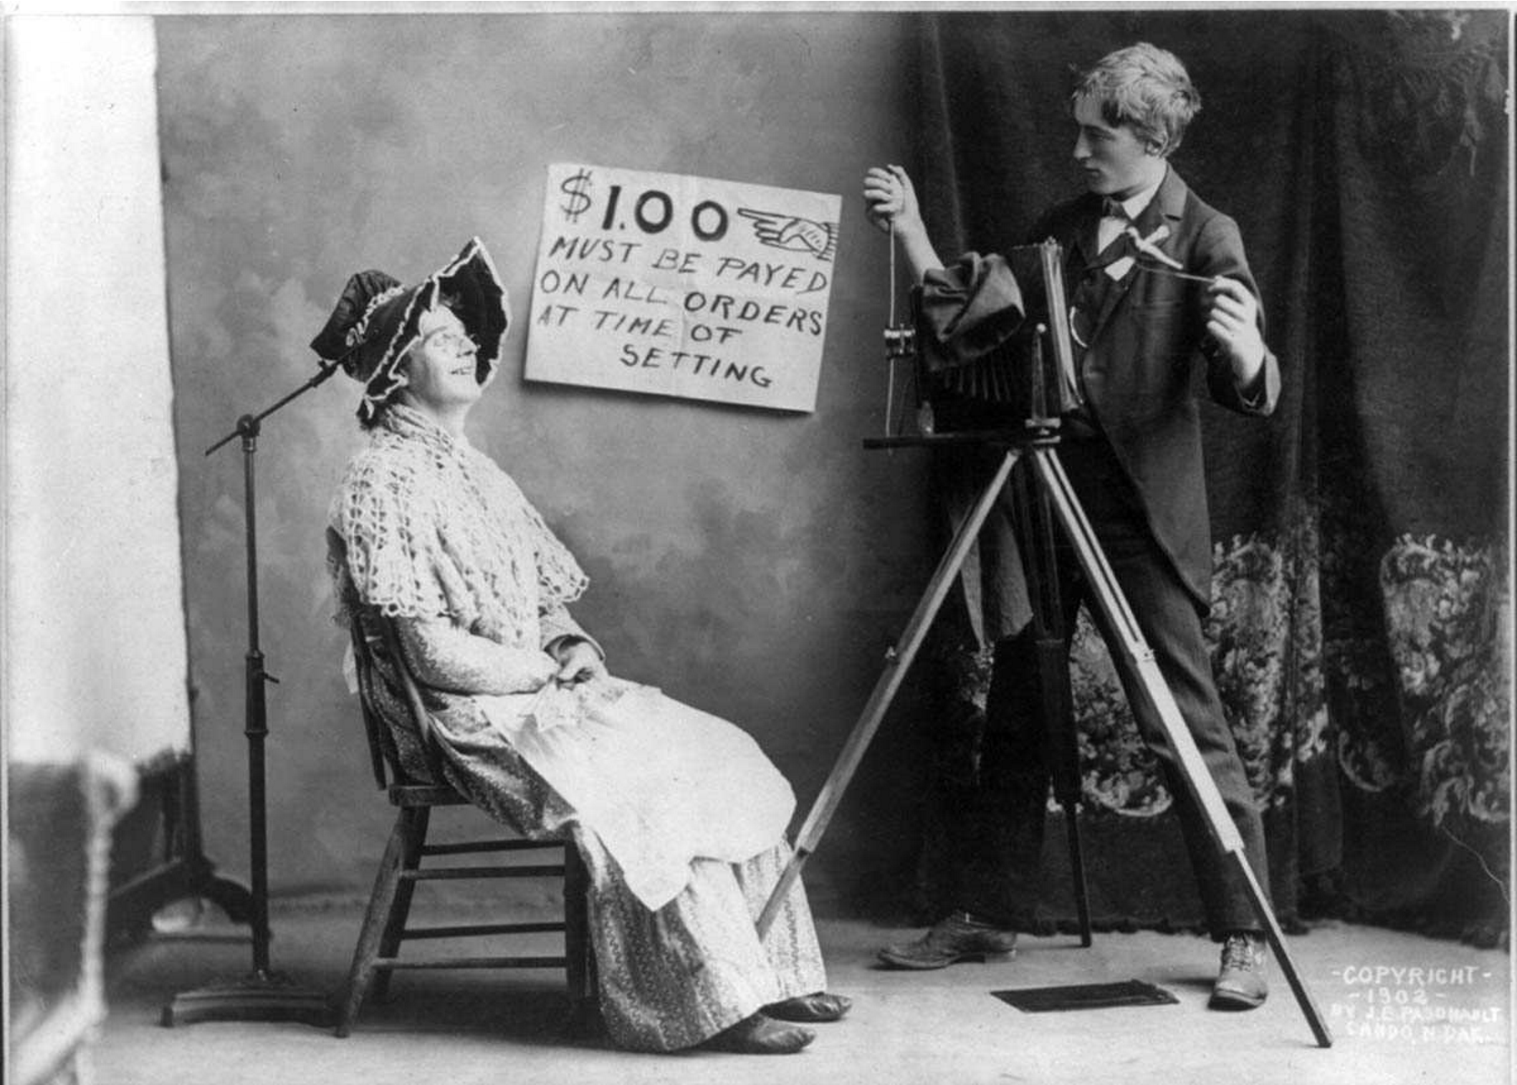

Slide 47
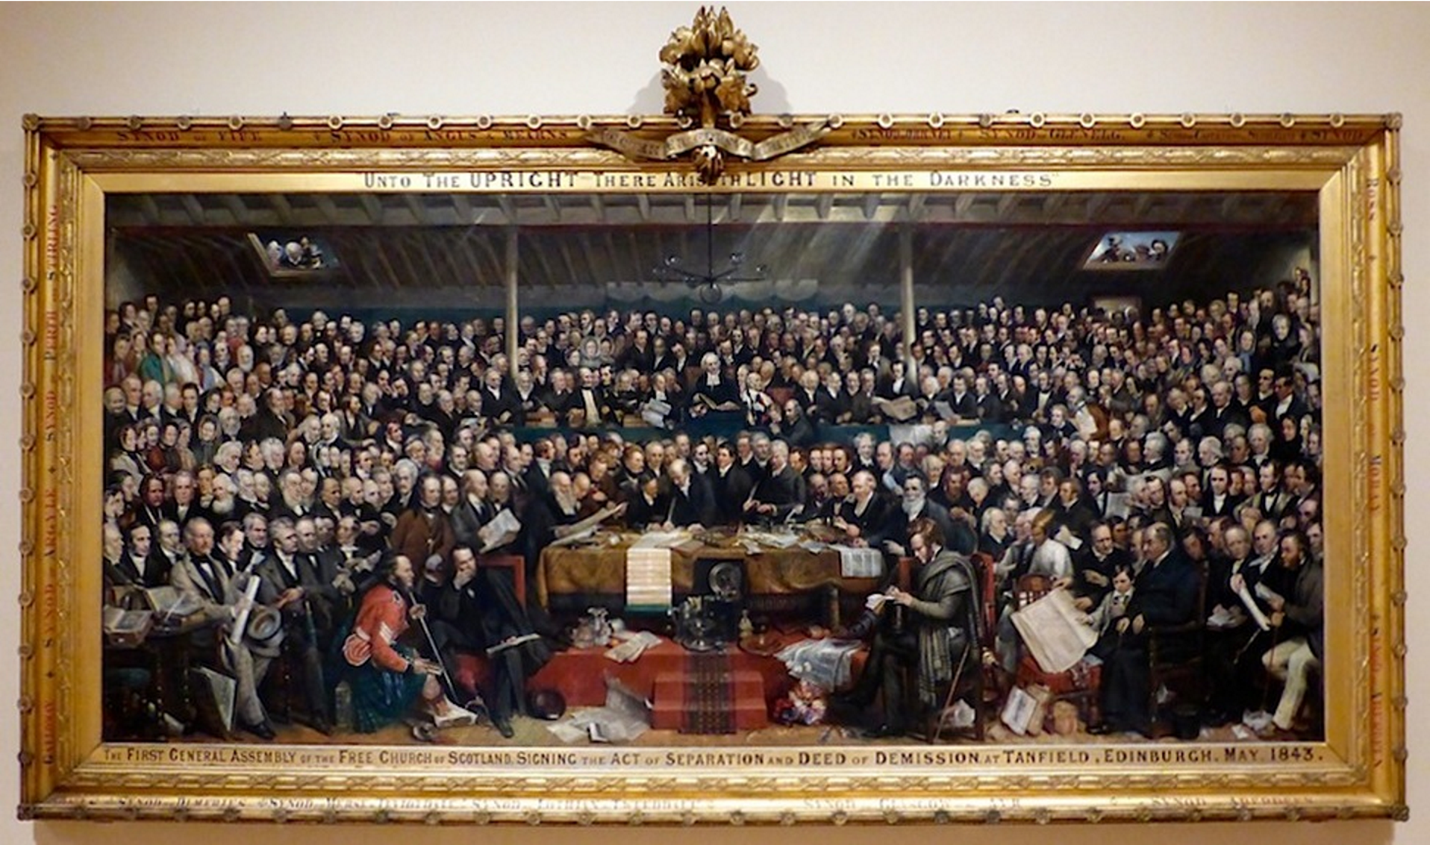

Slide 48
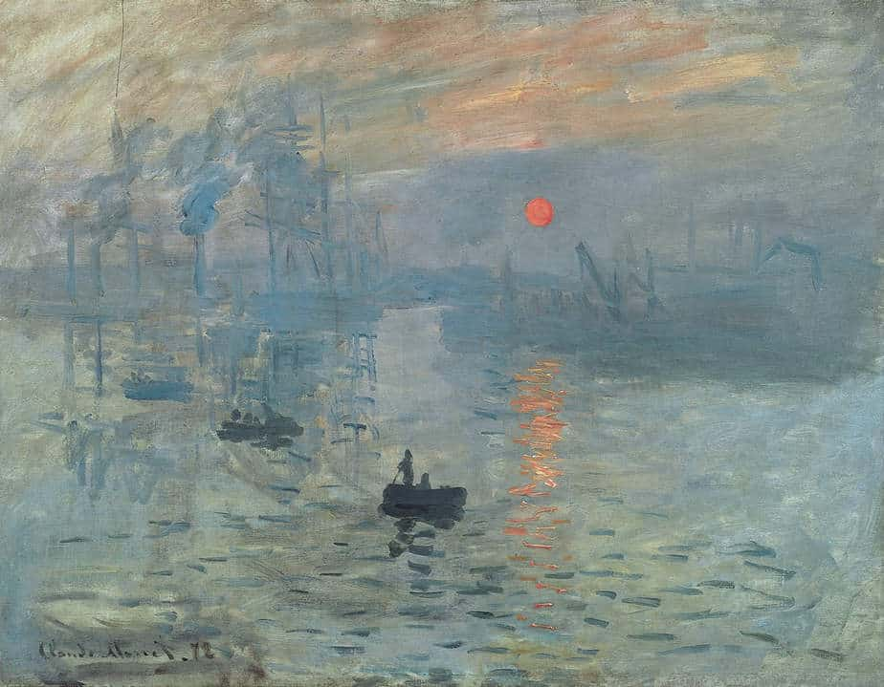

Slide 49
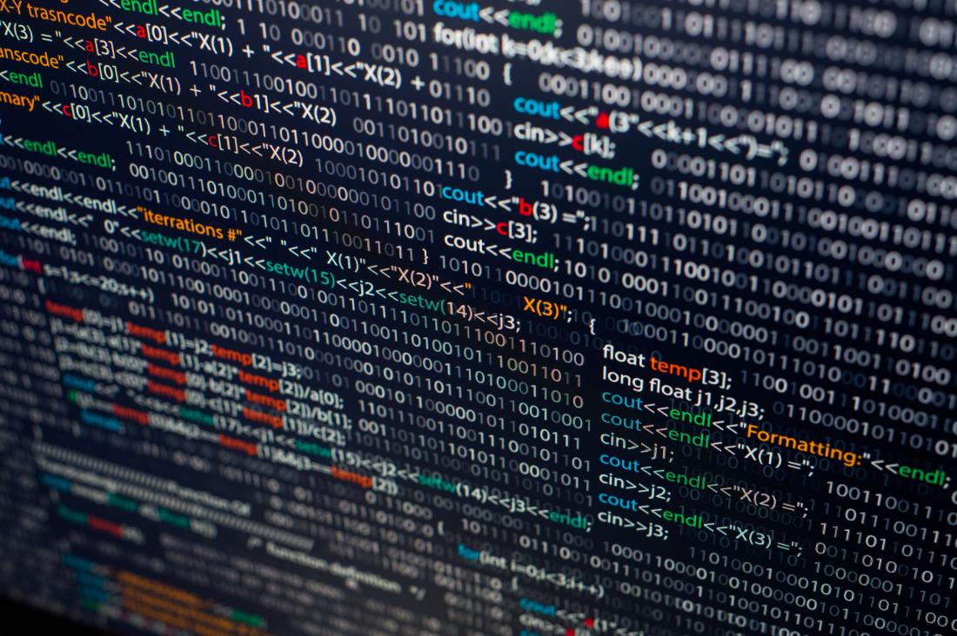

Slide 50
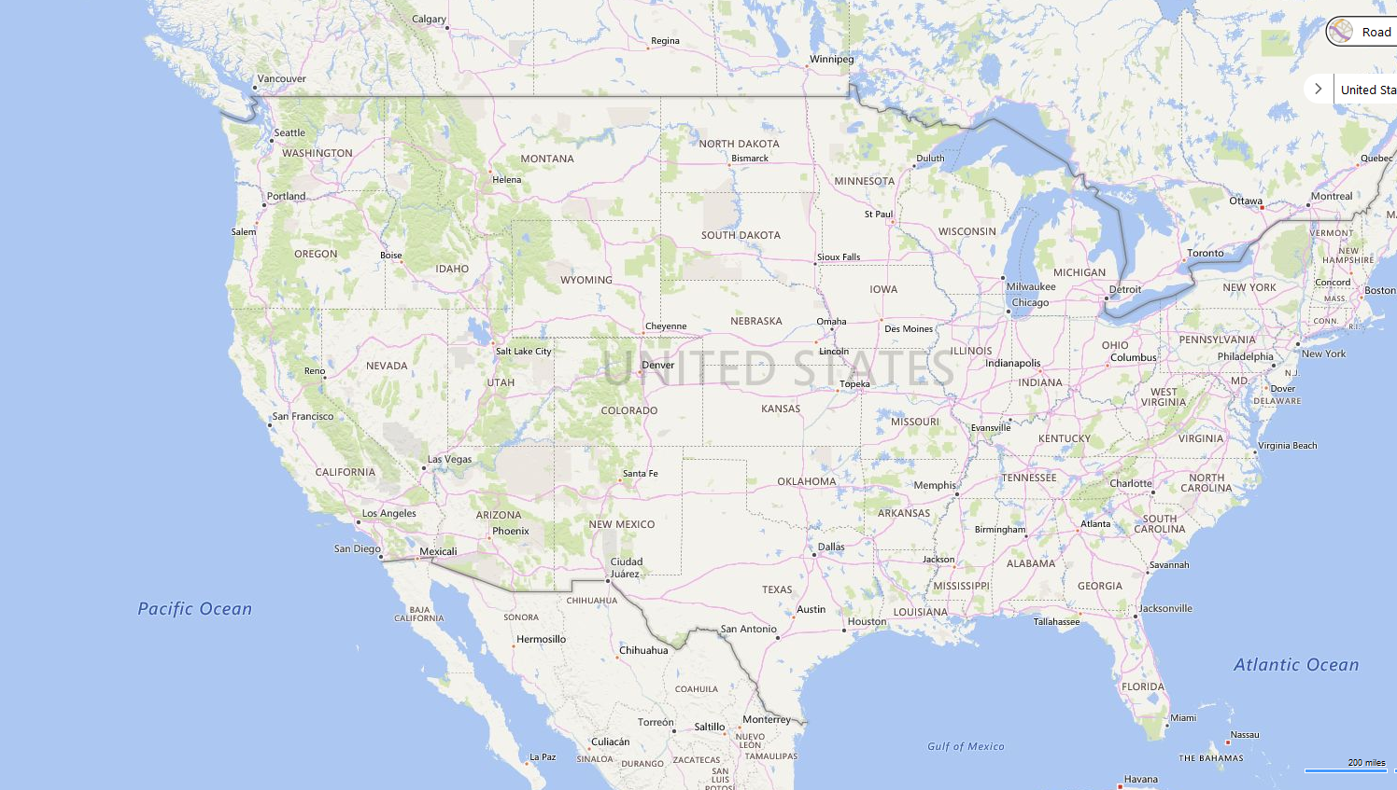






Slide 51
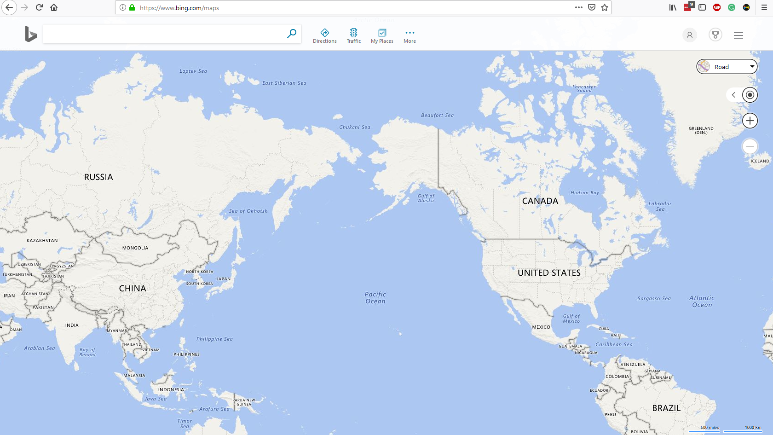

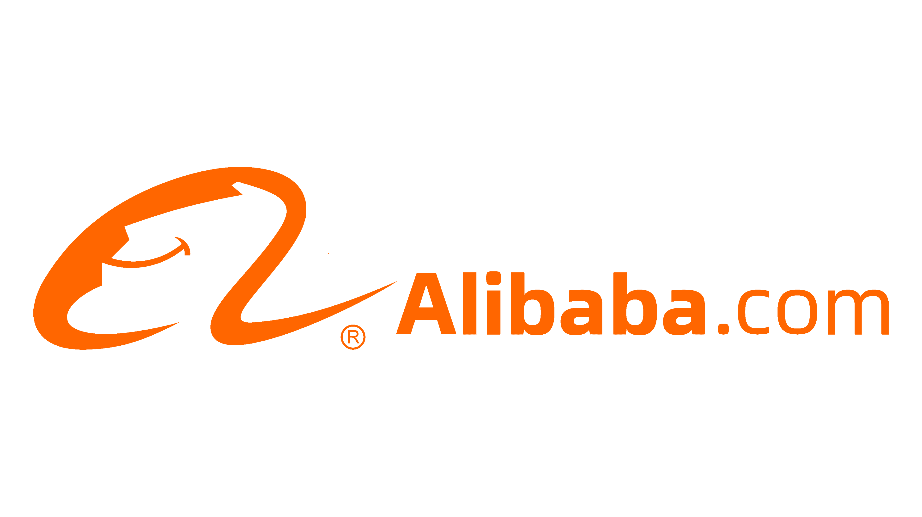
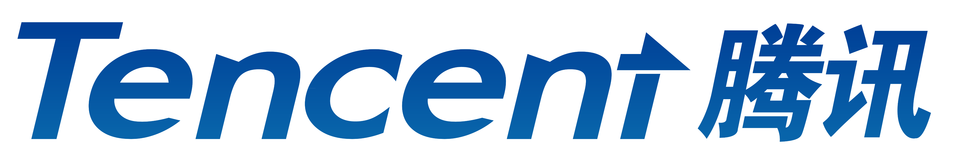

Slide 52
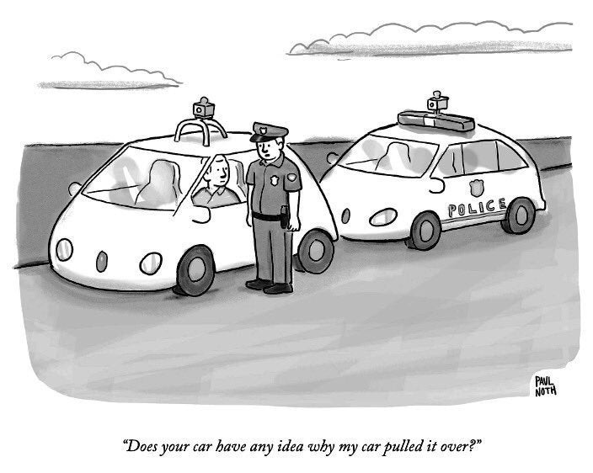

Slide 53
San Francisco 2023
AI Robotics Youth Program
g
AI:
The Good,
The Bad, & The Impact on
Society
Scott Mauvais
scott@mauvais.com
www.mauvais.com/talks

