Slide 1
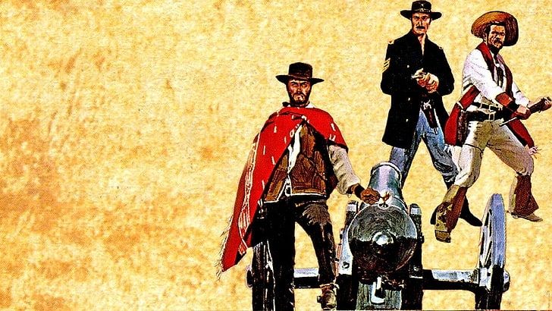
SF Tech Week 2023
AI:
The Good,
The Bad
& The Ugly
Scott Mauvais
scott@mauvais.com
www.mauvais.com/talks
May 11, 2023

Slide 2

Agenda
The Bad
There is inherent bias in the data that underpins AI
The Good
AI provides a path for addressing extremely difficult problems
The Ugly
The biggest risks for AI aren’t technical, they are social

Slide 3
The Bad

Slide 4

Reality is biased

Slide 5
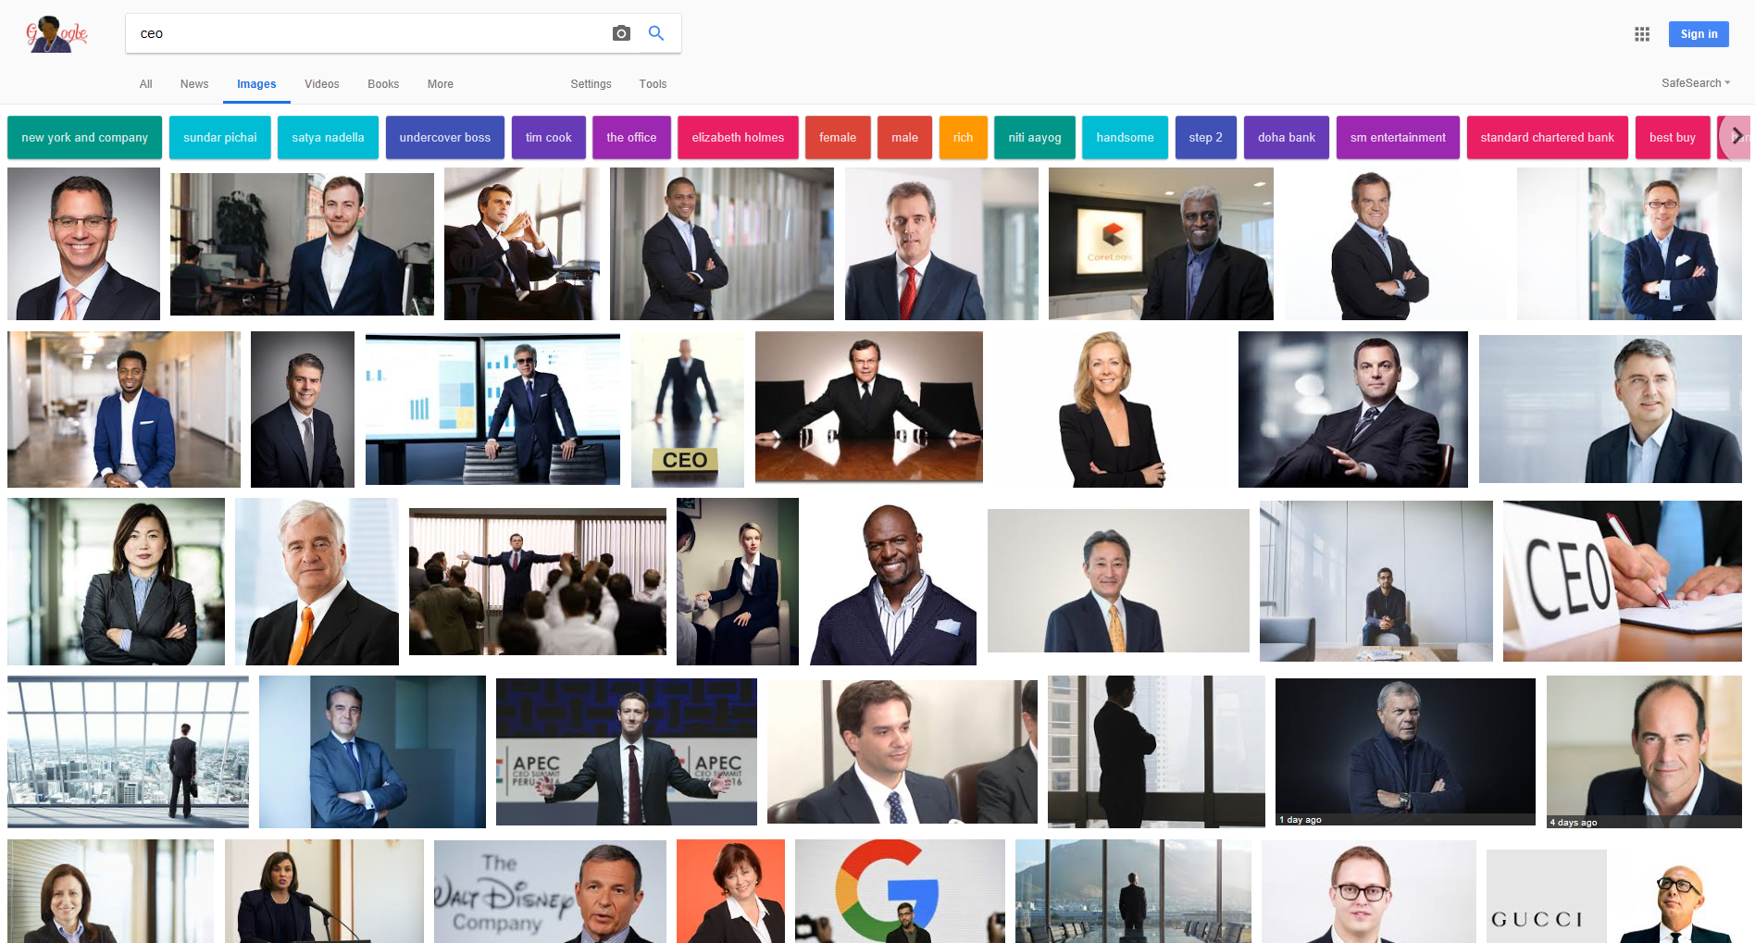

Slide 6
Percentage of Fortune 500 CEOs

Slide 7
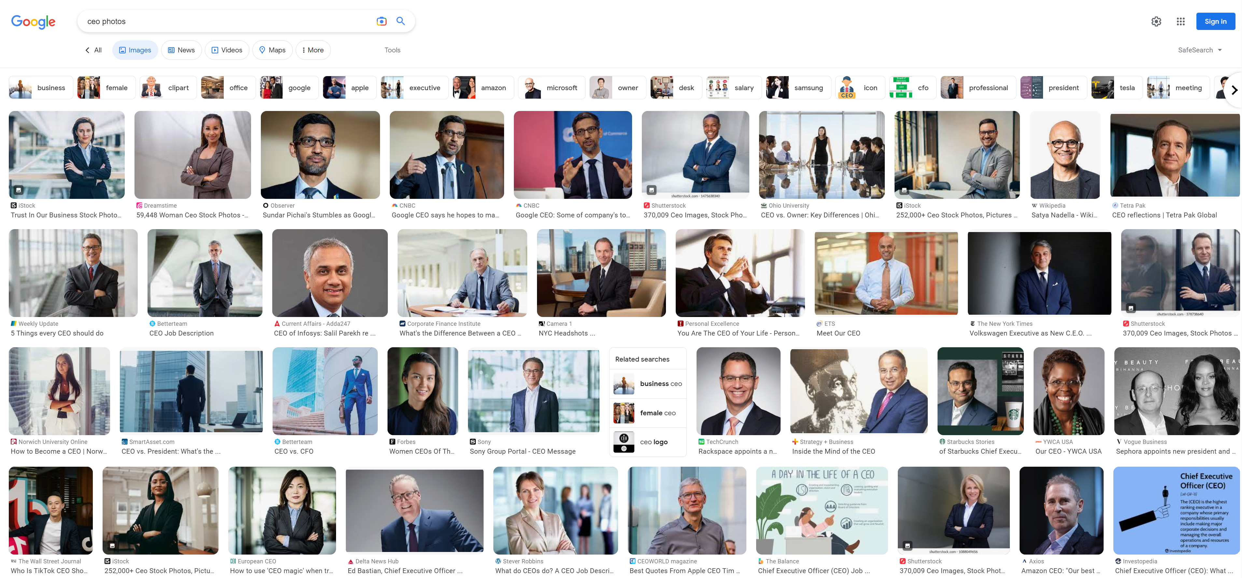
Search Engines Curating Results (2023)

Slide 8
Search Engines Curating Results (2023)

Slide 9
Data voids create bias

Slide 11
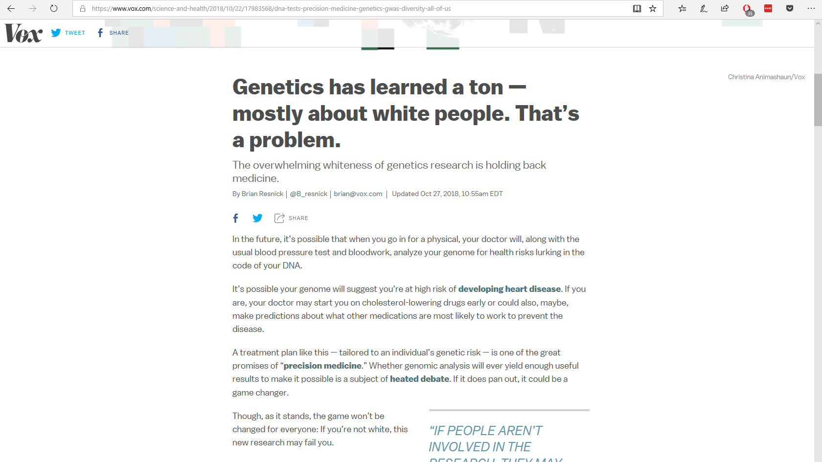

Slide 12
Training data is biased

Slide 13
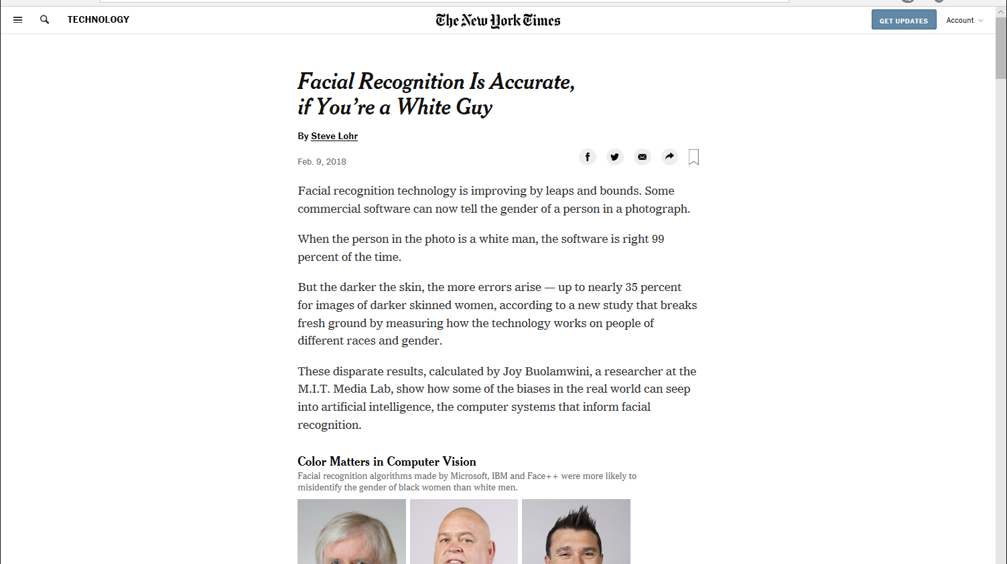

Slide 14
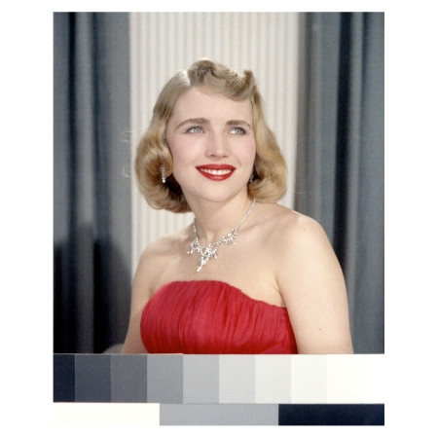
Meet Shirley

Slide 15
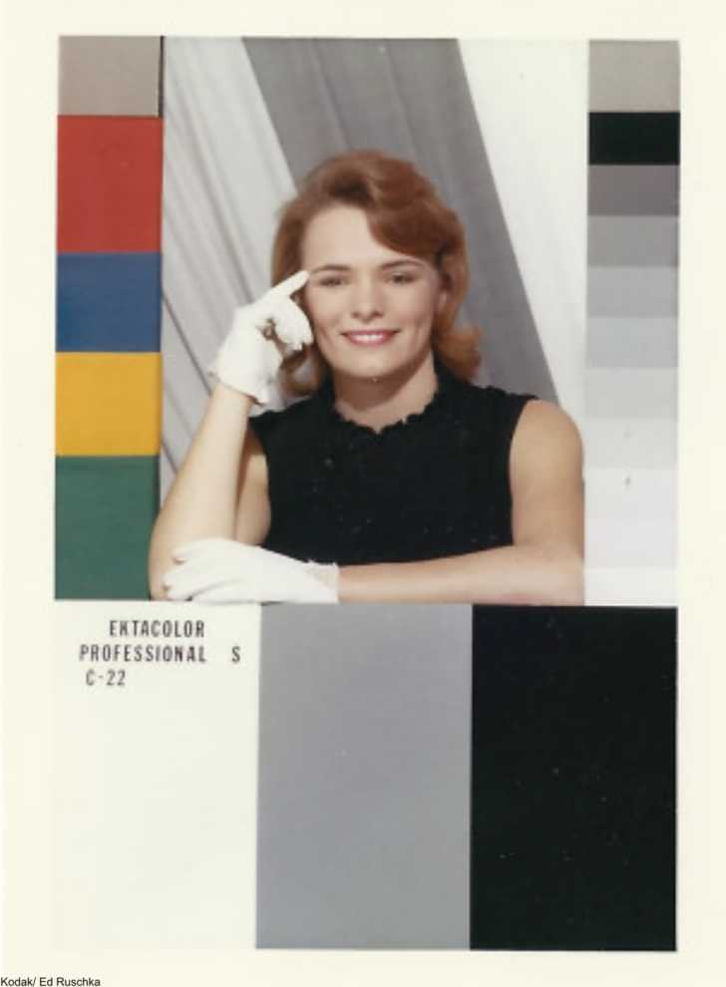
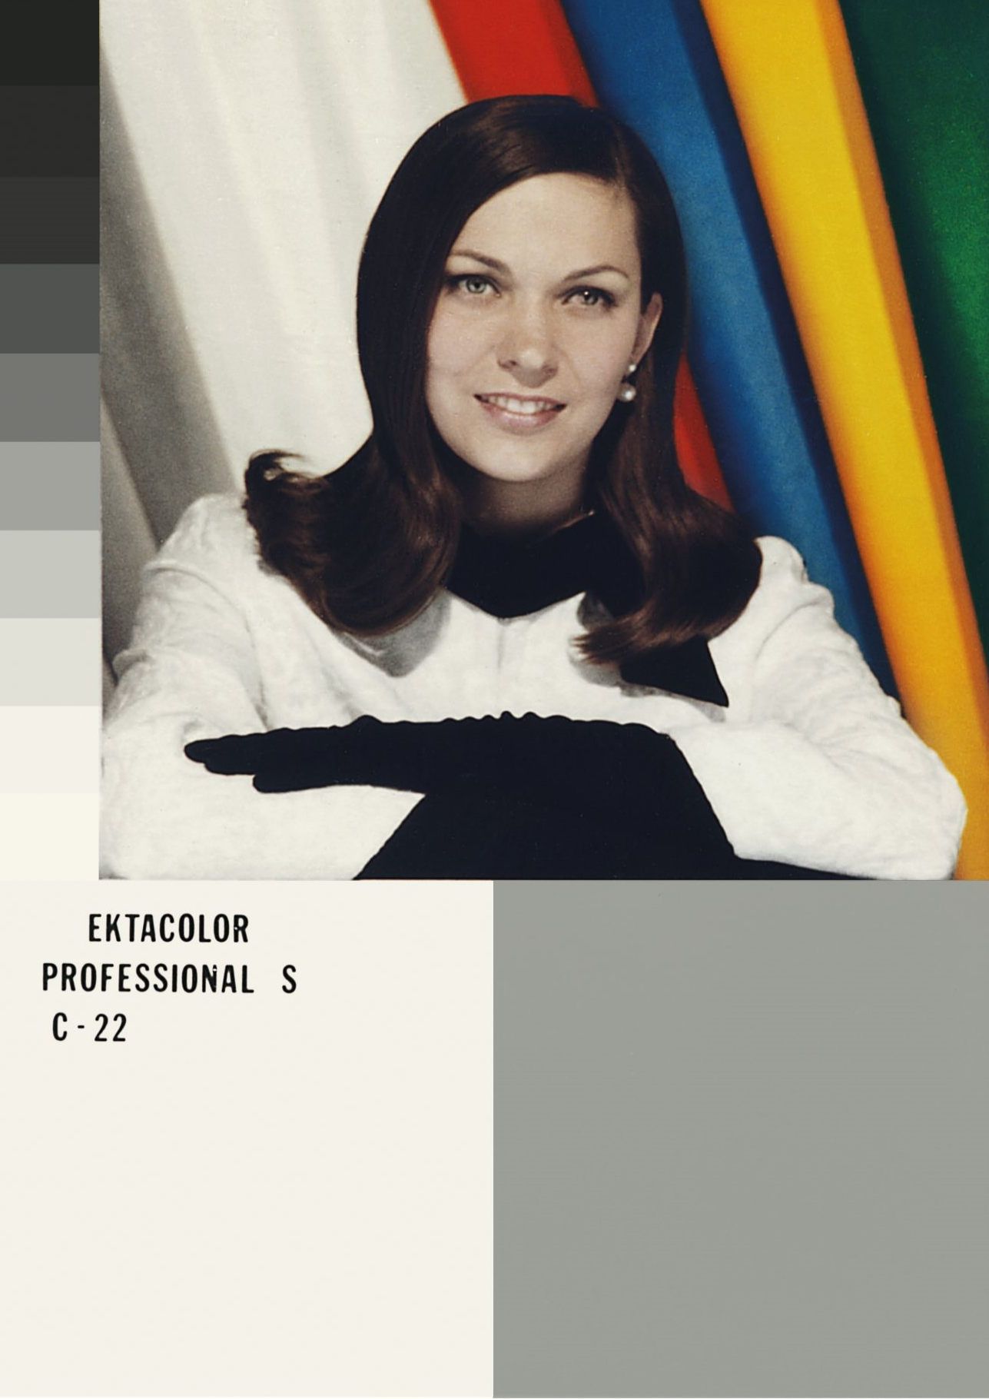
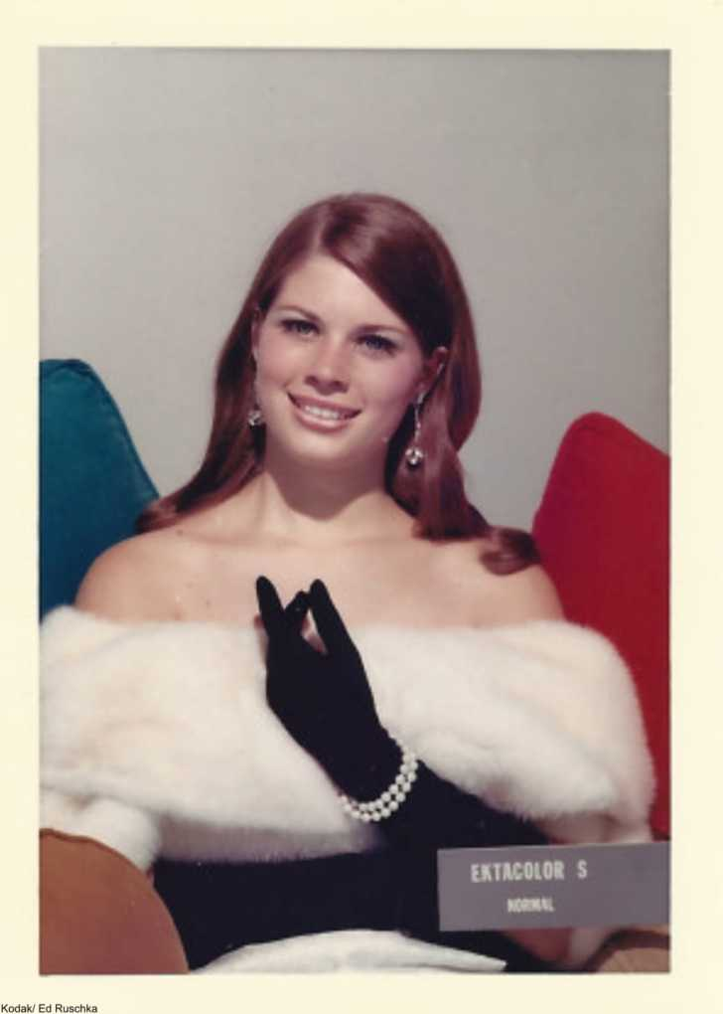
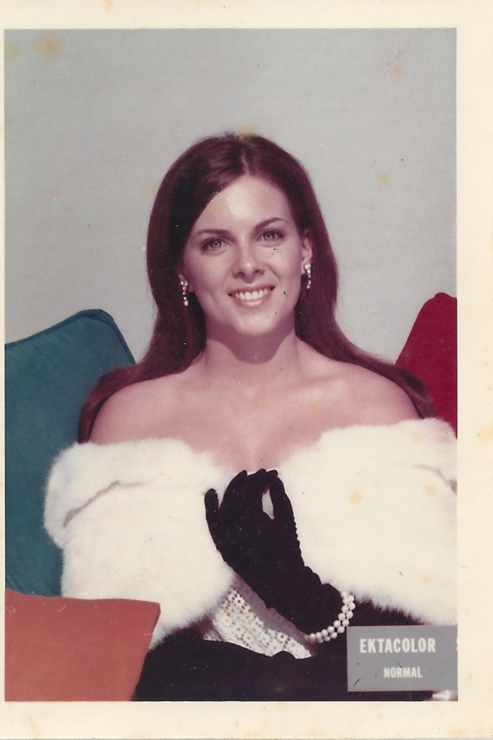
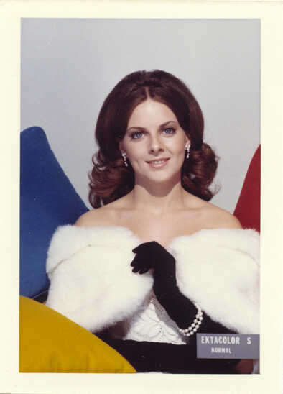
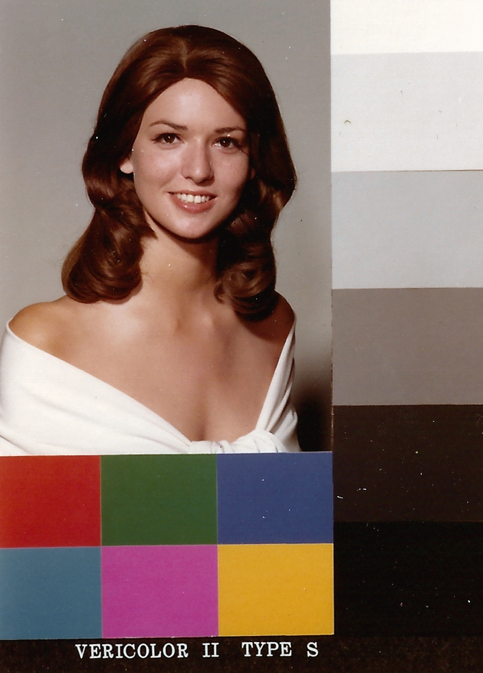
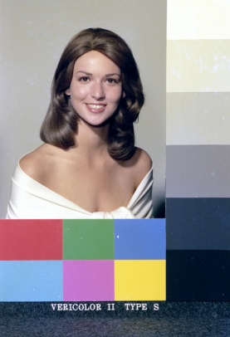
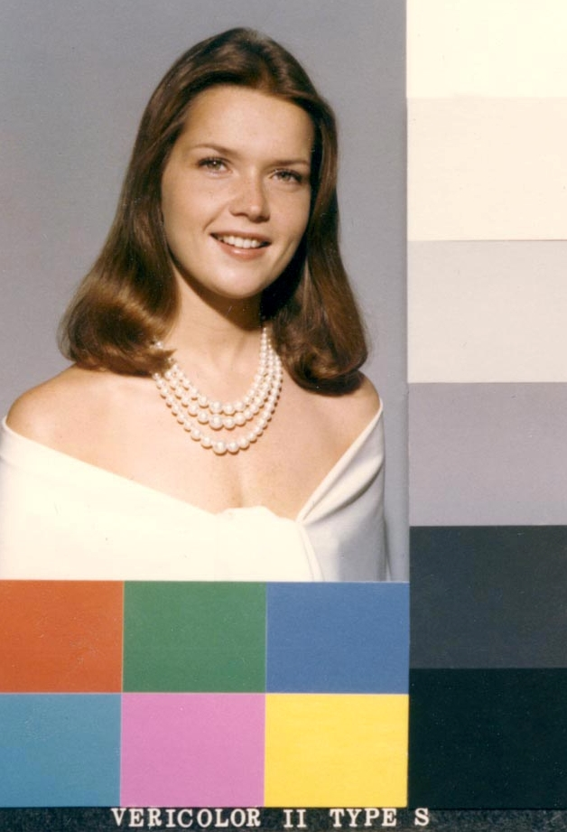

Slide 16
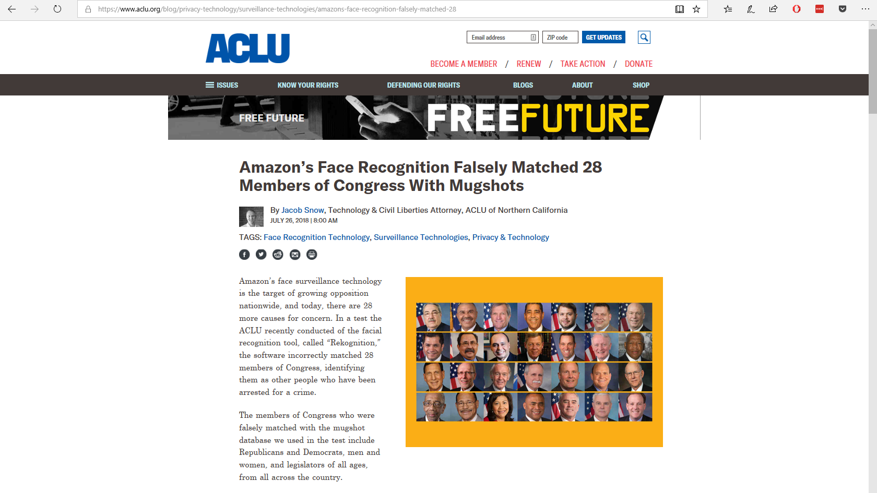

Slide 17
More than just biased data

Slide 18
It is us
We are biased

Slide 19
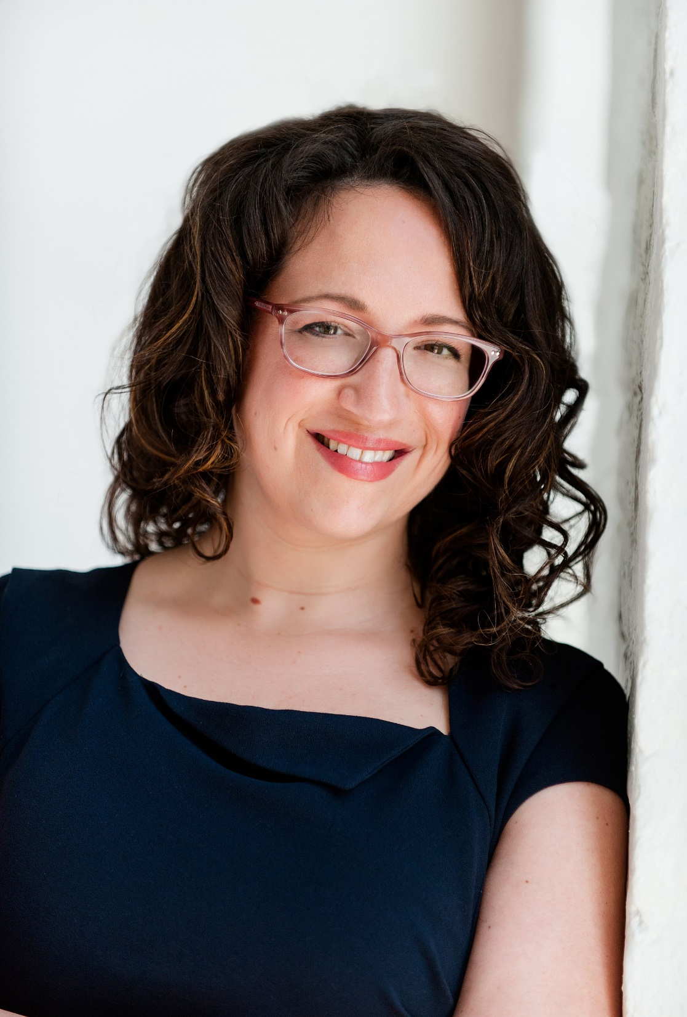
We are AI’s study-buddy and we are teaching all our misogyny and hatred
—Amy Webb

Slide 20

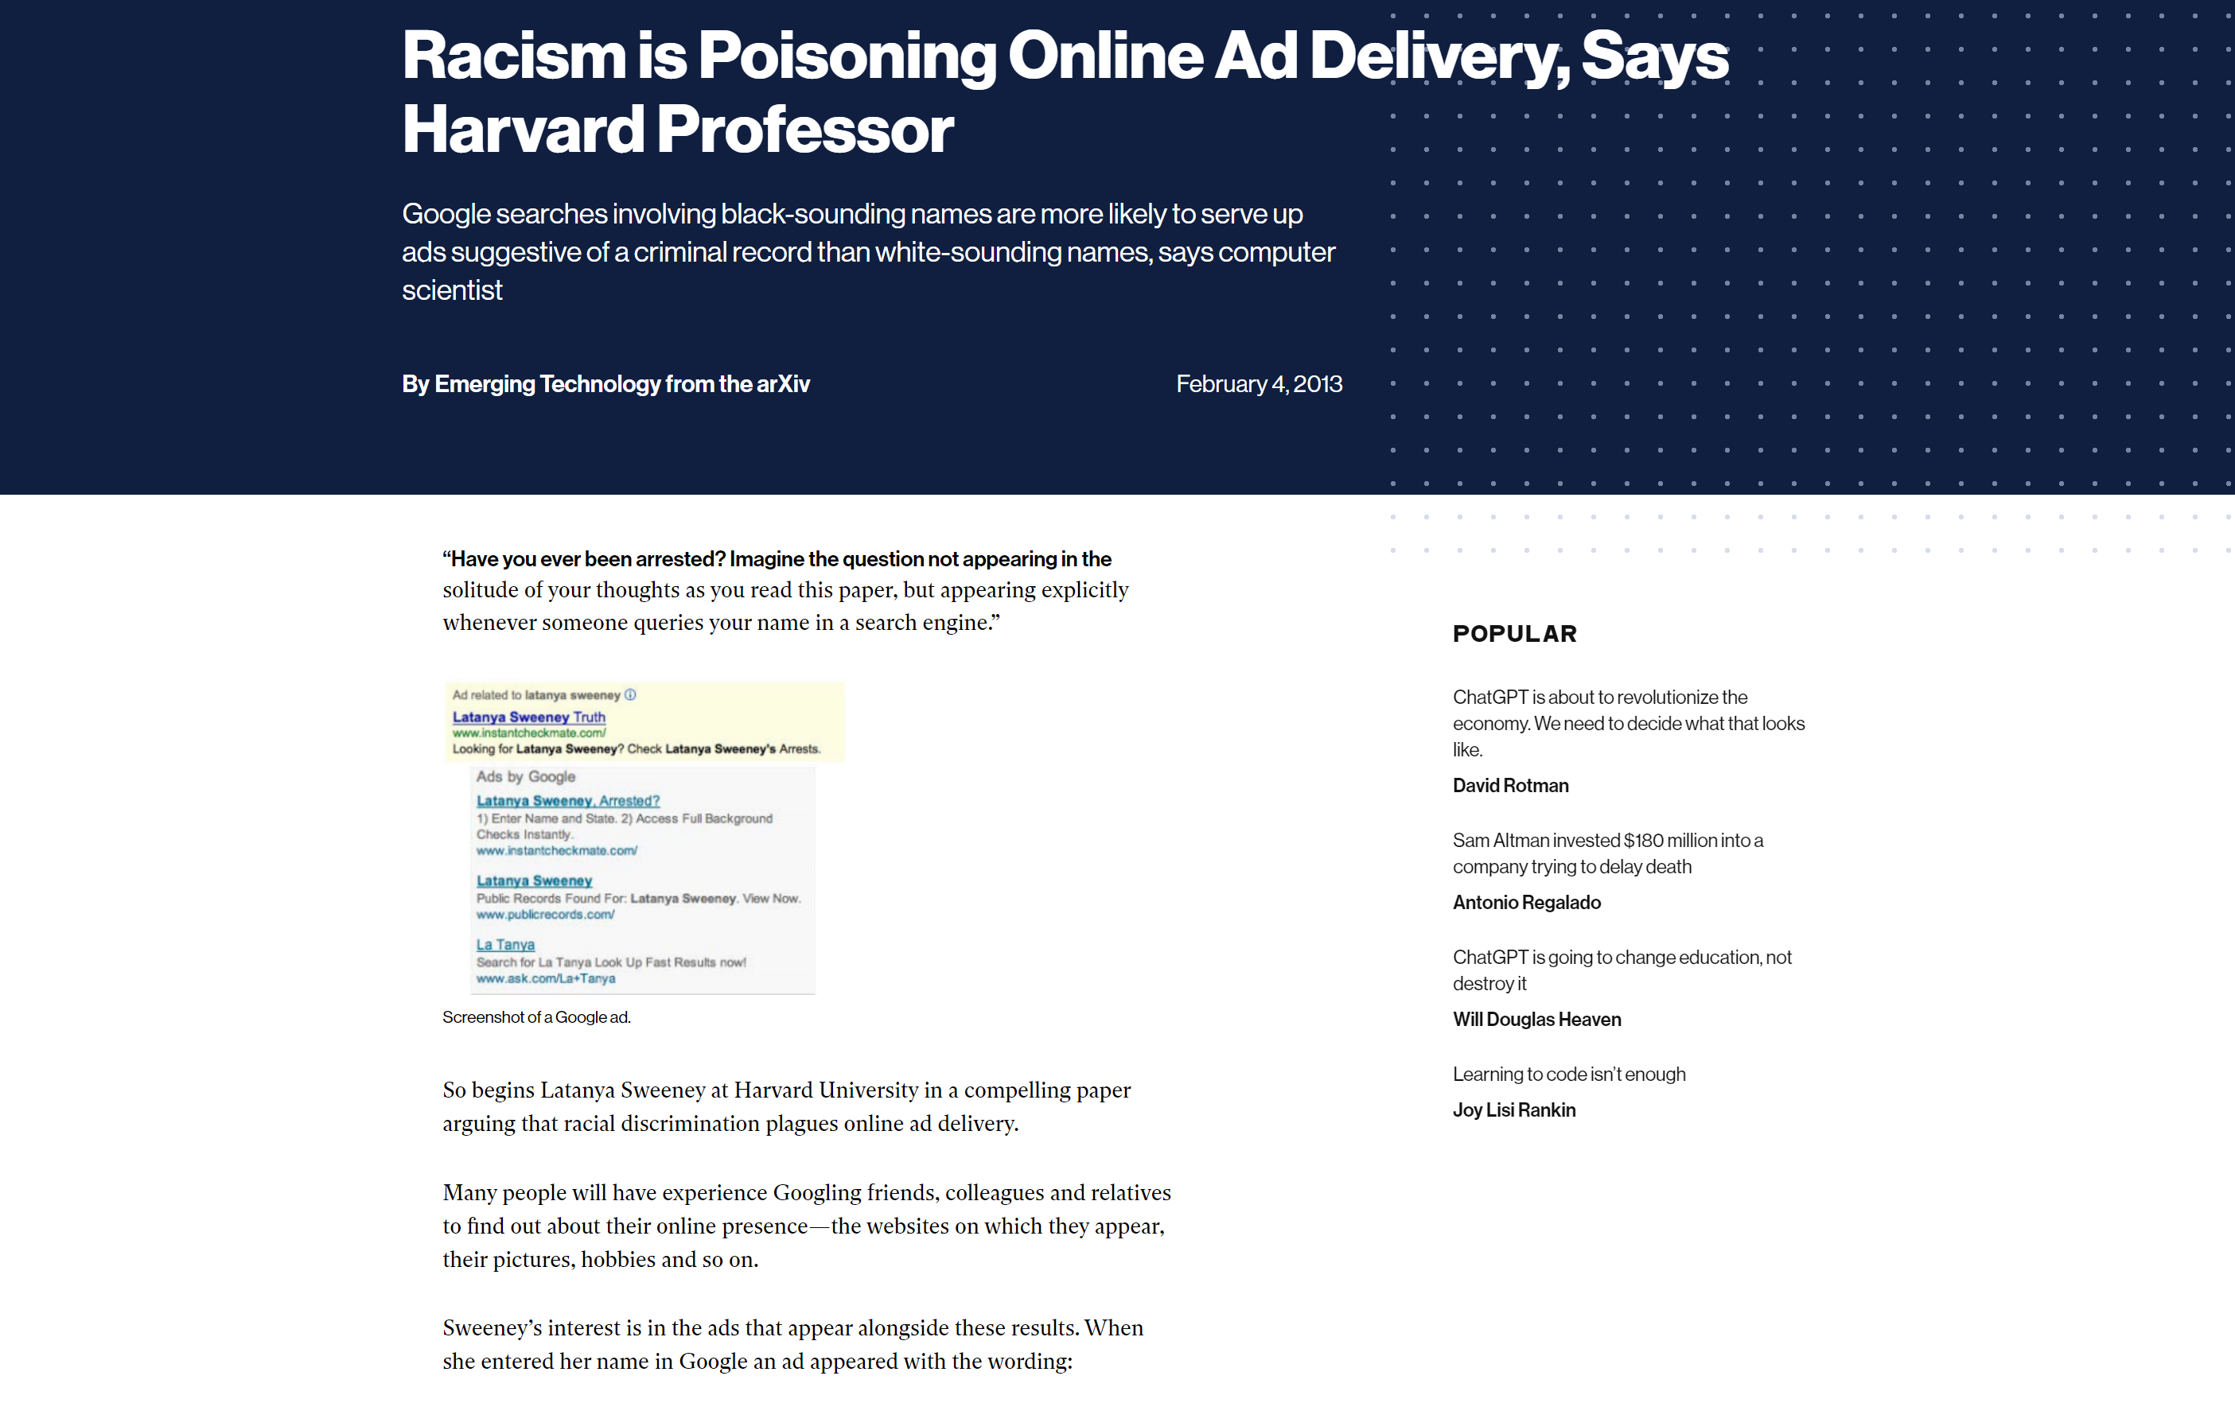

Slide 21

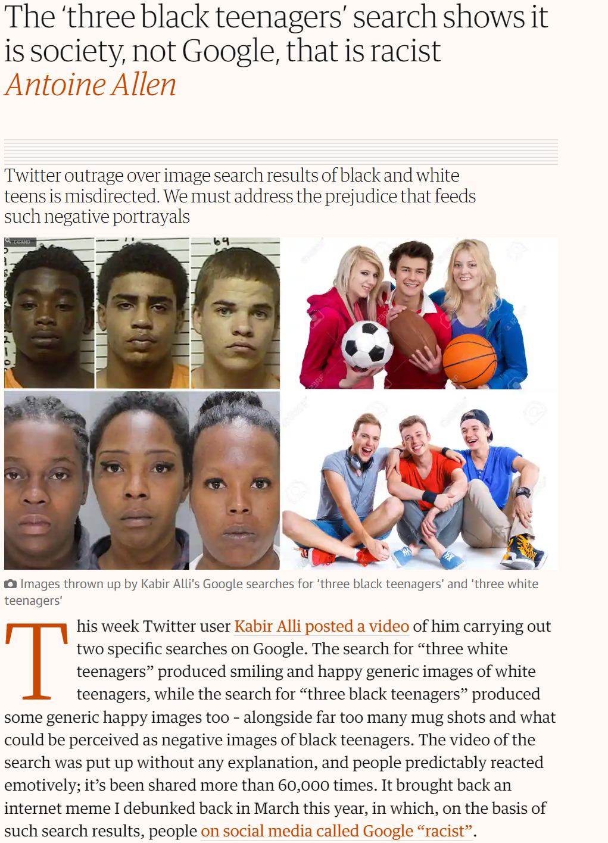

Slide 22
Bias in AI is fixable
(I’m not so sure about human bias)

Slide 23
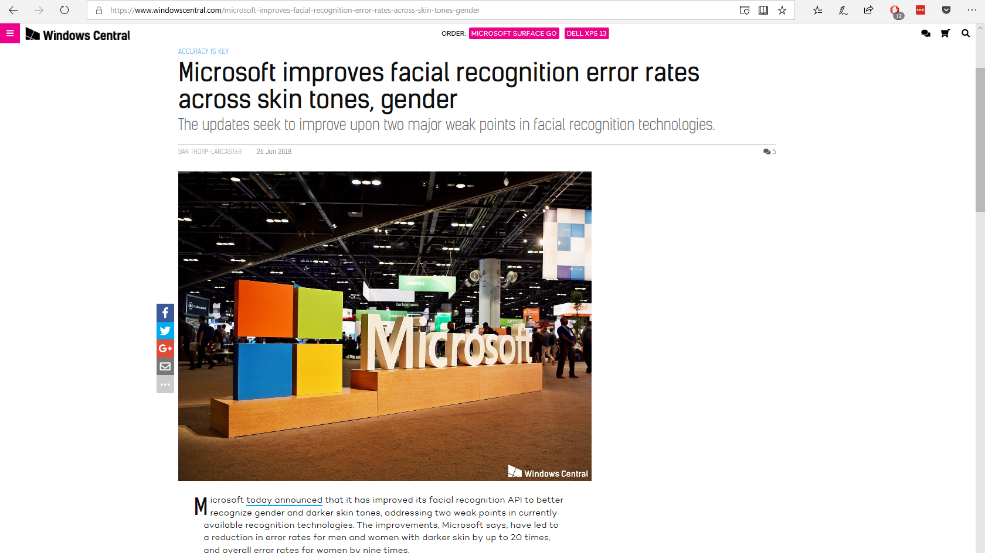

Slide 24
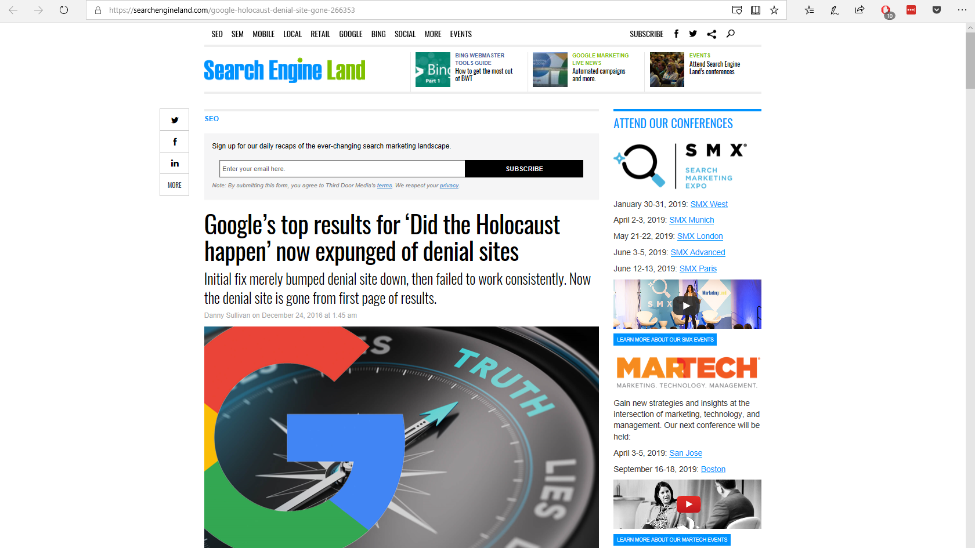

Slide 25
The Good

Slide 26







Illegal Fishing is threatening our oceans
80%
THE OCEAN PRODUCES
OF ALL LIFE ON
EARTH DWELLS
IN THE OCEAN
OVER
HALF
THE OCEAN IS CRUCIAL TO THE CARBON CYCLE, AND REGULATES OUR WEATHER AND CLIMATE
OF THE OXYGEN
WE BREATHE
3
THE OCEAN PROVIDES FOOD SECURITY FOR
BILLION PEOPLE
AND THE LIVELIHOOD OF
12%
OF THE WORLDS POPULATION

Slide 27
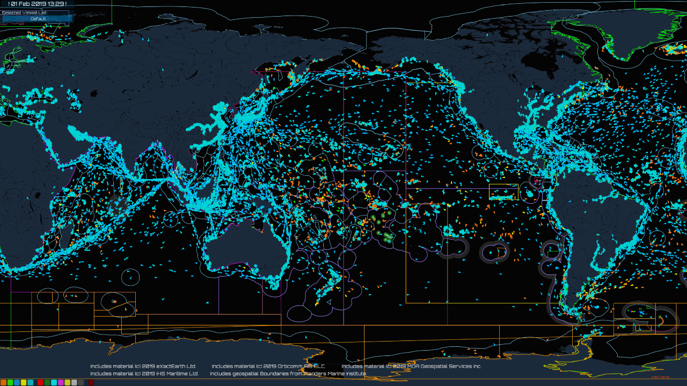

Slide 28















How OceanMind Works
Satellite
Observations
Web
Portal
Vessel Identity
Artificial
Authorities
Vessel Tracking
Intelligence
?
Regulations
Local
Information
Actionable
Insights
Seafood Buyers

Slide 29
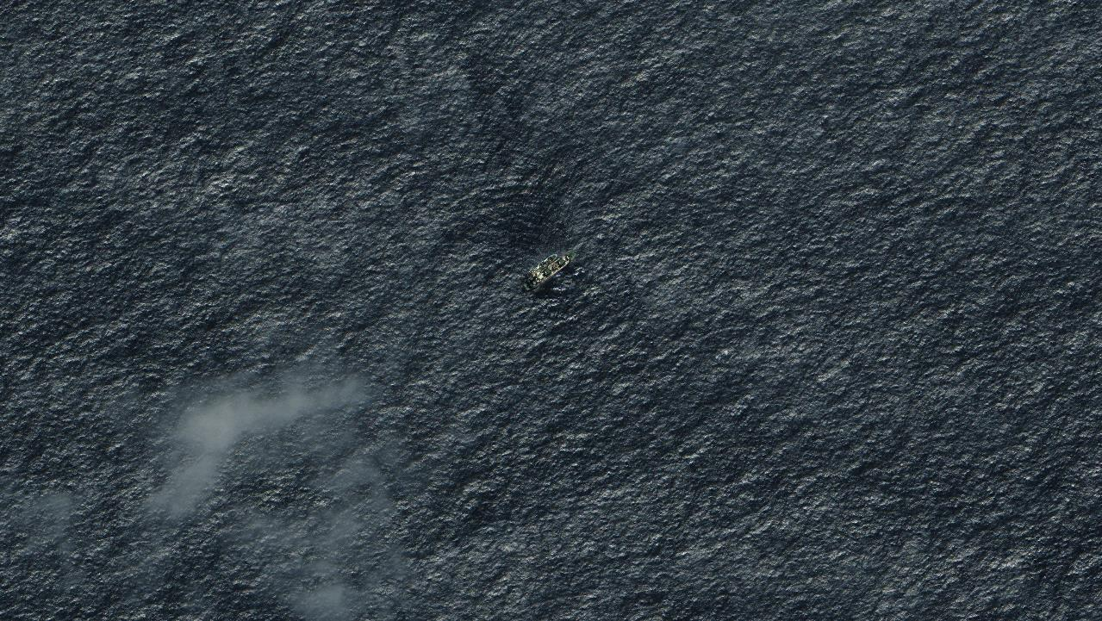
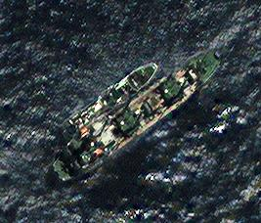
Image: © Digital Globe Inc, All Rights Reserved

Slide 30
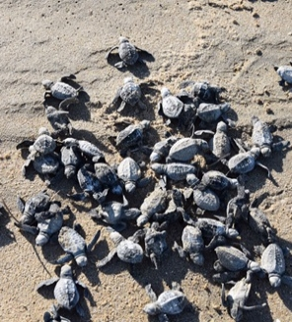
CASE STUDY: Australia, ANZ
Guidance for Field
Instructions Select regionally relevant case studies from appendix to add to the deck. Customize slide content for audience as needed. For latest case studies, visit Win Wire for complete list and description of S500 engagements.
CSIRO
Turtle conservation through AI
Partnered with Indigenous communities, nonprofits and private companies to reverse effects of predators on turtle populations.
AI-based solution is 90% accurate in analyzing tens of thousands of images every month.
The partnership has reduced the loss of turtle hatchlings from 100% to 30%.

Slide 31

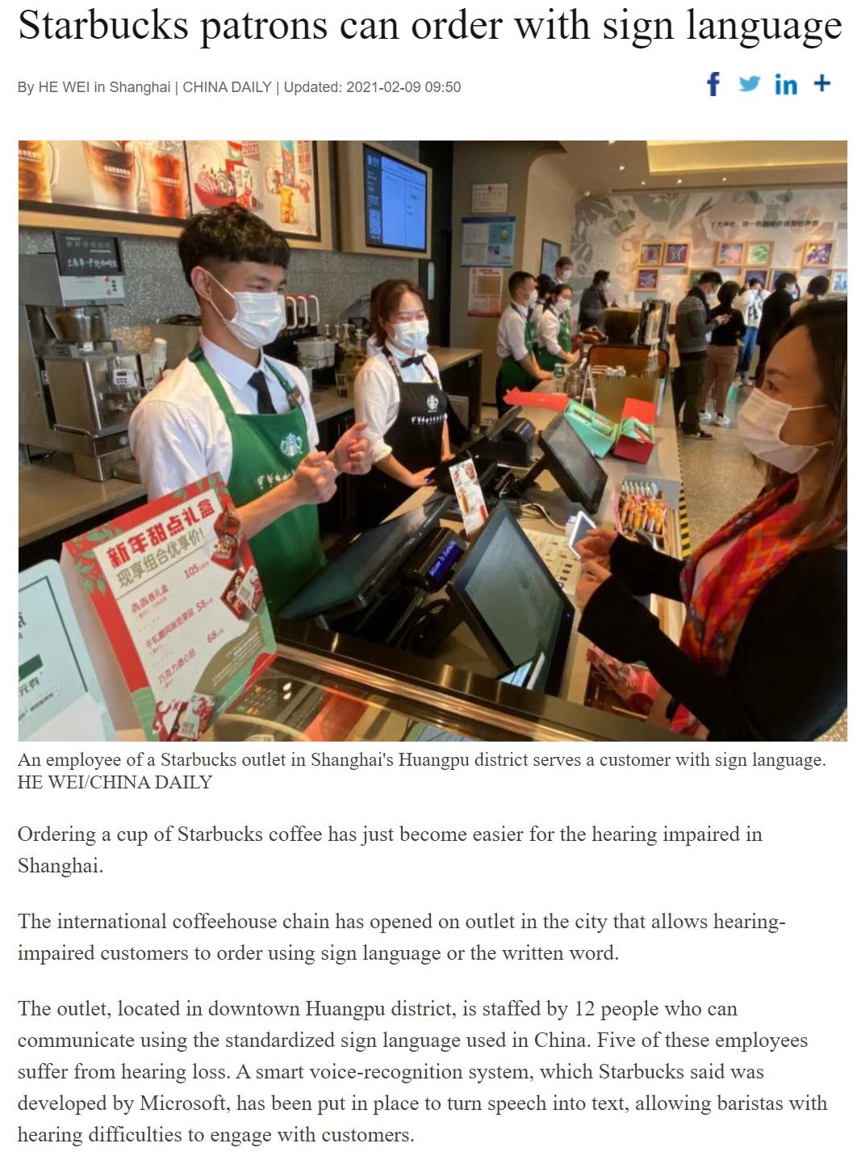

Slide 32
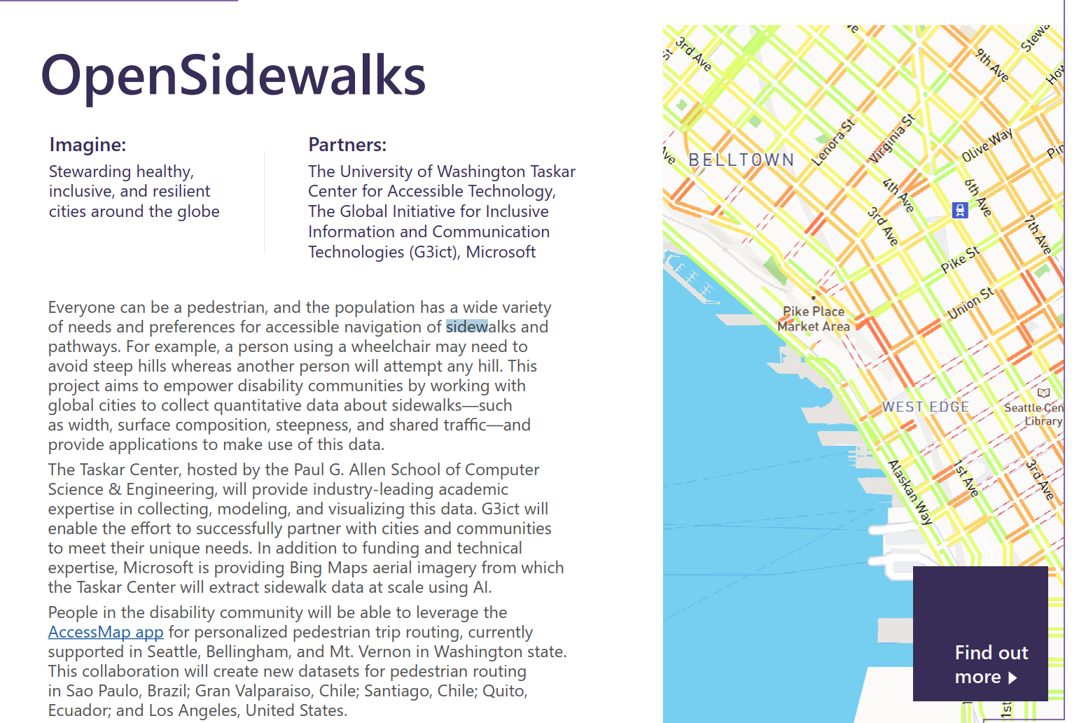

Slide 33
The Ugly

Slide 34
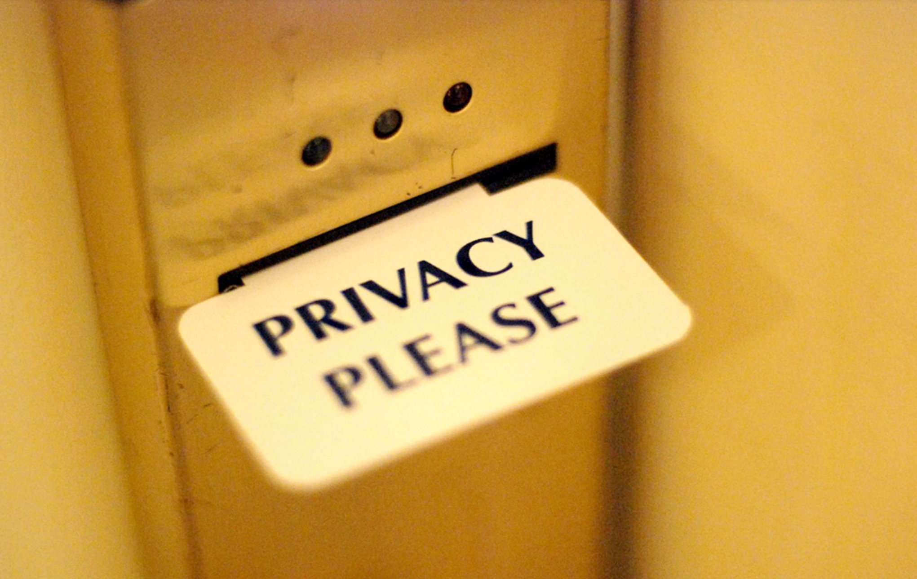

Slide 35
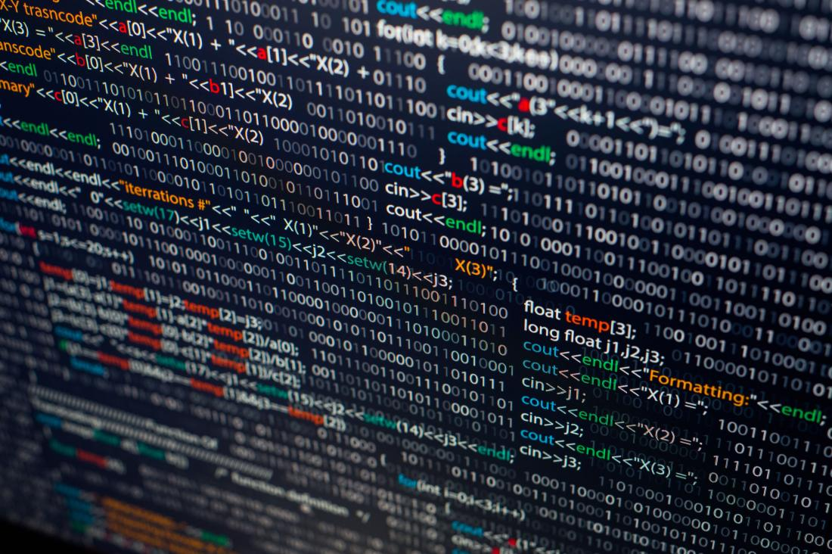

Slide 36

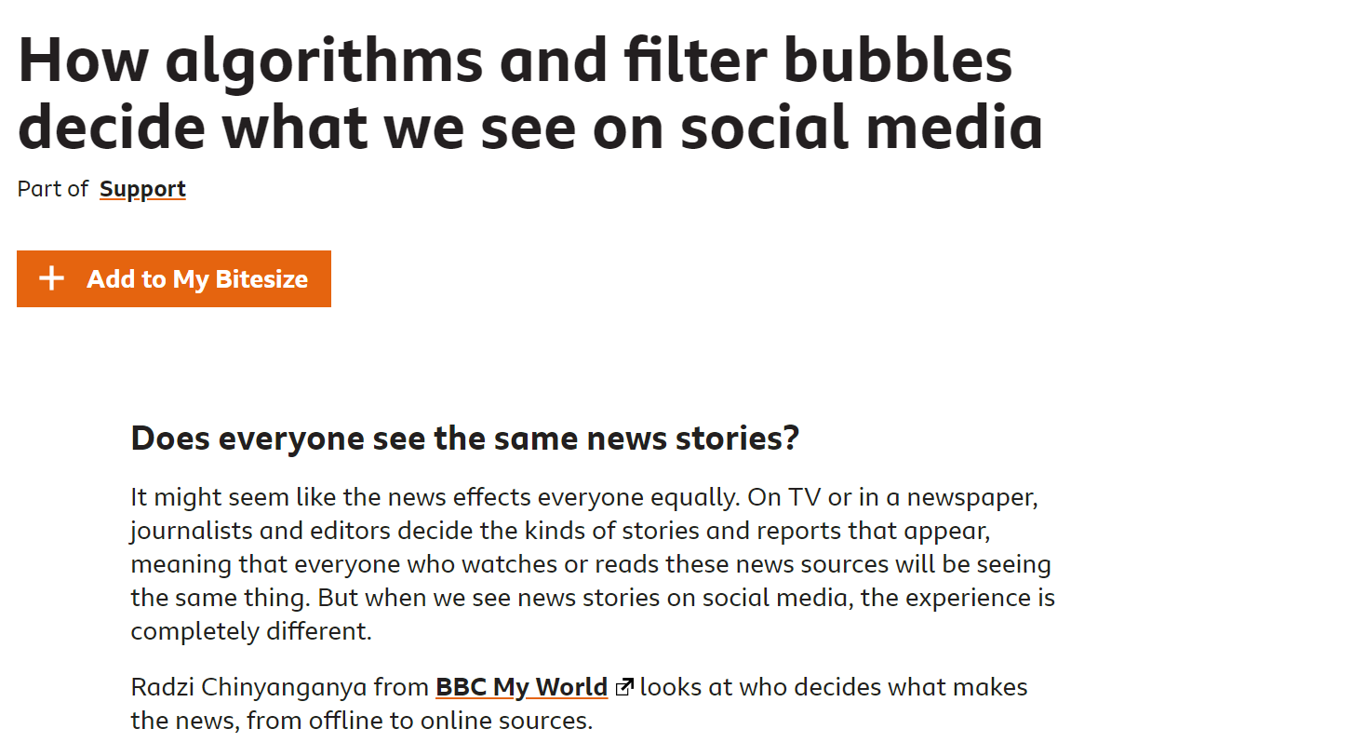
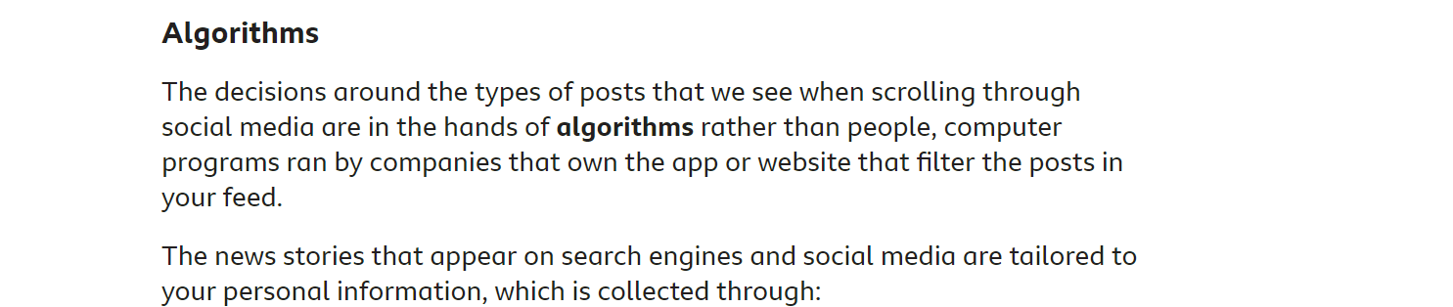

Slide 37
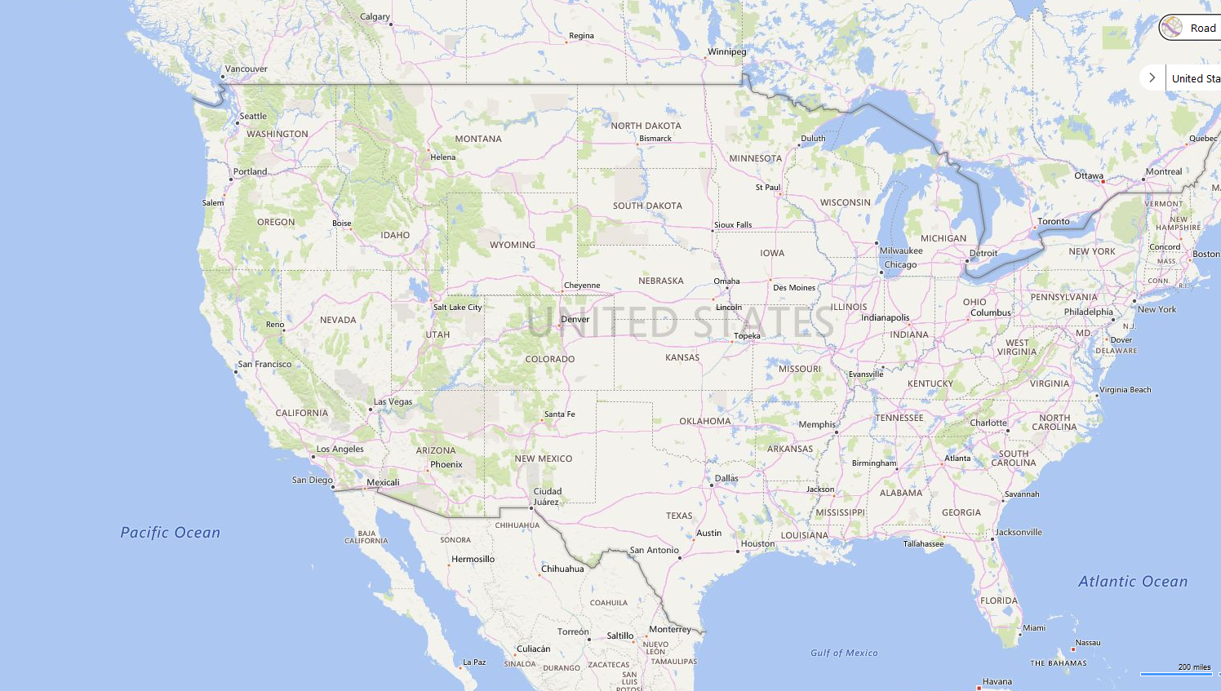






Slide 38
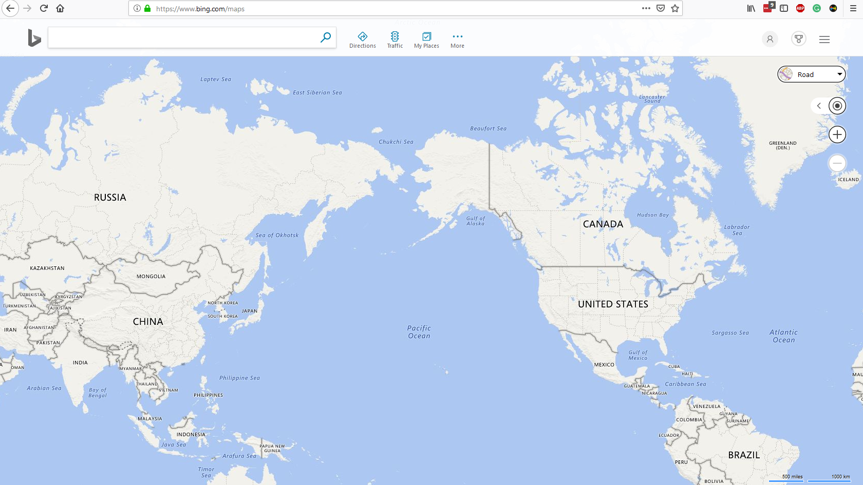




Slide 39

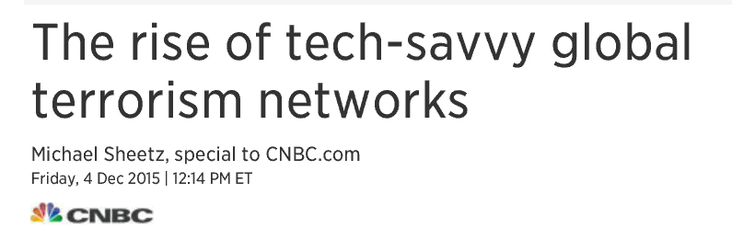

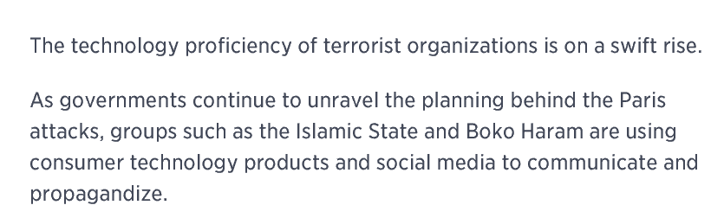
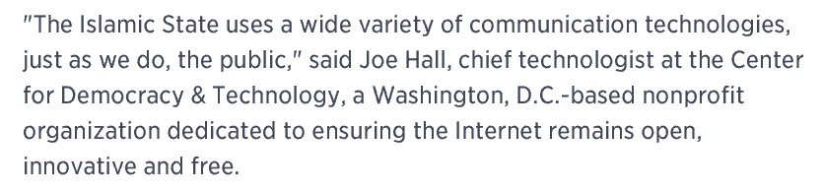

Slide 40


Slide 41
SF Tech Week 2023
AI:
The Good,
The Bad
& The Ugly
Scott Mauvais
scott@mauvais.com
www.mauvais.com/talks

